Slide 1

R e d e f i n e c i t y l i v i n g .
F o r in t e r n a l / t r a i n i n g p u r p o s e s o n l y

Slide 2
CR A FTED B Y E XP E RT S
Fo r i n t ern a l / t r a in i n g p u r p o s e s o n l y

Slide 3
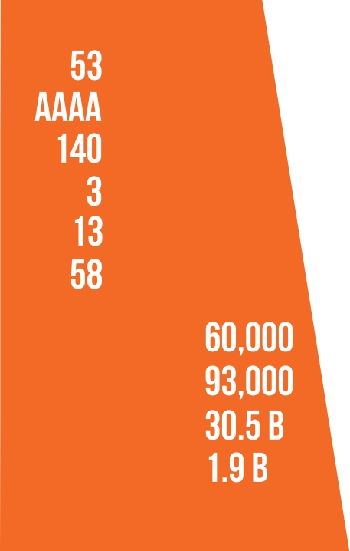












For internal / t ra i n ing p urposes only
Years in business
PCAB LICENSE
Construction projects
Residential condos
Residential
Commercial
Construction
Commercial buildings
Has. landbank
Other
Businesses
Residential GFA (sqm):
Commercial gfa (sqm):
Market capitalization*:
Net profit after tax**:
Start of
Reclamation
1 Land
1
1 Office
1 Residential
Completion of
reclamation
substantially
st
st
st
st
Aseana 3 and
works
done
Lease (S&R)
Commercial
Bldg (Aseana
Project Launched
Bldg (Aseana
One)
(Pixel Residences),
Aseana
Powerstation)
COD formally
Square
opens, Ayala Mall
*as of Jan 31, 2019 (in Philippine Peso) **as of Dec 31, 2018 (in Philippine Peso)
begins construction

Slide 4
I N S I D E THE ‘ N E X T G E N E R A T I O N C I T Y ’
F o r i nt e r n a l / t r a i n i n g p u r p o s e s o n l y

Slide 5
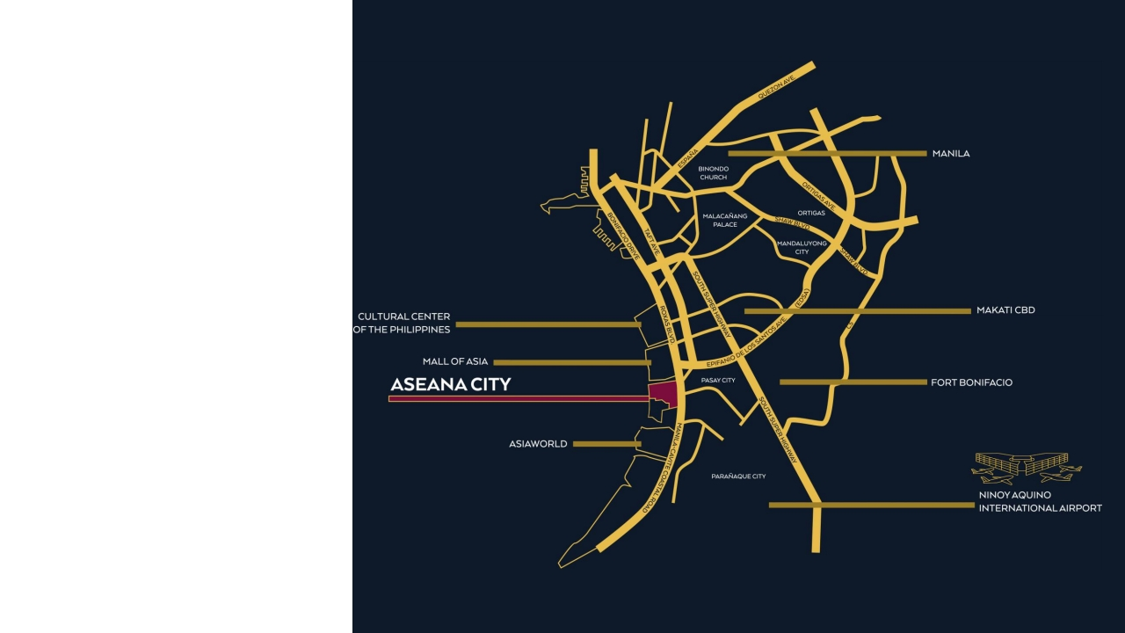
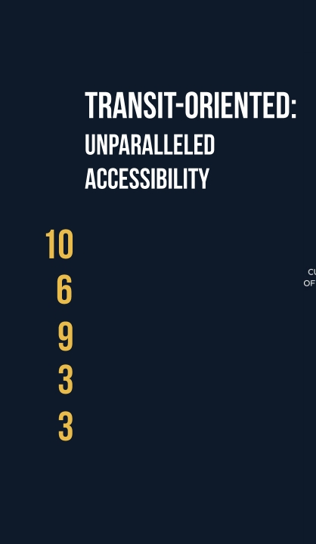
Mins from naia
Kms from makati
Kms from bgc
Major hotels & casinos
Major transport nodes
(PITX, NAIAx, LRT ext)
Fo r i n t e r n a l / t r a i n i n g p u r p o s e s o n l y

Slide 6


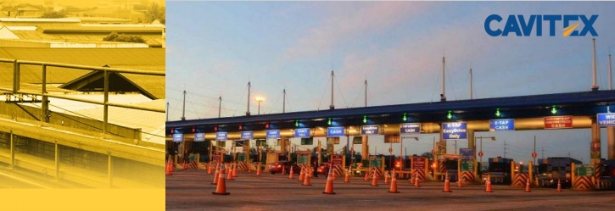
F o r i n t e r n a l / t r a i nin g p u r pos e s o n l y

Slide 7













million
increase
₱
2017 NAIA passenger count
In land values, highest in CBDs ‘19
Bn pesos
rooms
Worth of Capex in the next 5 years
Total Hotel rooms by 2021
vacancy
LRT 1 extension daily capacity
Lowest office vacancy among CBDs
F or in t er n a l / t r a i n i n g p u r p o s es on l y

Slide 8

F or i n ternal / train i n g p u r p o s e s o n l y

Slide 9
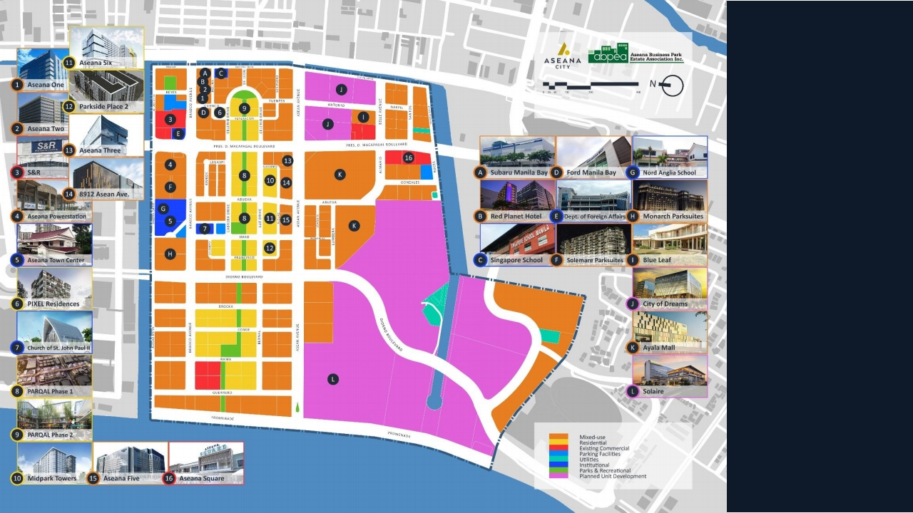



Community
City Living
Infrastructure
F o r i n t e r n a l / t r a i n i n g p u r p o s e s o n ly

Slide 10
INDU L G E I N T I M E L E S S L I V I NG
F or i n t e r nal / t r a i n i n g p u r pose s only

Slide 11
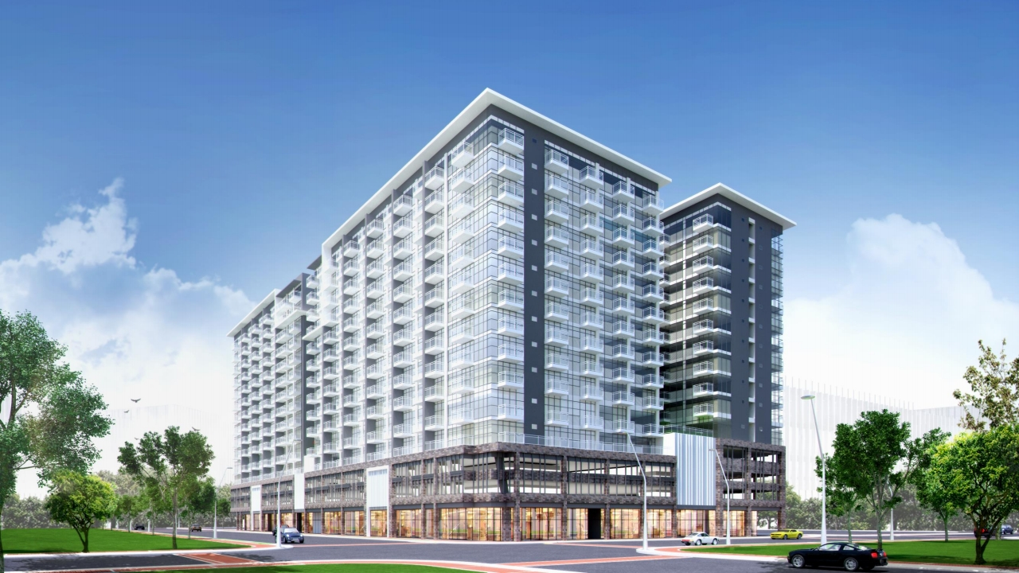

F o r i n t e r n a l / t r a i n i n g p u r p o s e s o n l y

Slide 12
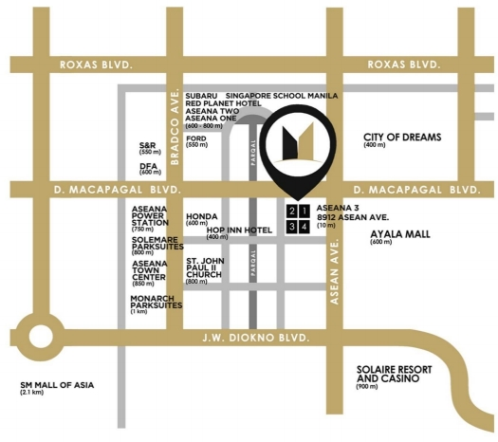
A grand edifice rising between Ayala’s biggest mall and Aseana City’s most modern and integrated mixed -use development, Parqal, MidPark
Towers is the place where you want to live diversely in your own comfortable space.
Near the grounds are the airport, bus terminal, and train station, for the comfort and convenience of traveling. Get connected to the rest of the
world as Ninoy Aquino International Airport is less than 10 minutes away via NAIA Expressway
For i n ter n a l / t r aining purp o se s o n ly

Slide 13
B A T H E D I N B E AU T Y A N D E N D L E S S I N SPI R A T I O N
F o r i nt e r na l / t r a i n i n g p u r p o s e s o n ly

Slide 14
D E VE L O P M E N T H I G H L I G H TS
7 , 1 5 5 s q m L a n d 4 T o w e rs
A r e a
6 6 9 U n it s
F o r i n t erna l / t rain i ng p u rpo s es o n l y

Slide 15
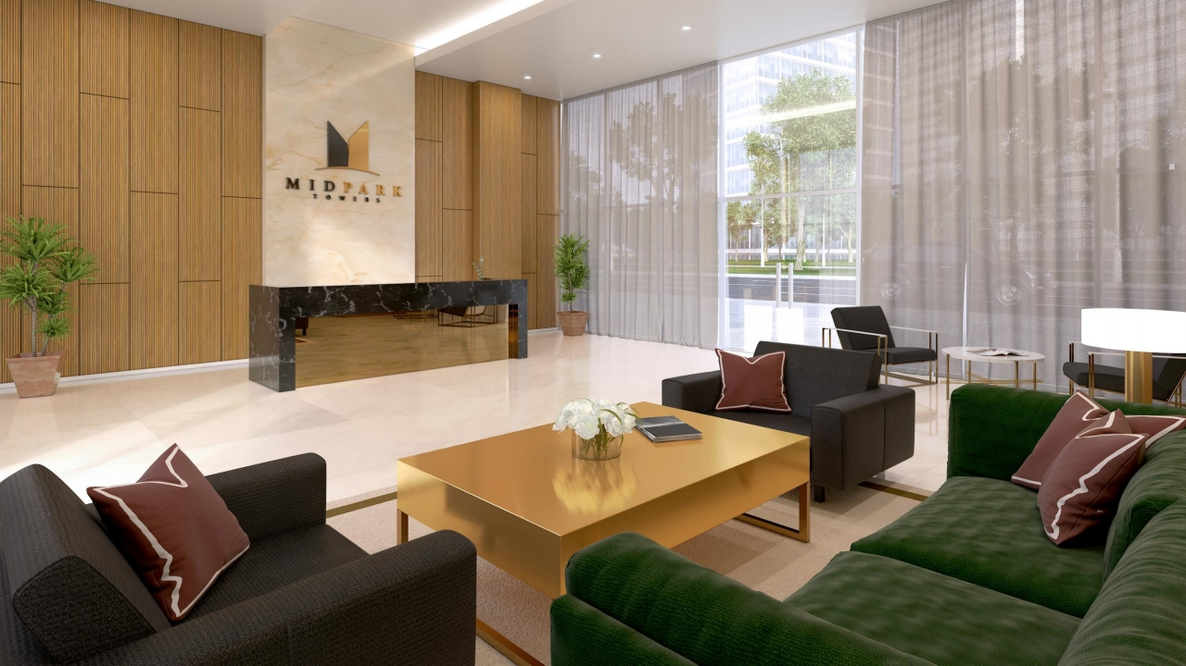
M A I N L O B B Y
Fo r i nt e r n a l / t r a i n i n g p u r p o s e s o n l y

Slide 16
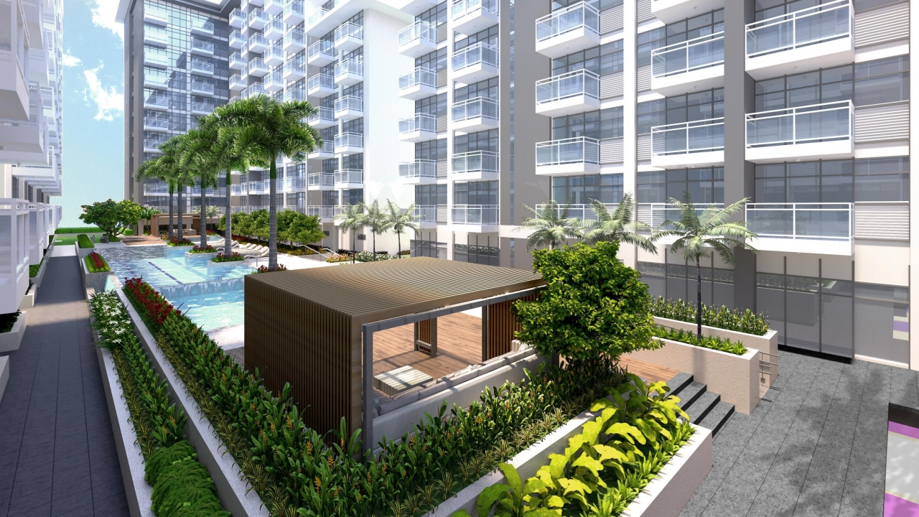
S W I M M I N G P O O L S
F o r i n t e r n a l / t r a i n ing p urposes o n ly

Slide 17
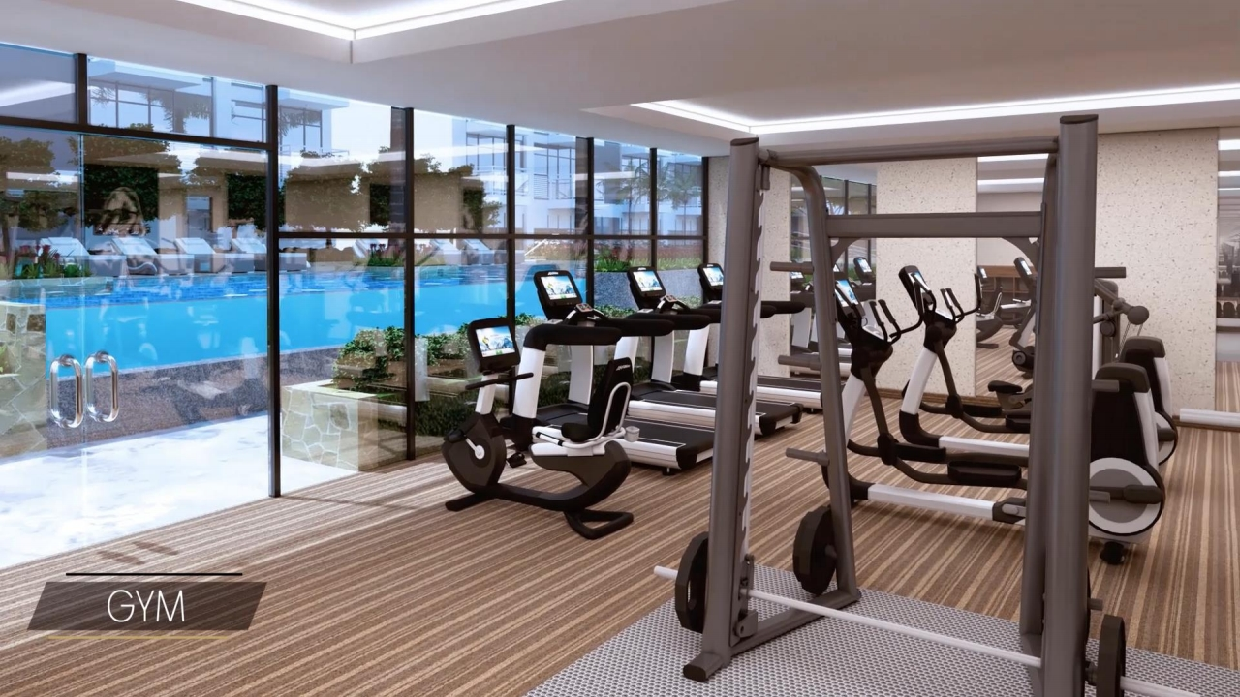
F o r in t e r n a l / t r a i n i n g p u r p o s e s o n l y

Slide 18
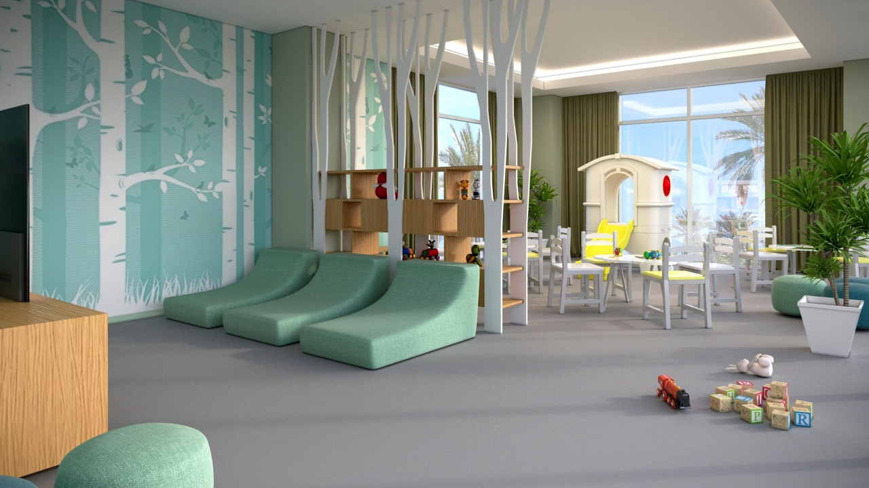
K I D S ’ D A Y C A R E
F o r i n t erna l / tr a in i n g pu r p o se s o n l y

Slide 19
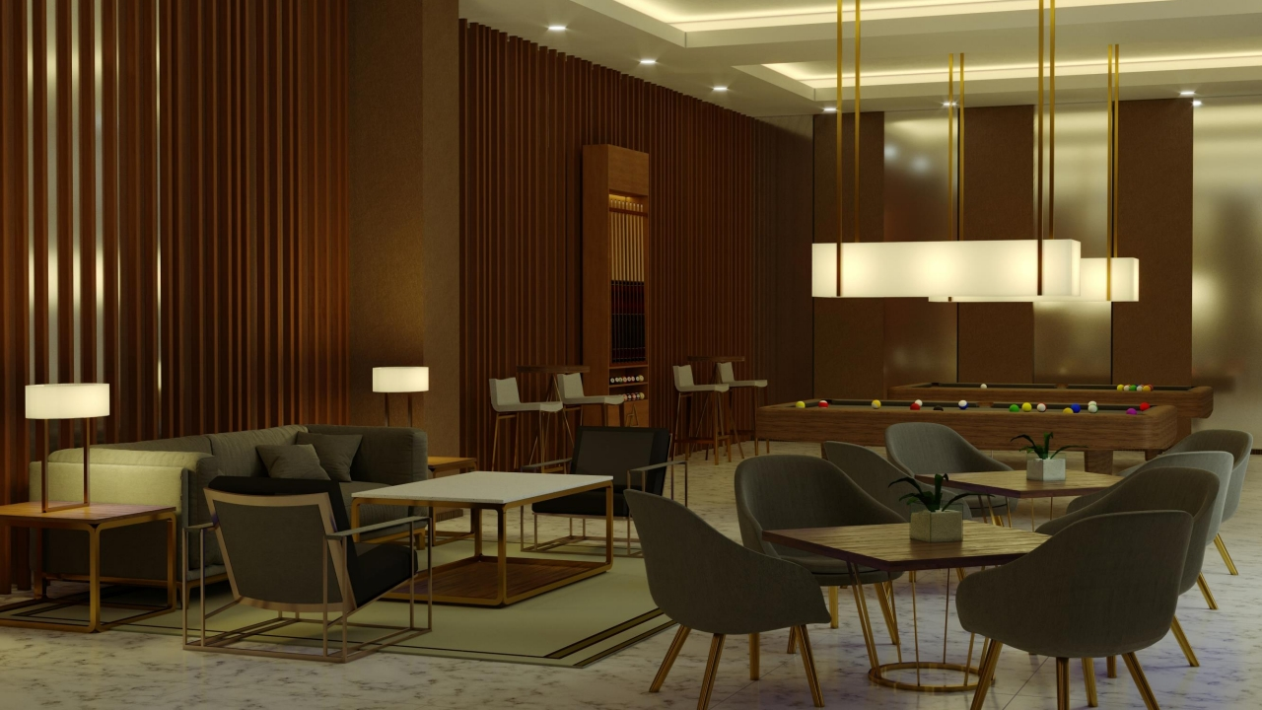
G A M E R O O M
F o r in t e r n al / t r a ining p urposes o nly

Slide 20
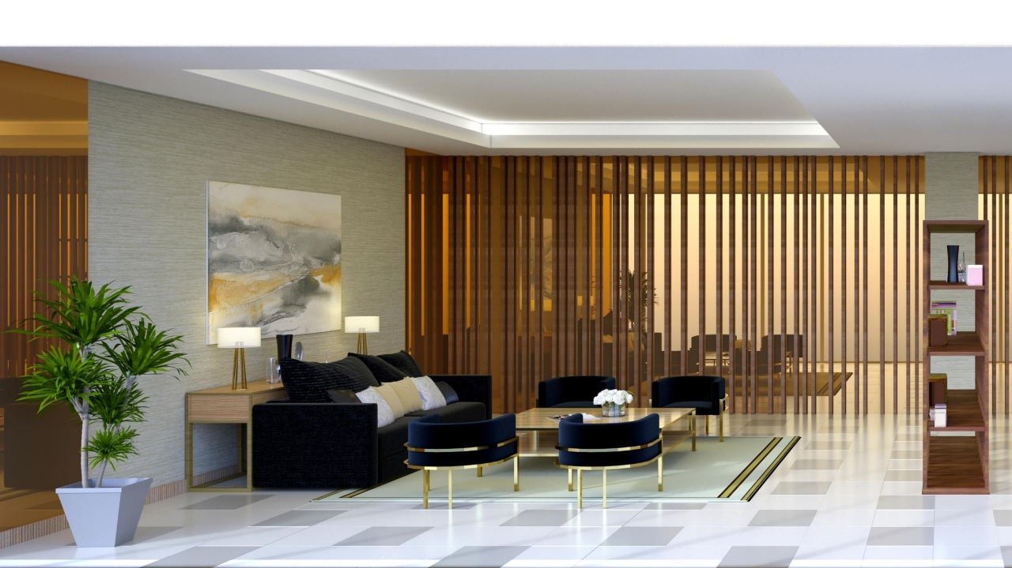
L I B R A R Y
F o r i n t e r n a l / t r a in i n g p u rposes o nl y

Slide 21
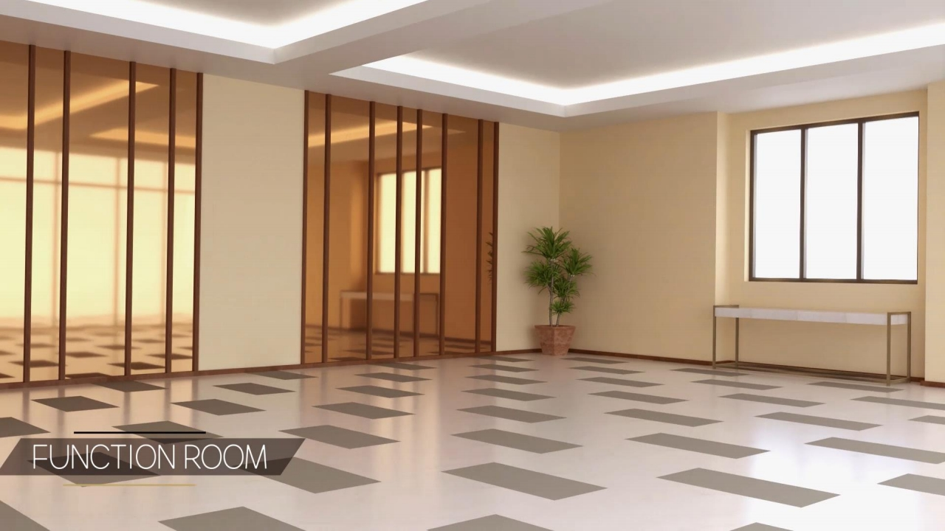
F or i n t e r n a l / t rai n i n g p u r p o s e s o n l y

Slide 22
B U ILDING FEATURES
• Modern contemporary main lobbies
• 24-hour security system with CCTV cameras • Secure keycard access to elevators
• High-speed elevators
• 100% stand-by back-up power
• Two (2) fire exits per residential floor • Fully-automated fire protection system
• Water reservoir with separate fire reserves
• Intercom per unit
• Dedicated property management team
F o r i nte r n a l / t r a ini n g p u r p o s e s o n l y

Slide 23
L I V E A N D N U RTU R E
F o r i nte r na l / t ra i ni n g p u r p o s e s on l y

Slide 24
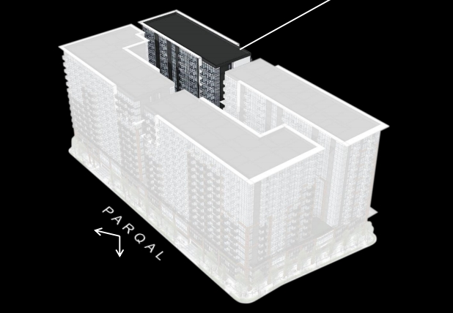
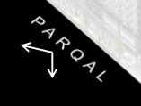
M ER C E R
• 163 units
• 10 floors | 3 lifts | 15 units/floor • Studios | 36 sqm± | 88 units
• 1 BR | 48 sqm± | 42 units
• 2BR | 72 sqm± | 33 units
• Facing amenities/ facing 8912
F o r i n t e r n a l / t r a i n i n g p u r p o s es o n l y

Slide 25
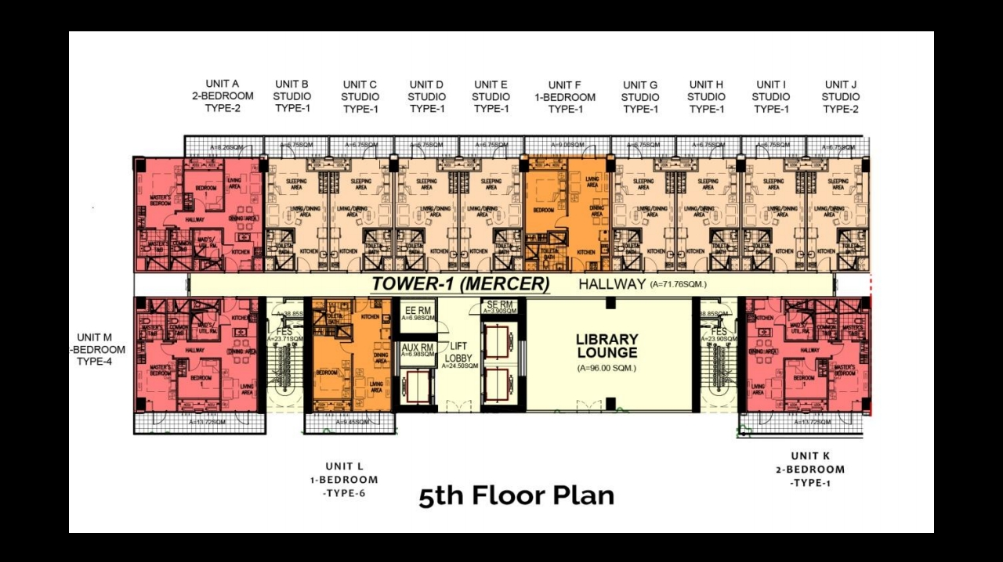
F o r i n t e r n a l / t r a i ni n g p u r p o s e s onl y

Slide 26
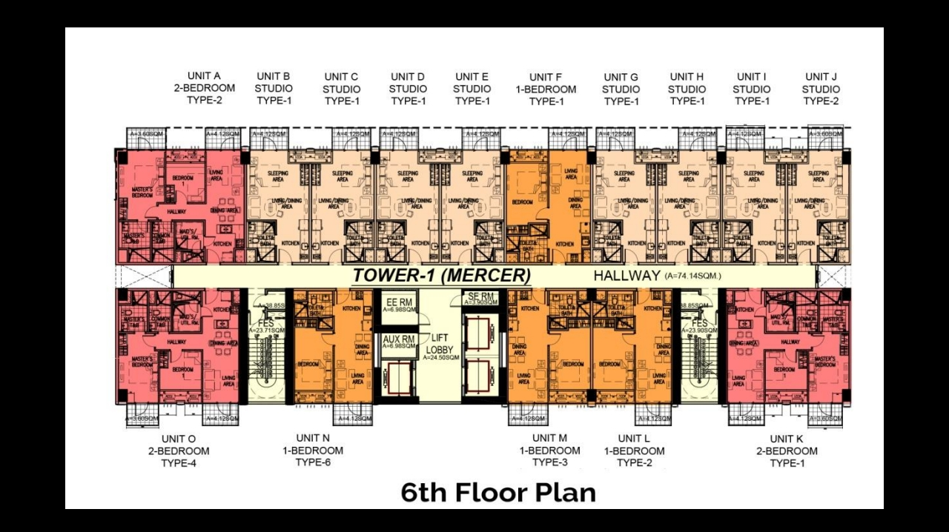
F o r i n te r n a l / t r a i n i n g p u r p o s e s o n l y

Slide 27
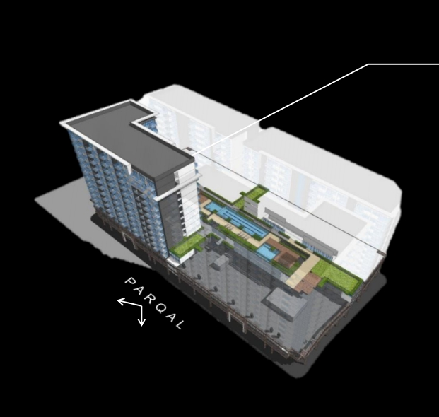
H O W E LL
• 146 units
• 11 floors | 3 lifts | 13 units/floor • Studios | 36 sqm± | 20 units
• 1 BR | 48 sqm± | 24 units
• 2BR | 72 sqm± | 78 units
• 3BR | 108 sqm± | 24 units
• Facing amenities/ facing Parqal
• Units with convenient access to parking at 3 floor
rd
F o r i nt e r n a l / t r a i ni n g p u rpo s e s o n ly

Slide 28
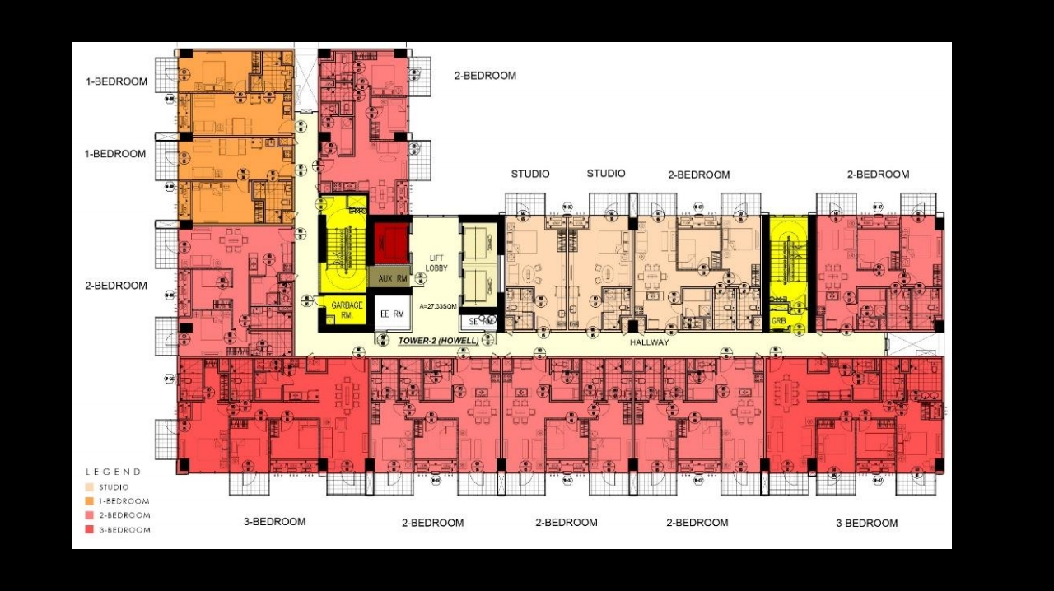
Unit A
Unit M
Unit B
Unit L
Unit K
Unit J
Unit I
Unit C
Unit D Unit E Unit F Unit G Unit H
F or in t e r n a l / t r a i n i n g p u r p o s e s o n l y

Slide 29
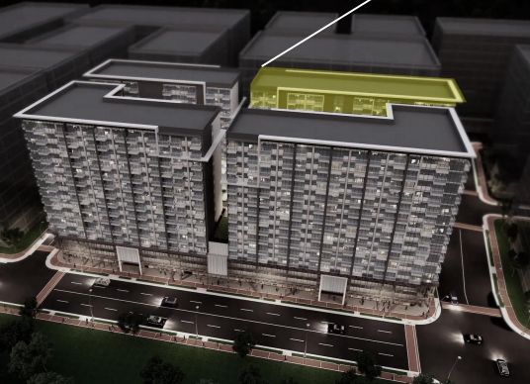
M ALDE N
• 204 units
• 10 floors | 3 lifts | 19 units/floor • Studios | 36 sqm± | 108 units
• 1 BR | 48 sqm± | 63 units
• 2BR | 72 sqm± | 22 units
• 3BR | 108 sqm± | 11 units
• Facing amenities/ facing 8912
F or i n t e r n a l / t r a i n in g p u r p o s es o nly

Slide 30
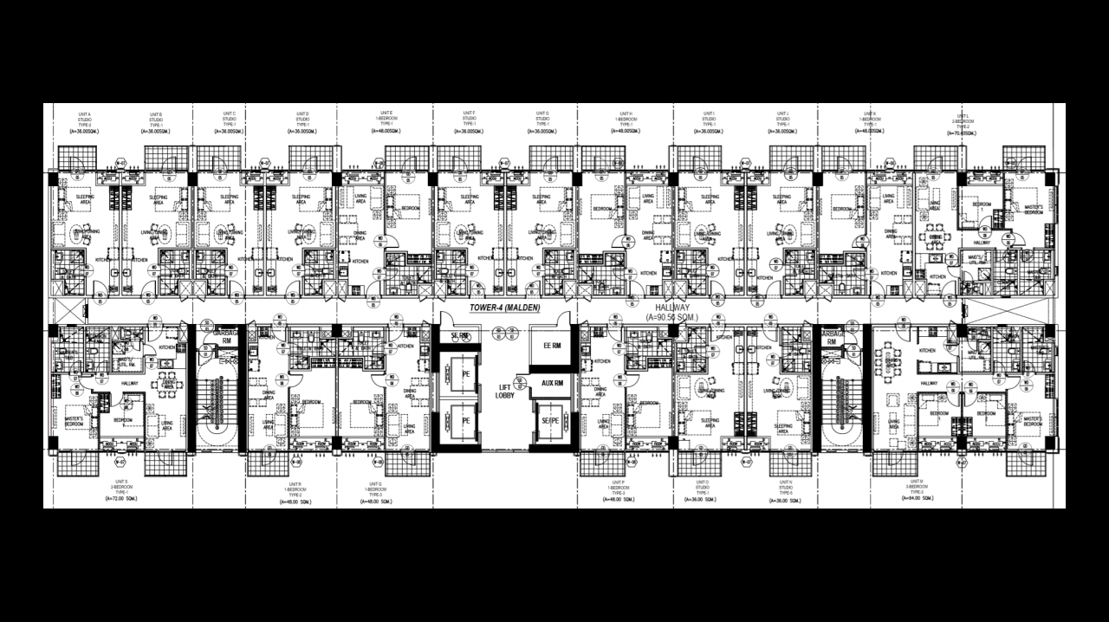
TY P I C A L F L OO R P L A N
F o r i n t e r n a l / t r a i n i n g p u r po s e s o n l y

Slide 31
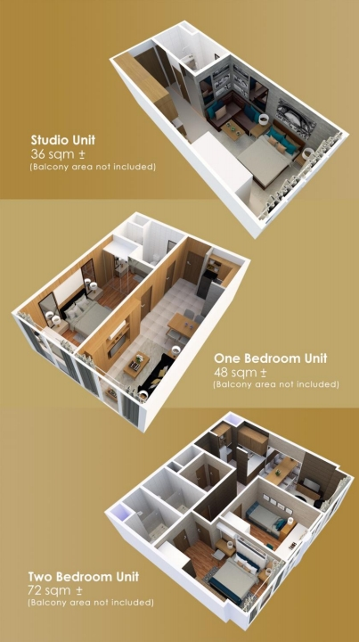
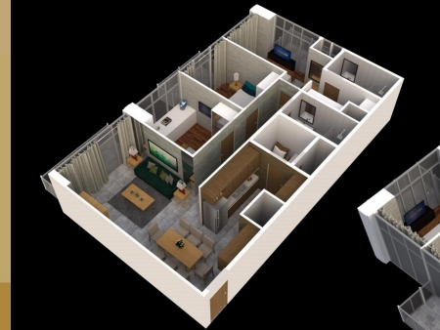
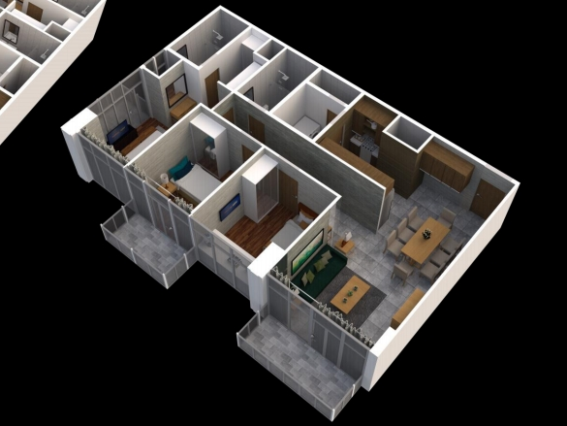
U NIT I ZED FL O O R P L A N S
Three Bedroom Unit
108 sqm ±
(Balcony area not included)
F o r in t e r n a l / t r ai n i n g p u r p os e s o n l y

Slide 32
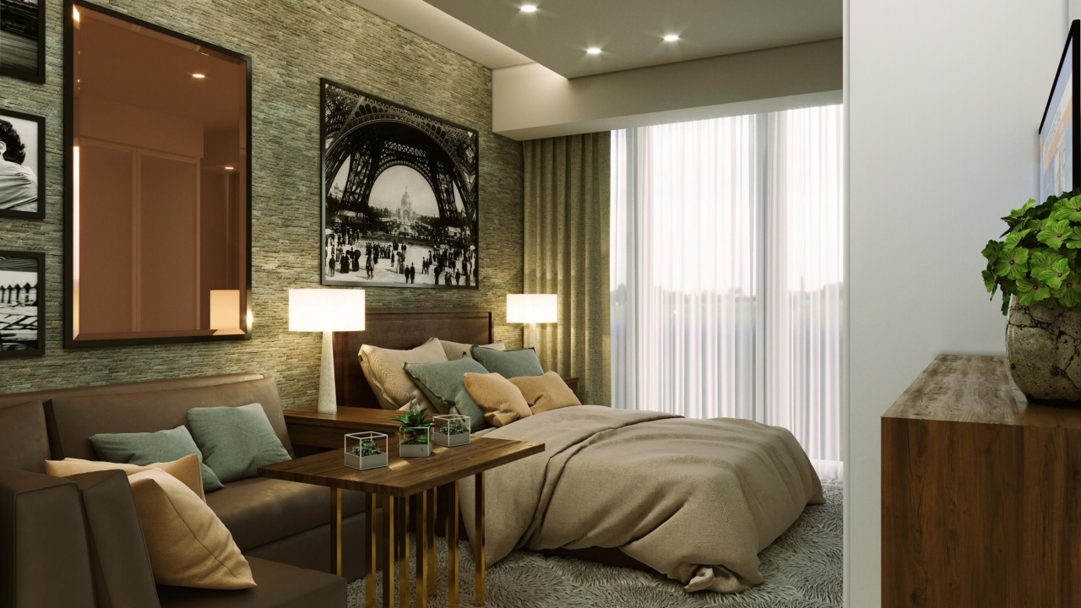
S T U D I O
For in t e r n a l / t r a i n i n g p u r p o s e s o n l y

Slide 33
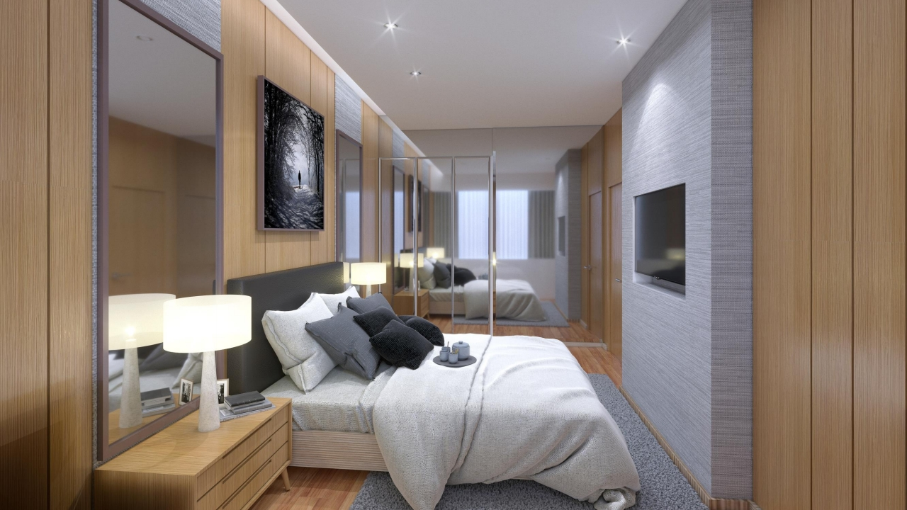
1 B E D R O O M
F o r i n t e rn a l / t r ai n i n g p u r pose s o n ly

Slide 34
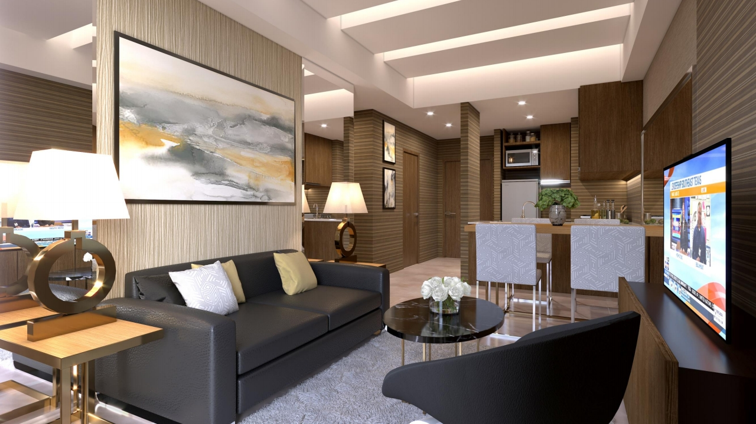
2 B E D RO O M
F or i n t e r na l / t r a i n i n g p u r p o s e s o n l y

Slide 35
U N IT FINISHES
Floors | Porcelain Tiles (Living, Dining, Kitchen T&B)
Engineered Wood (Bedrooms)
Walls | Painted Finish (Living, Dining, Kitchen)
Porcelain Tiles (T&B)
Kitchen | Solid Surface Countertop with Overhead and Undercounter Kitchen Cabinets
Sink with Grease Trap
Rangehood
T&B | Solid Surface Vanity Countertop with undercounter cabinets
Water closet, Shower set, Shower enclosure
Others | Bedroom Closets
Fo r i ntern a l / t r a i n i ng pur p o s e s o n l y

Slide 36
U N P A R A L LELE D V A L U E
F o r in t e r n a l / trai n i n g p u r p os e s o nl y

Slide 37
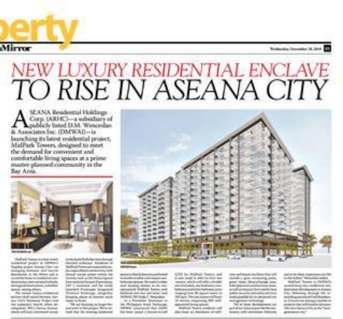
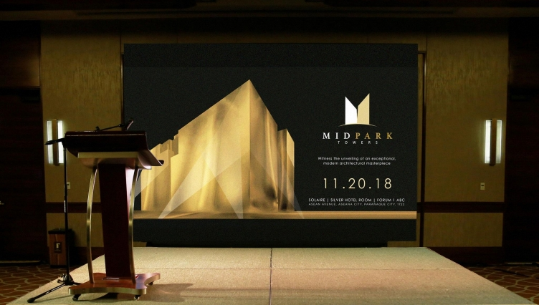
F o r i n t e r n a l / t r a i n i n g pu r p o s e s o n l y

Slide 38
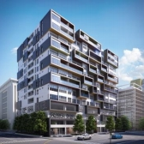
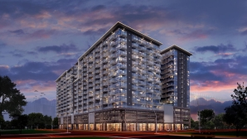
JUNE 2019:
Launch of Malden
275,000 Php/sqm
2016:
2018:
28% appreciation per year
Launch of Pixel
Launch of MidPark
Residences
Towers
150,000 Php/sqm
224,000 Php/sqm
BGC: 170,000 Php/sqm
BGC: 280,000 Php/sqm 24%
Makati: 190,000 Php/sqm
Makati: 349,000 Php/sqm 28%
F o r i n t ern a l / t r ain i n g pu r po s e s o n l y

Slide 39
Area | Rent/Sqm
Aseana City | 1,000-1,800
BGC | 628- 1,027
Makati | 554- 1,106
Rockwell | 748- 1,047
7%-30%
Superior Yield vs. Savings, Bonds, T-
bills and other securities
F or i n te r n a l / t r a i n in g p u r p o s e s o n l y

Slide 40


F o r i n t e r n a l / t r a i n i n g p u r p o s e s o n l y

Slide 41



w w w . m i d p a r k t o w e r s . c o m
F o r i n t e rnal / training p u r p o s e s o n l y

