Slide 1


Slide 2
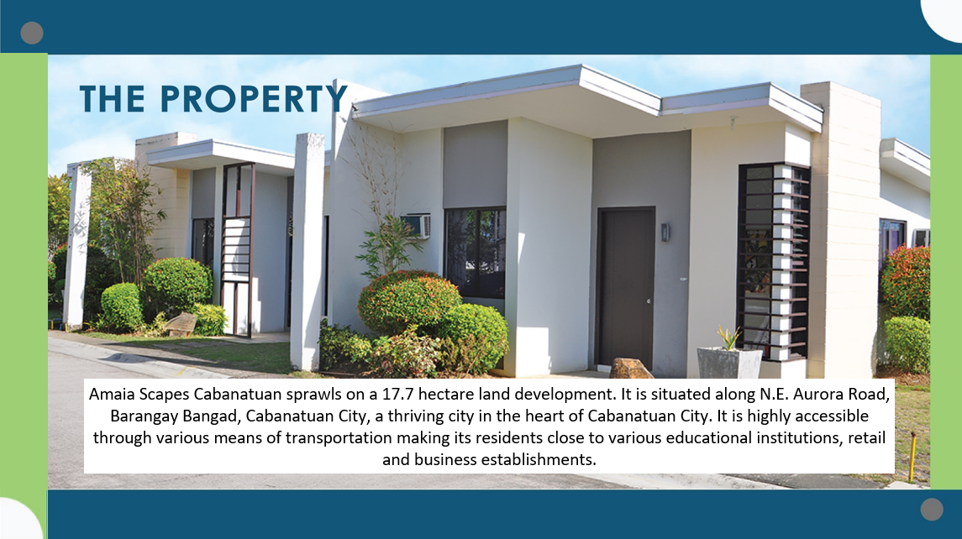

Slide 3
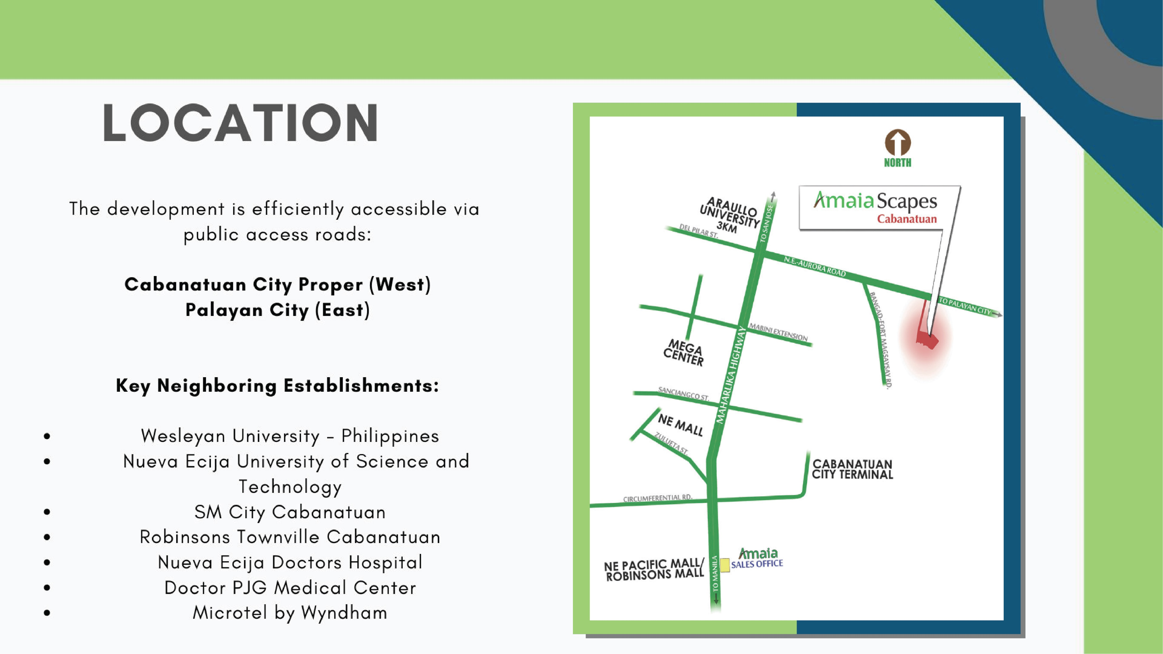

Slide 4
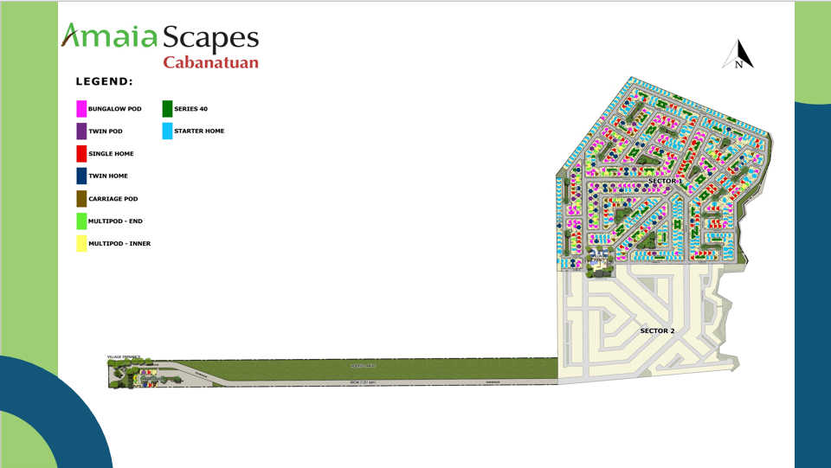

Slide 5


Slide 6


Slide 7
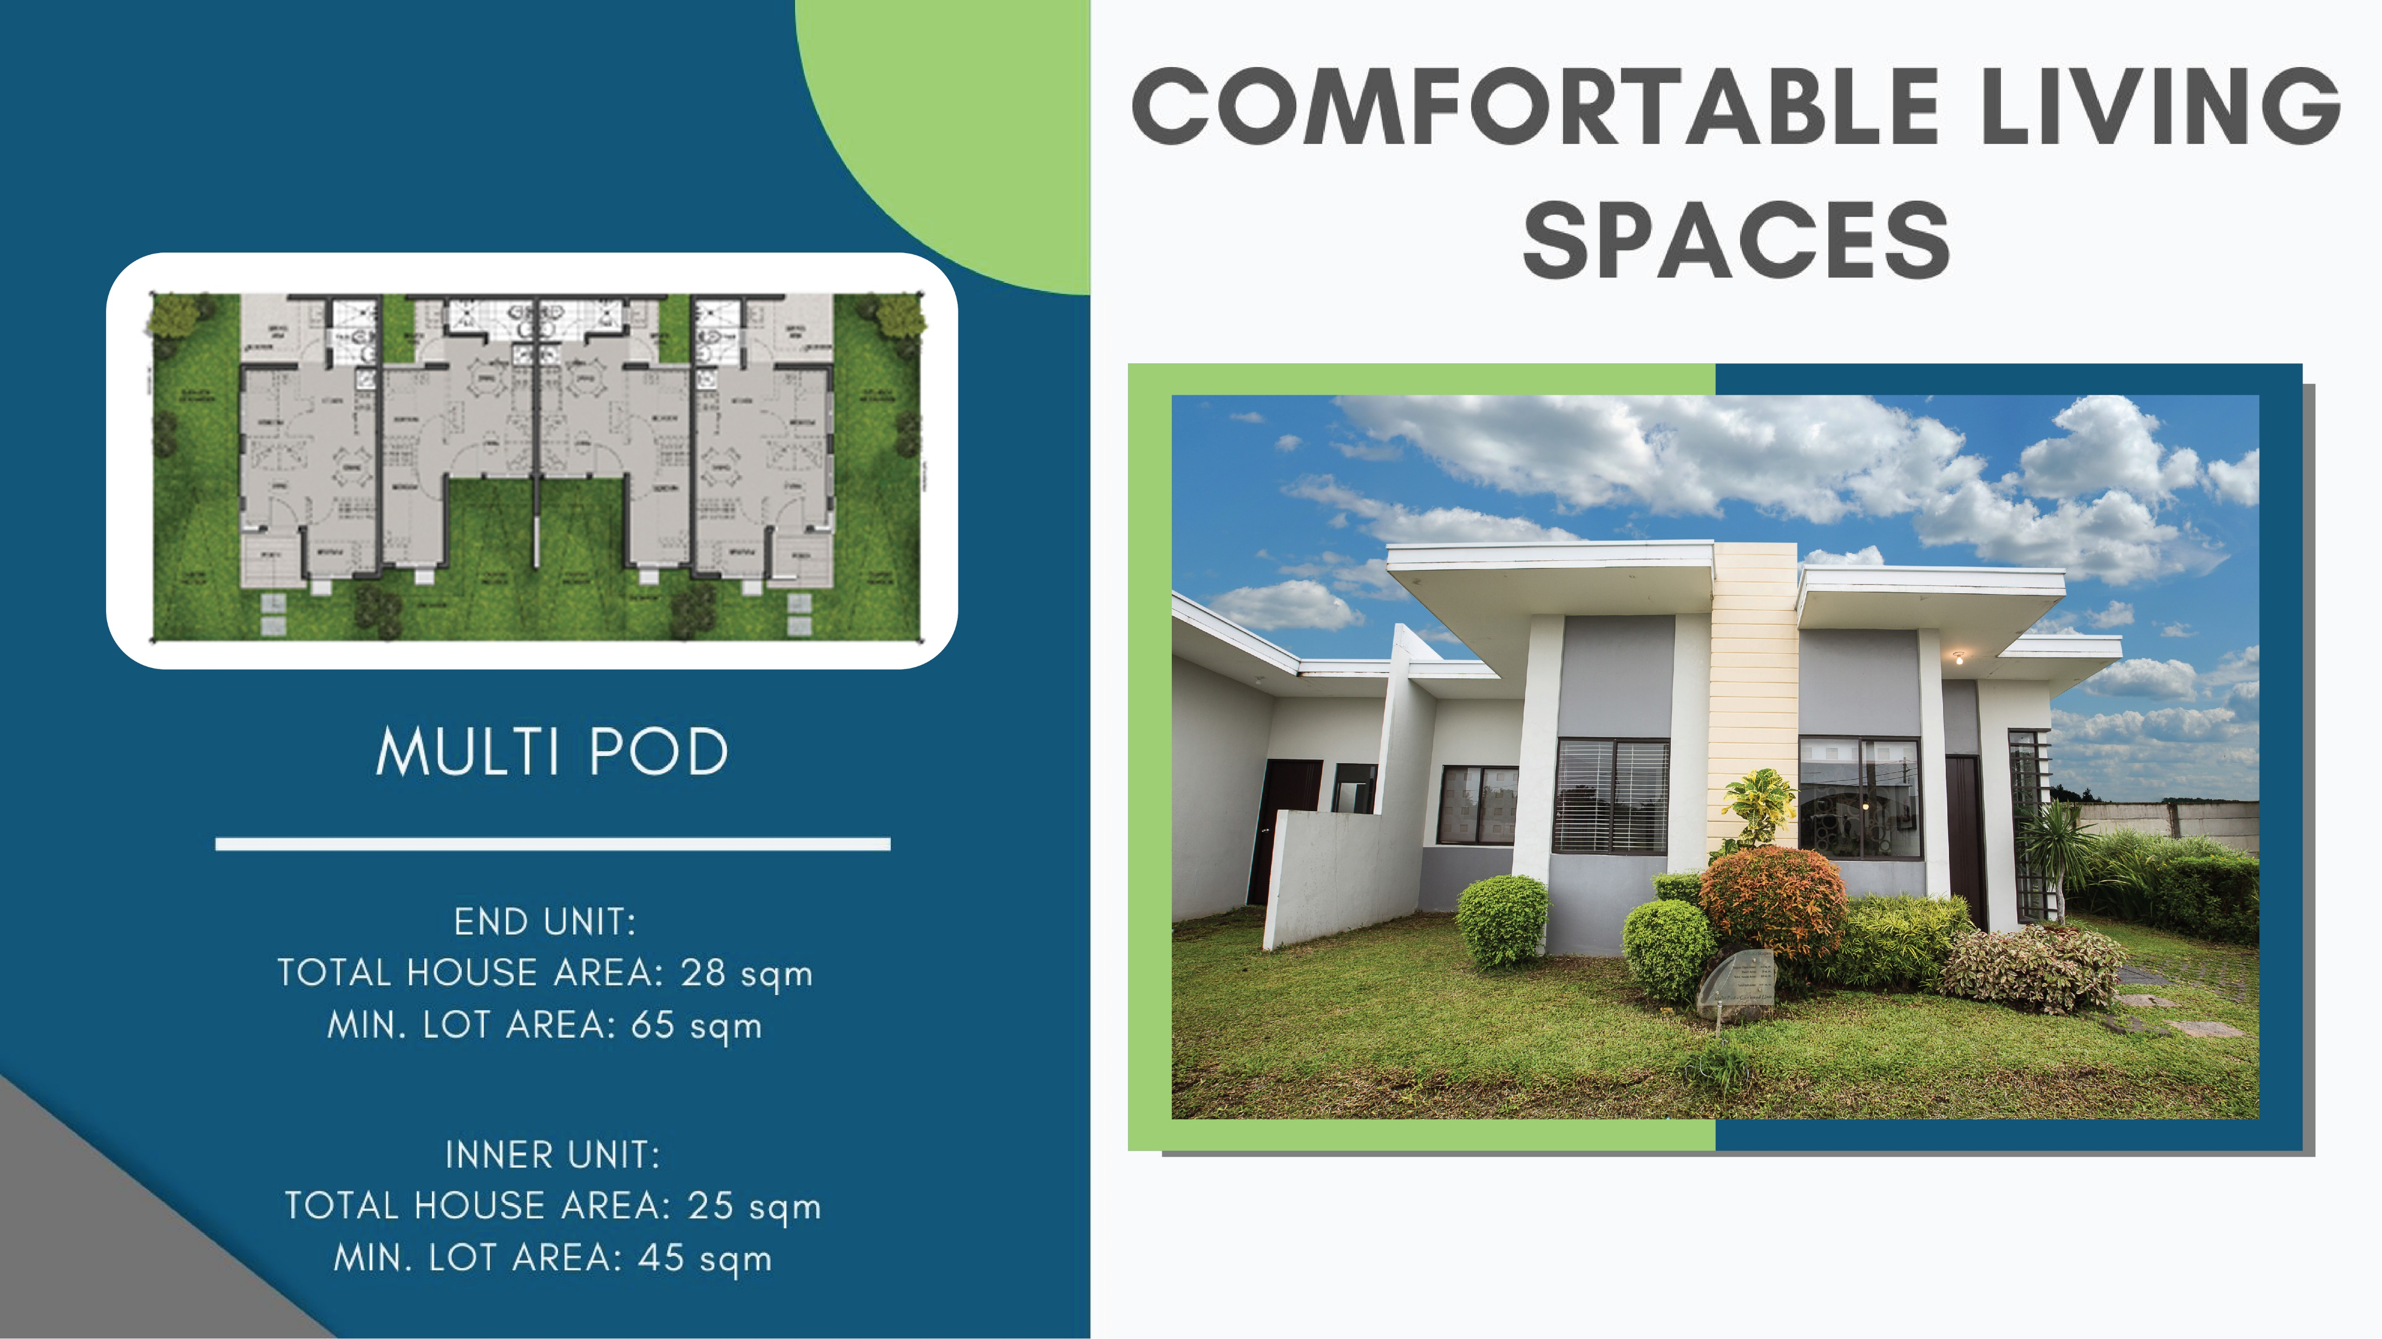

Slide 8


Slide 9
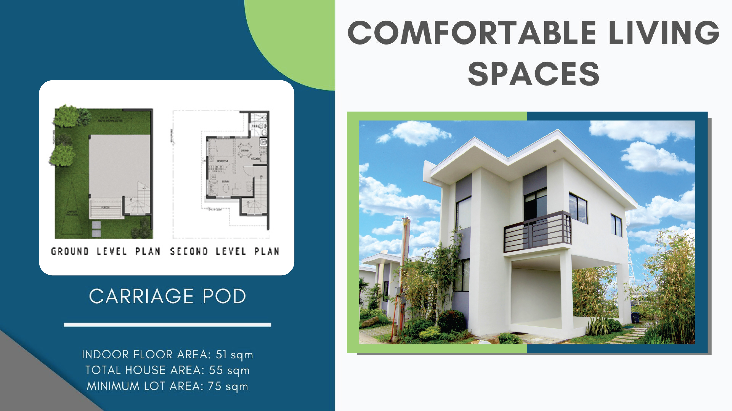

Slide 10


Slide 11
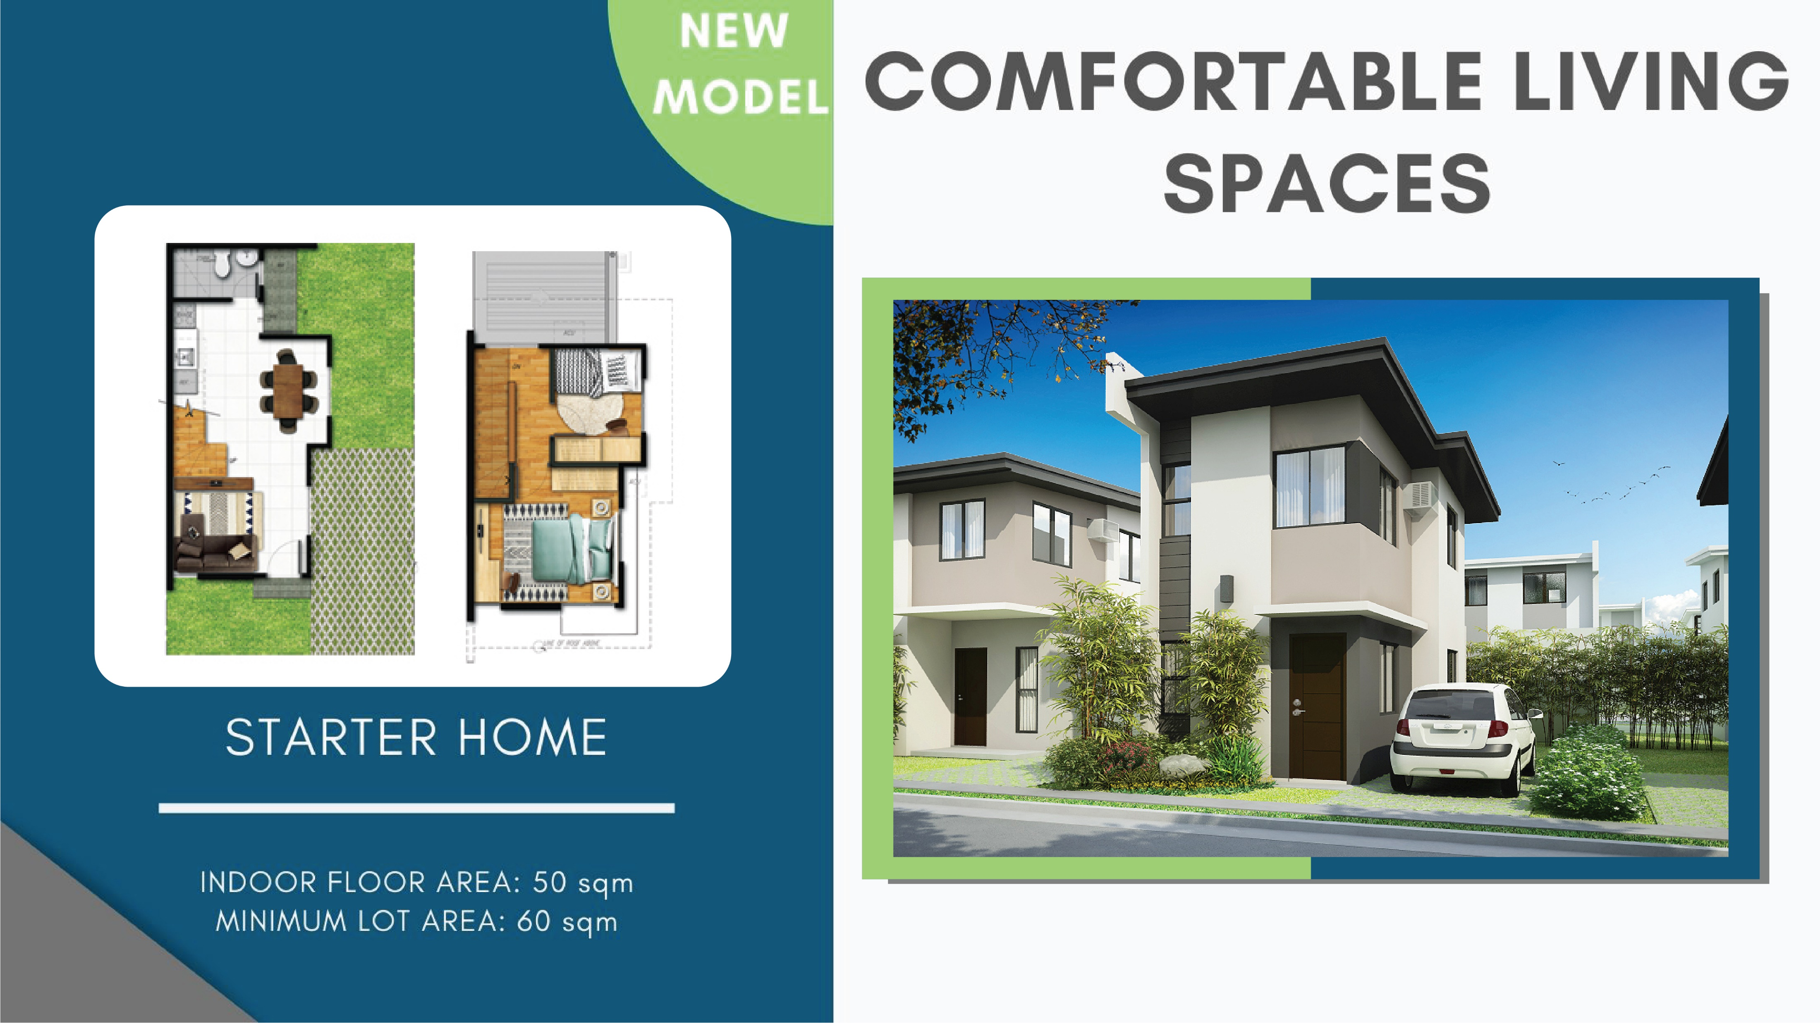

Slide 12
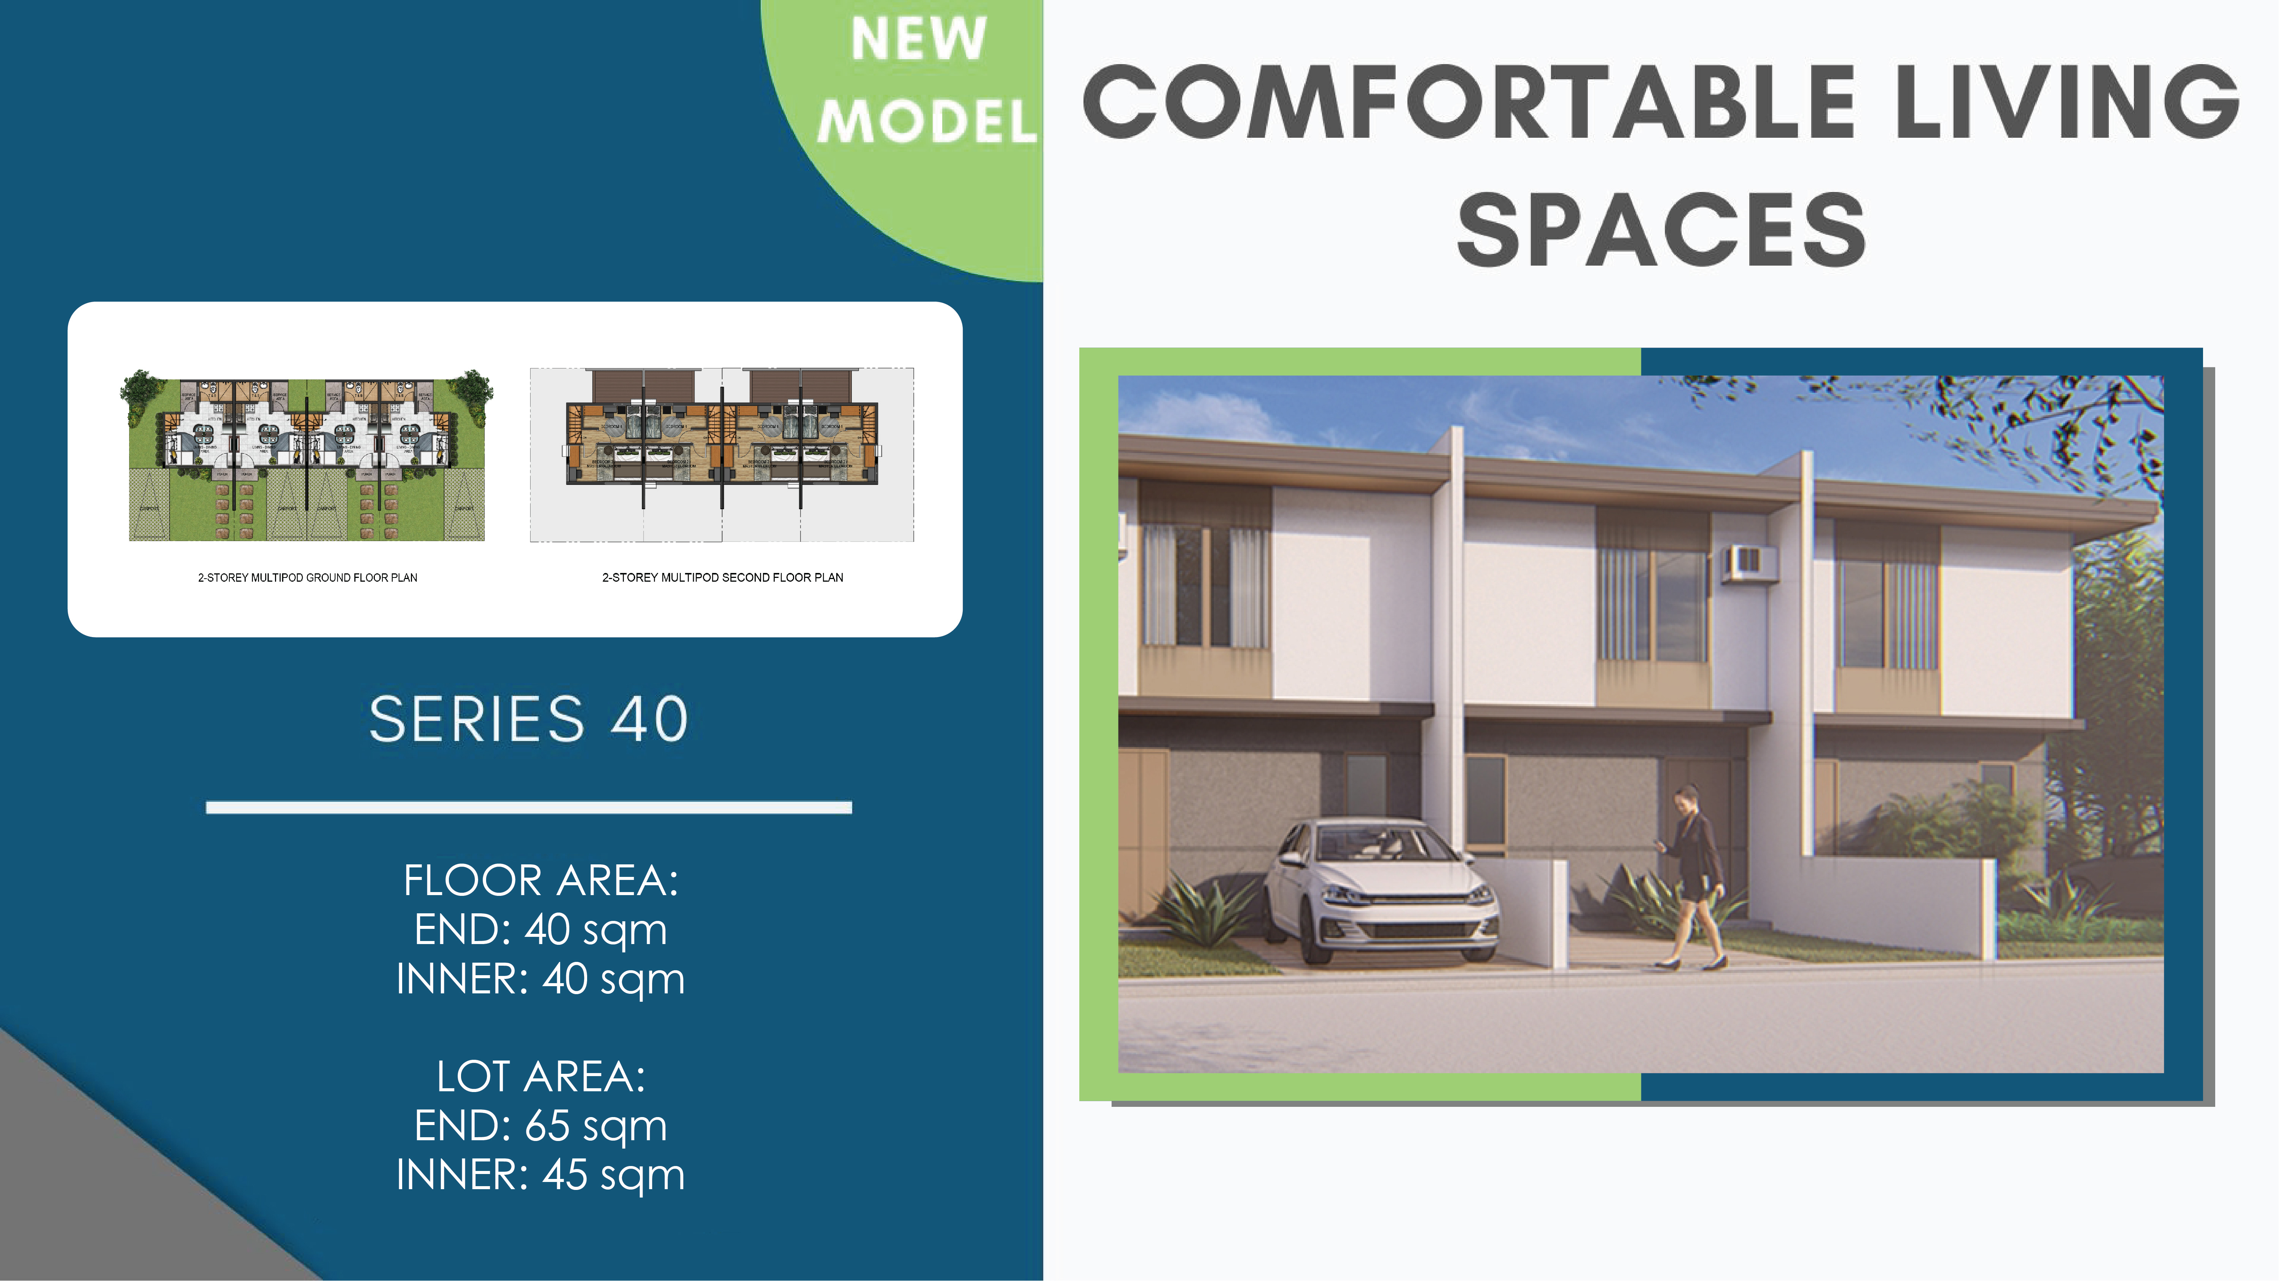

Slide 13
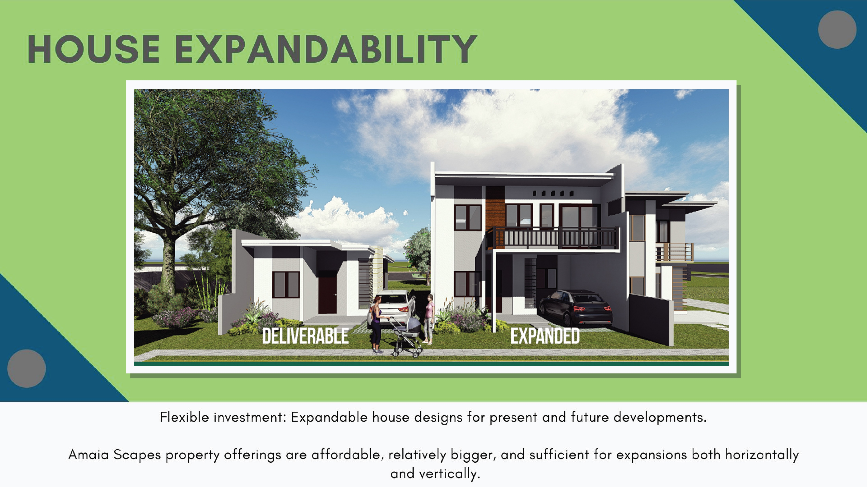

Slide 14
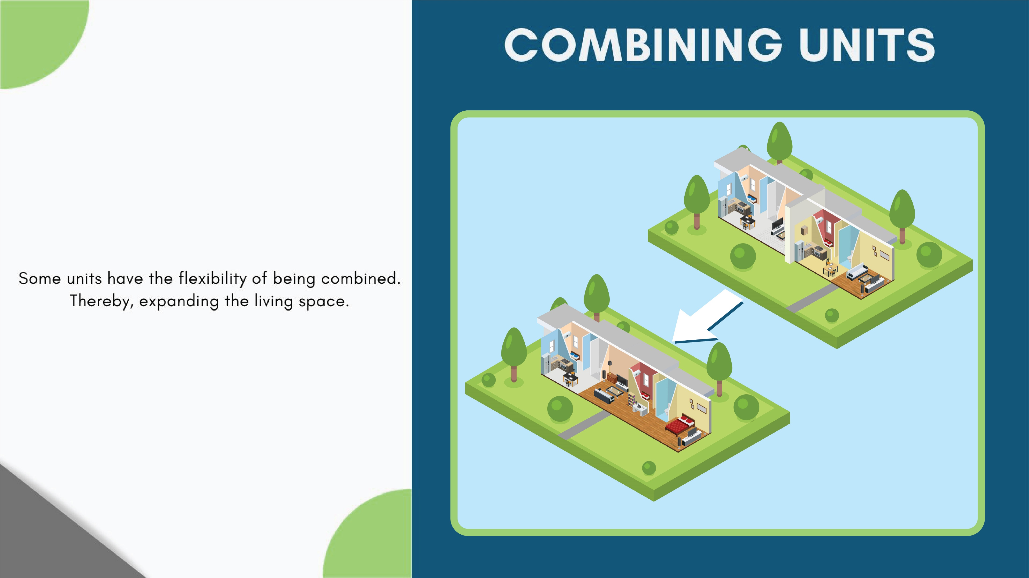

Slide 15


Slide 16
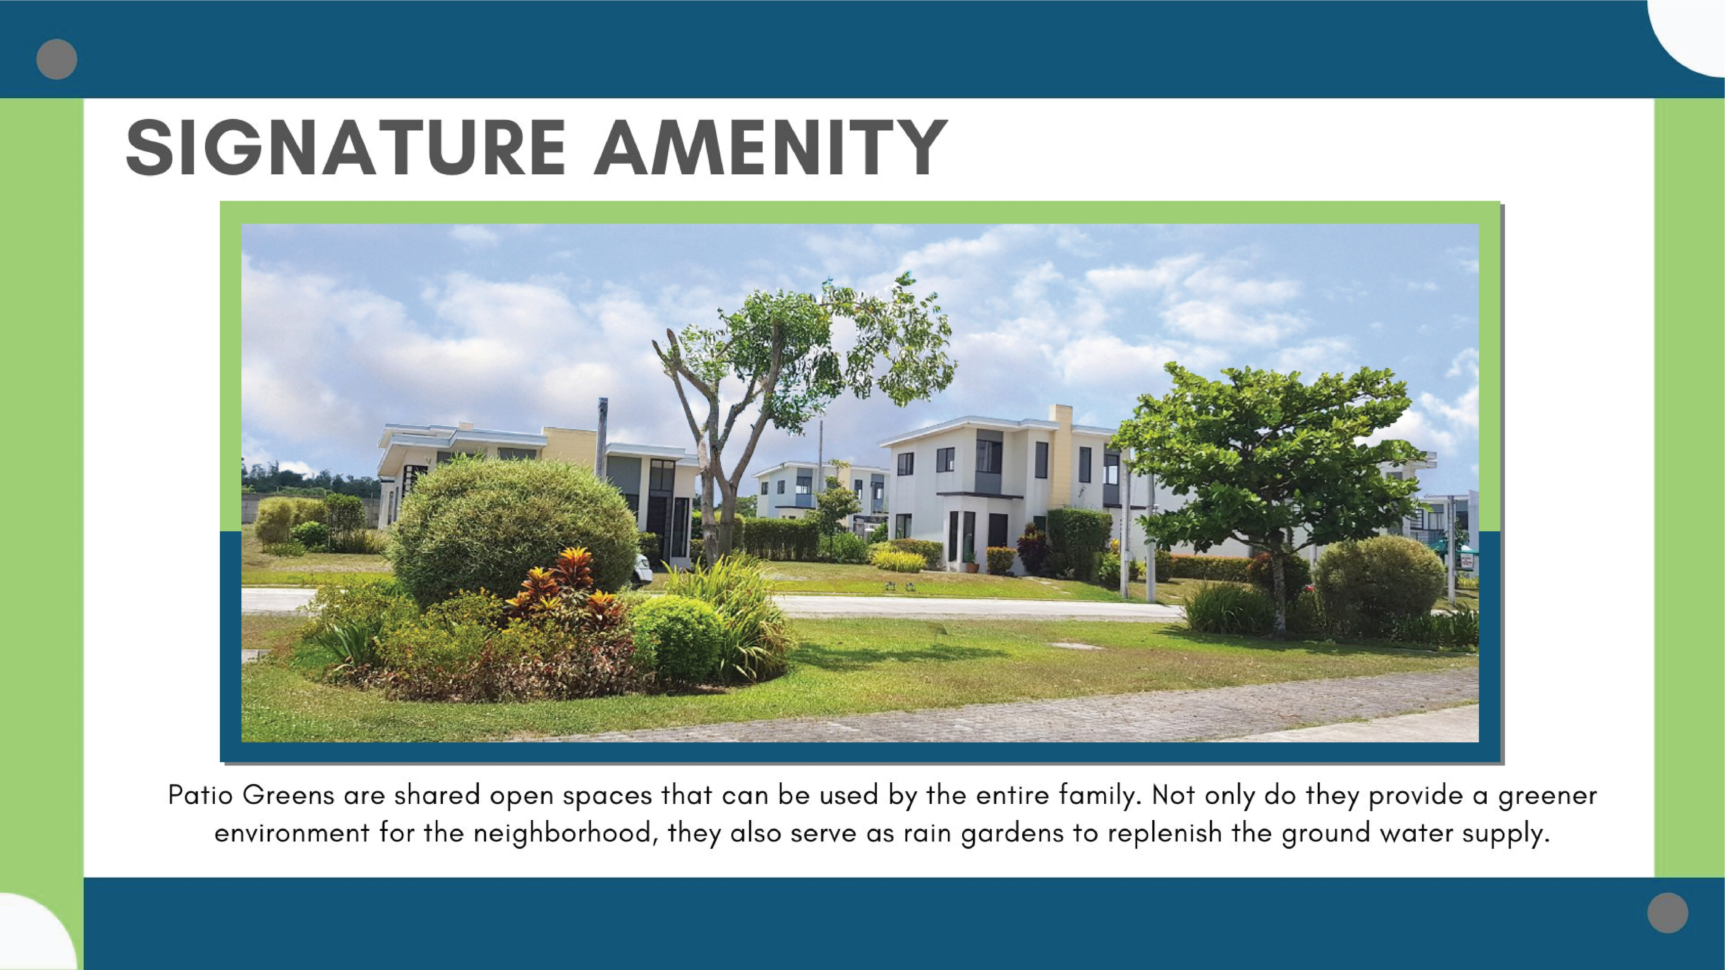

Slide 17
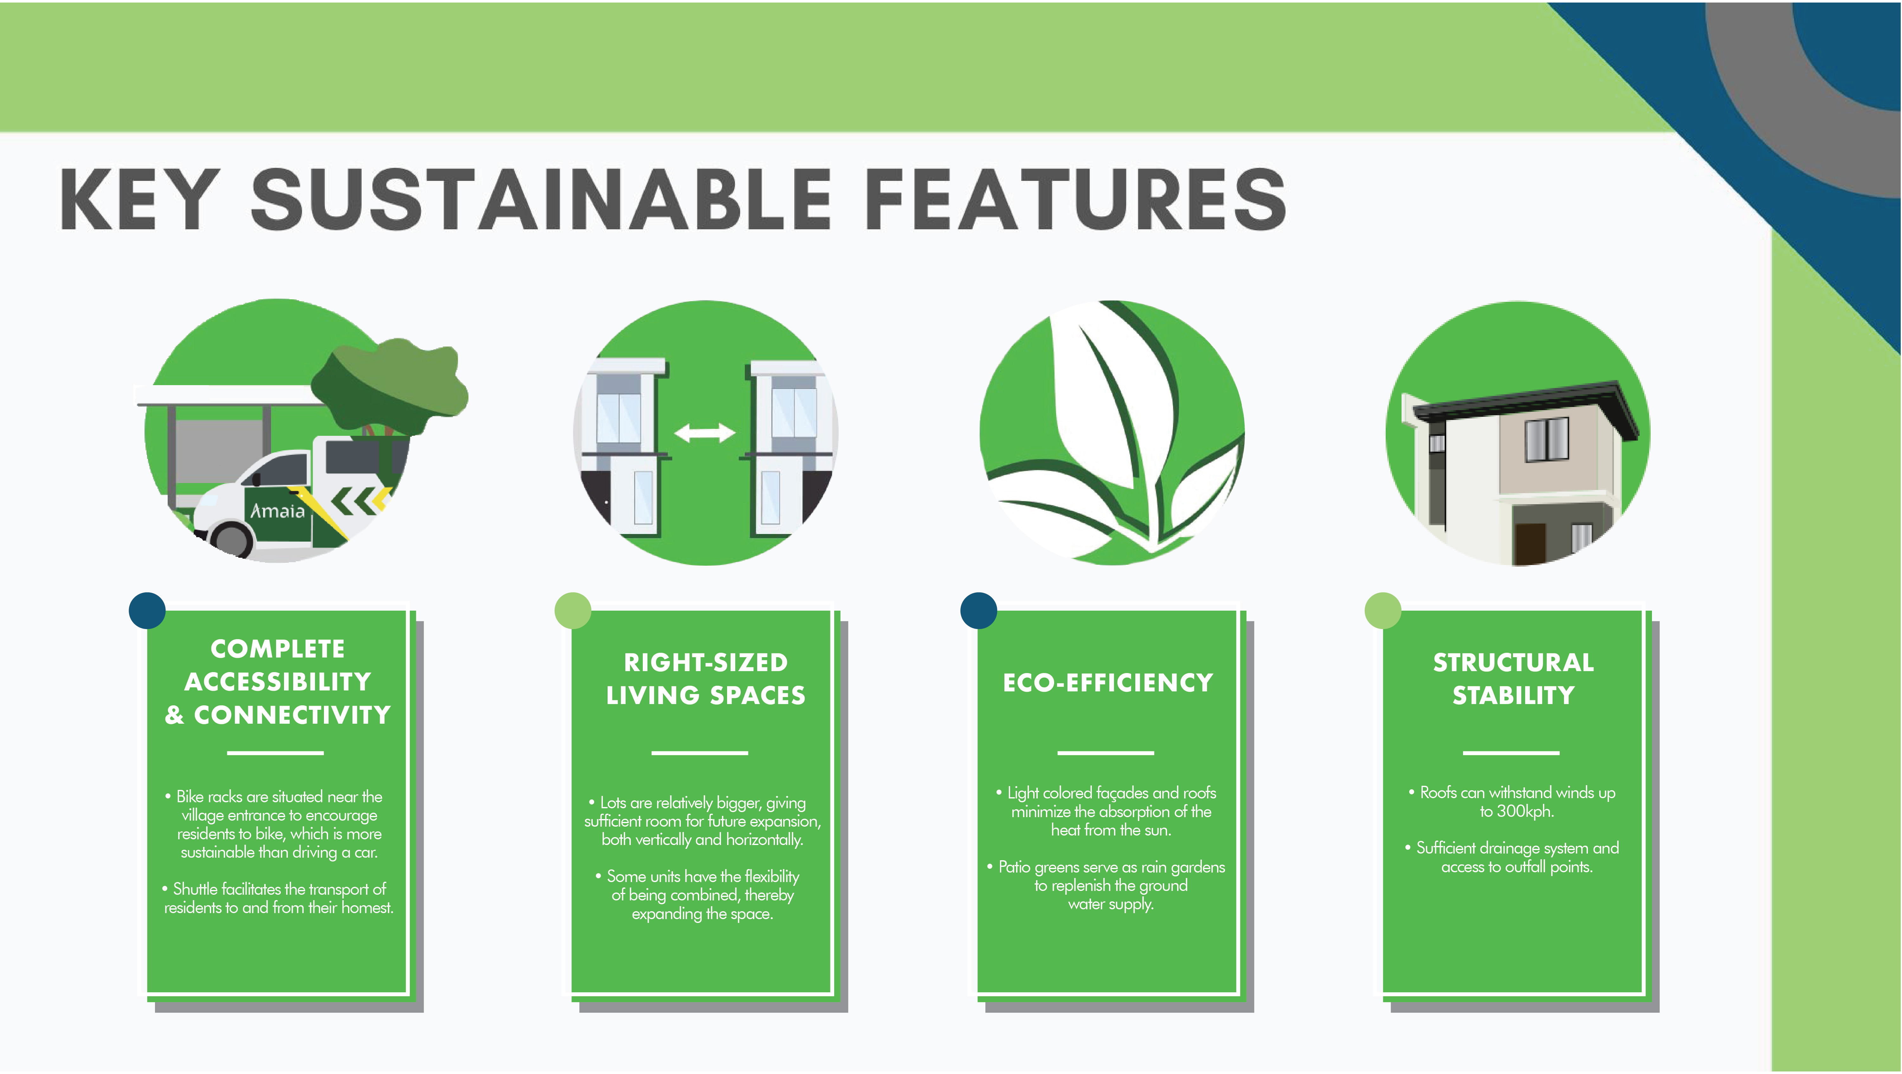

Slide 18
SAMPLE COMPUTATION
 | Starter Home | Series 40 - Inner | Series 40 - End
Contract Price | 1,894,301.50 | 1,615,727.75 | 1,782,872.00
10% Downpayment | 189,430.15 | 161,572.78 | 178,287.20
Reservation Fee | (20,000.00) | (20,000.00) | (20,000.00)
Net DP | 169,430.15 | 141,572.78 | 158,287.20
Monthly DP | 14,119.18 Payable for 12 mos. | 5,898.87 Payable for 24 mos. | 6,595.30 Payable for 24 mos.
90% Bank Loan | 1,704,871.35 | 1,454,154.97 | 1,604,584.80
MONTHLY AMMORTIZATION (8.88% Interest)
5 Years | 35,291.12 | 30,101.25 | 33,215.17
10 Years | 21,486.02 | 18,326.32 | 20,222.14
15 Years | 17,170.45 | 14,645.38 | 16,160.42
20 Years | 15,207.84 | 12,971.39 | 14,313.26

Slide 19


Slide 20


