Slide 1
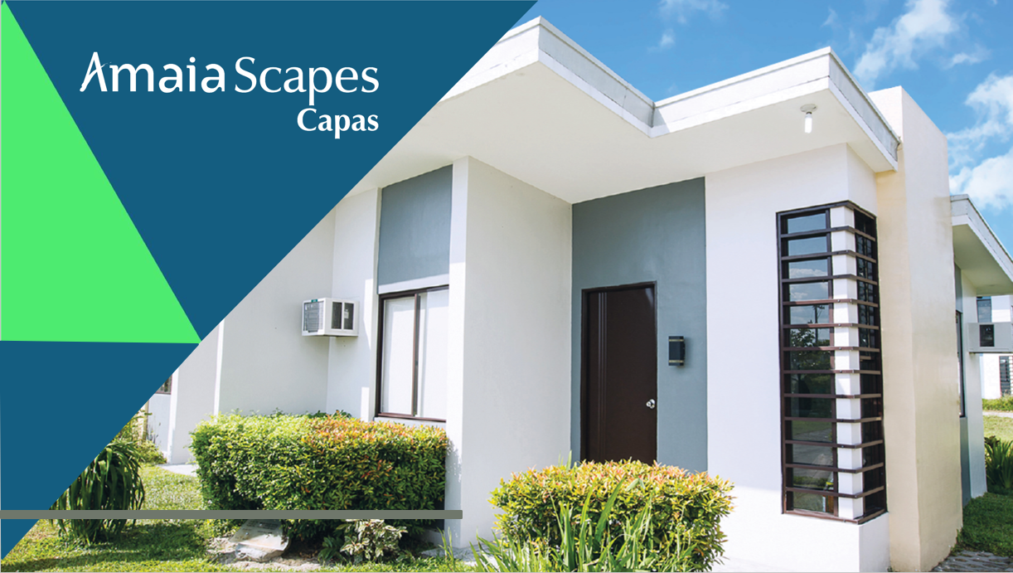

Slide 15
SAMPLE COMPUTATION
 | Bungalow Pod | Single Home
Contract Price | 1,894,301.50 | 3,269,341.53
10% Down payment | 189,430.15 | 326,934.15
Reservation Fee | (15,000.00) | (20,000.00)
Net DP | 174,430.15 | 306,934.15
Monthly DP | 14,535.85 Payable for 12 mos. | 25,577.85 Payable for 12 mos.
90% Bank Loan | 1,704,871.35 | 2,942,407.38
MONTHLY AMMORTIZATION (8.88% Interest)
5 Years | 35,291.12 | 60,908.32
10 Years | 21,486.02 | 37,082.35
15 Years | 17,170.45 | 29,634.18
20 Years | 15,207.84 | 26,246.95

