Slide 1
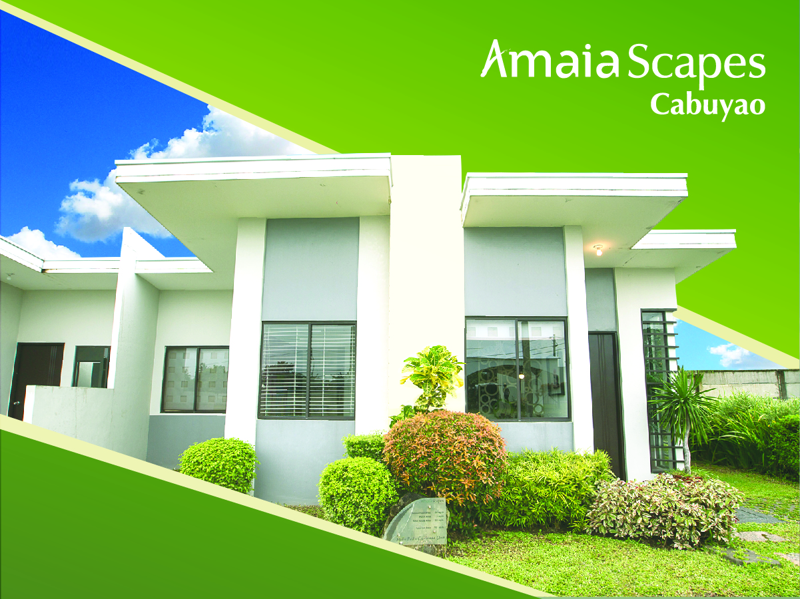

Slide 3
9.6 Hectares

Slide 4
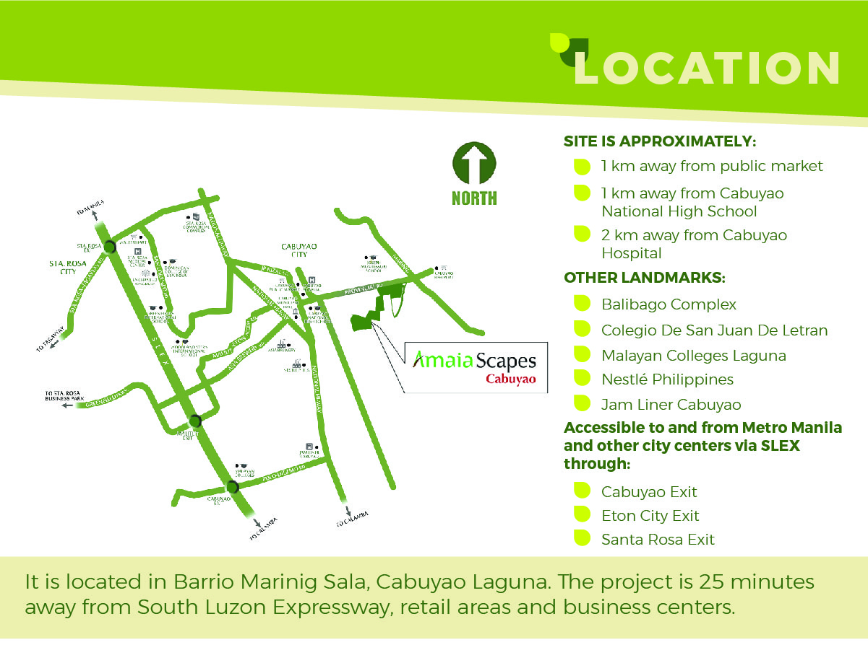

Slide 9
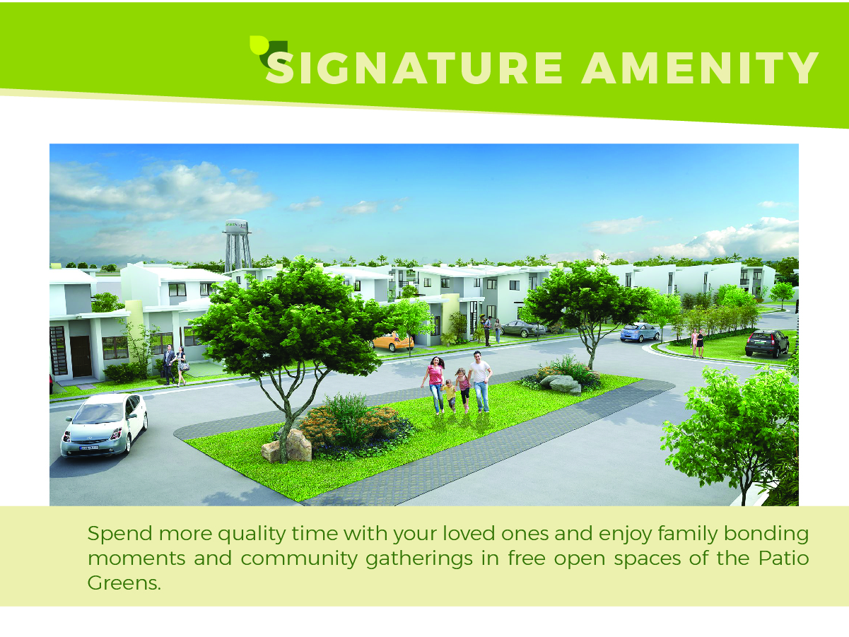

Slide 12
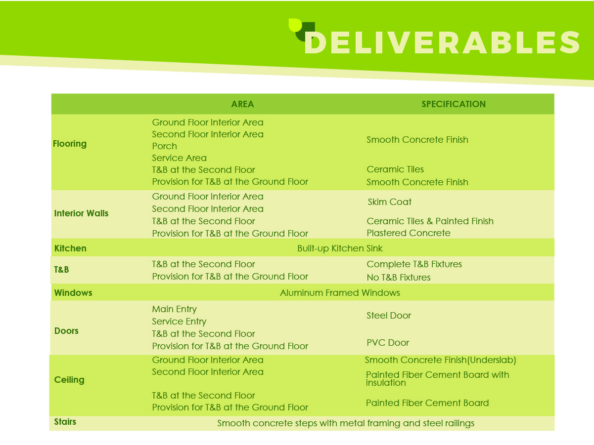

Slide 13
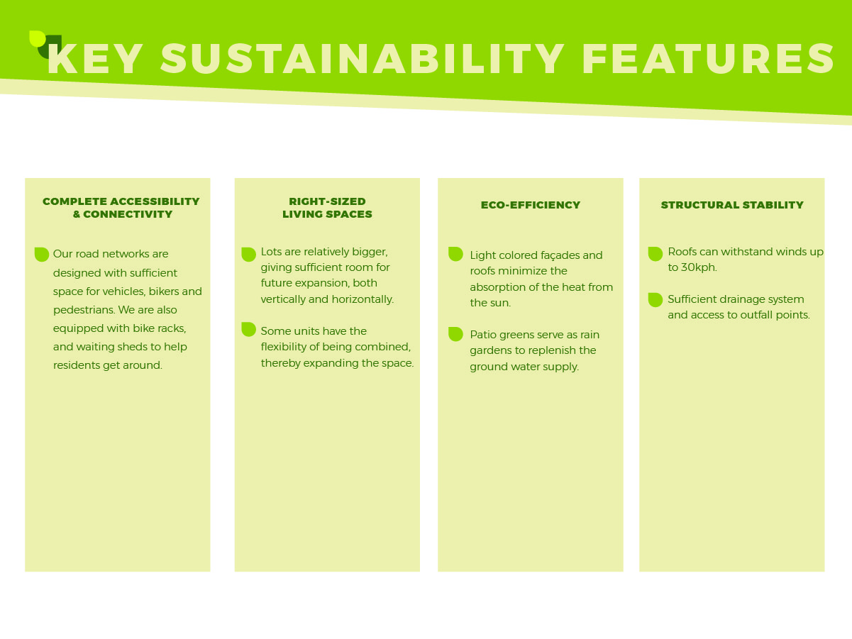

Slide 15
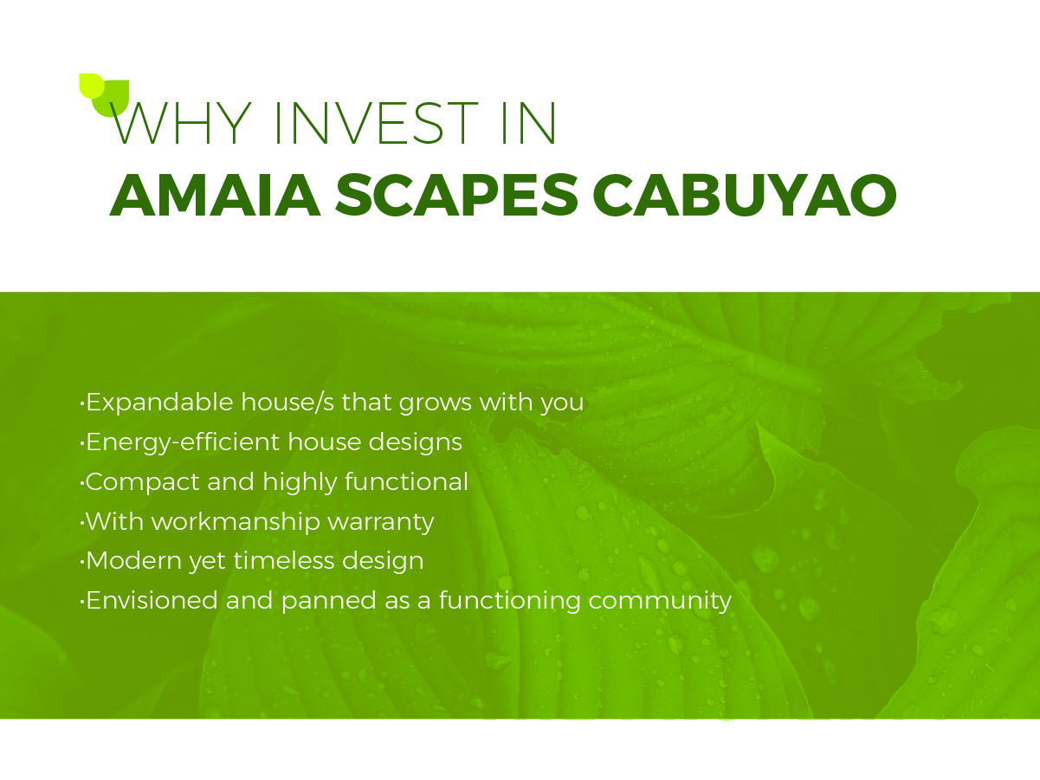
Expandable house/s that grows with you
Energy-efficient house designs
Compact and highly functional
With workmanship warranty
Modern yet timeless design
Envisioned and planned as a functioning community

