Slide 3
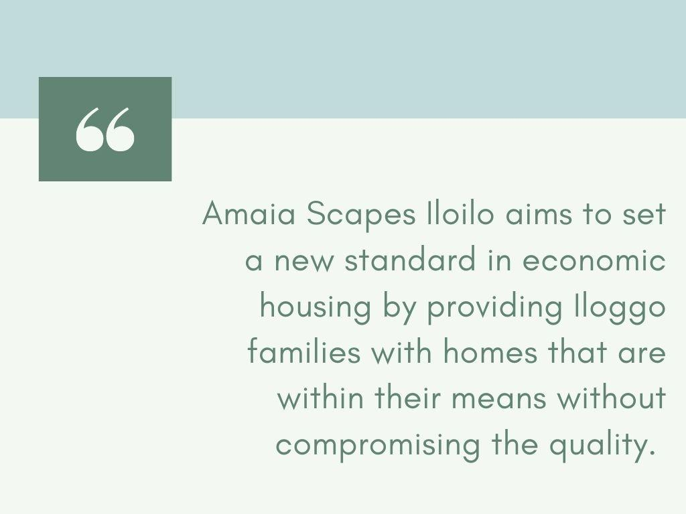

Slide 4
Barangay San Jose, San Miguel, Iloilo

Slide 5
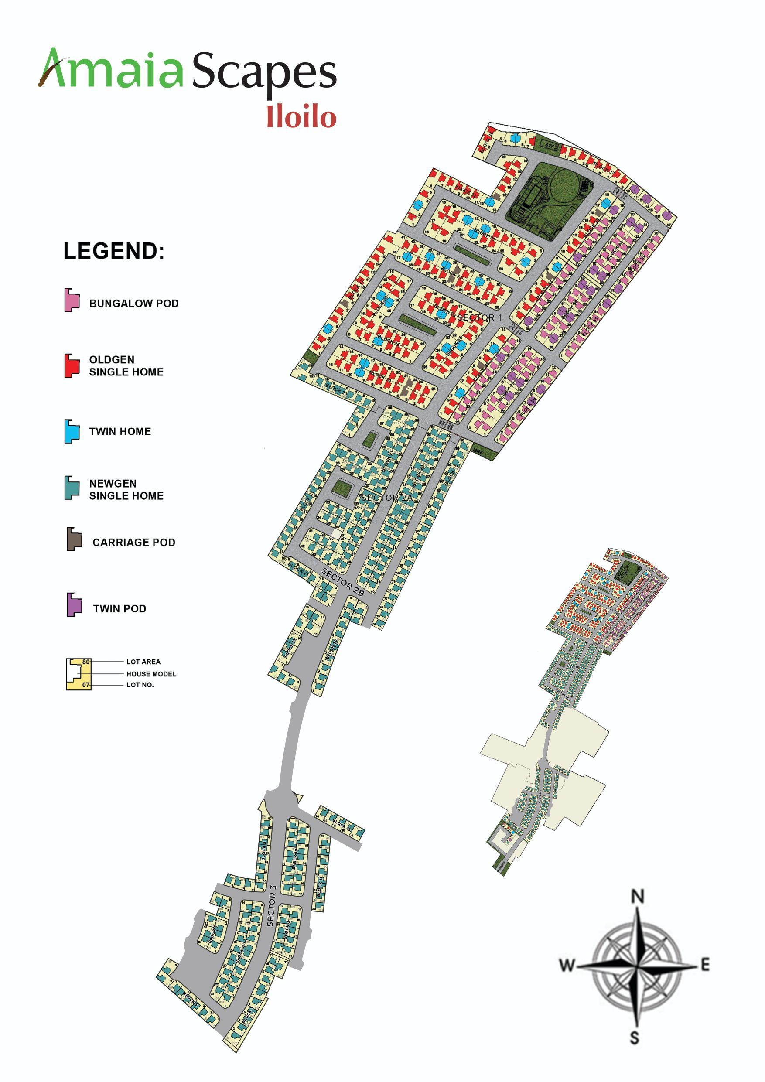
SECTOR 1
SECTOR 2

Slide 6
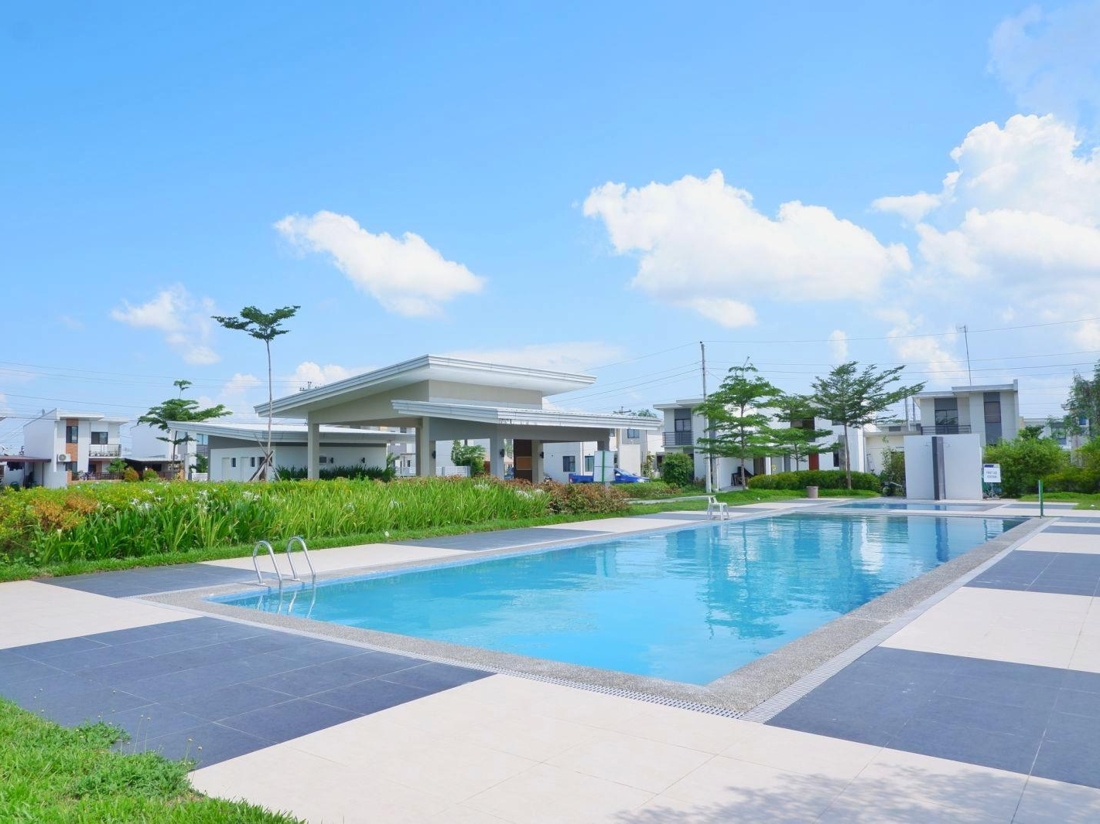
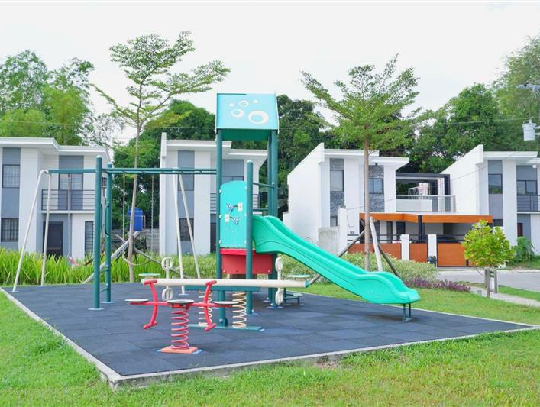

Slide 7
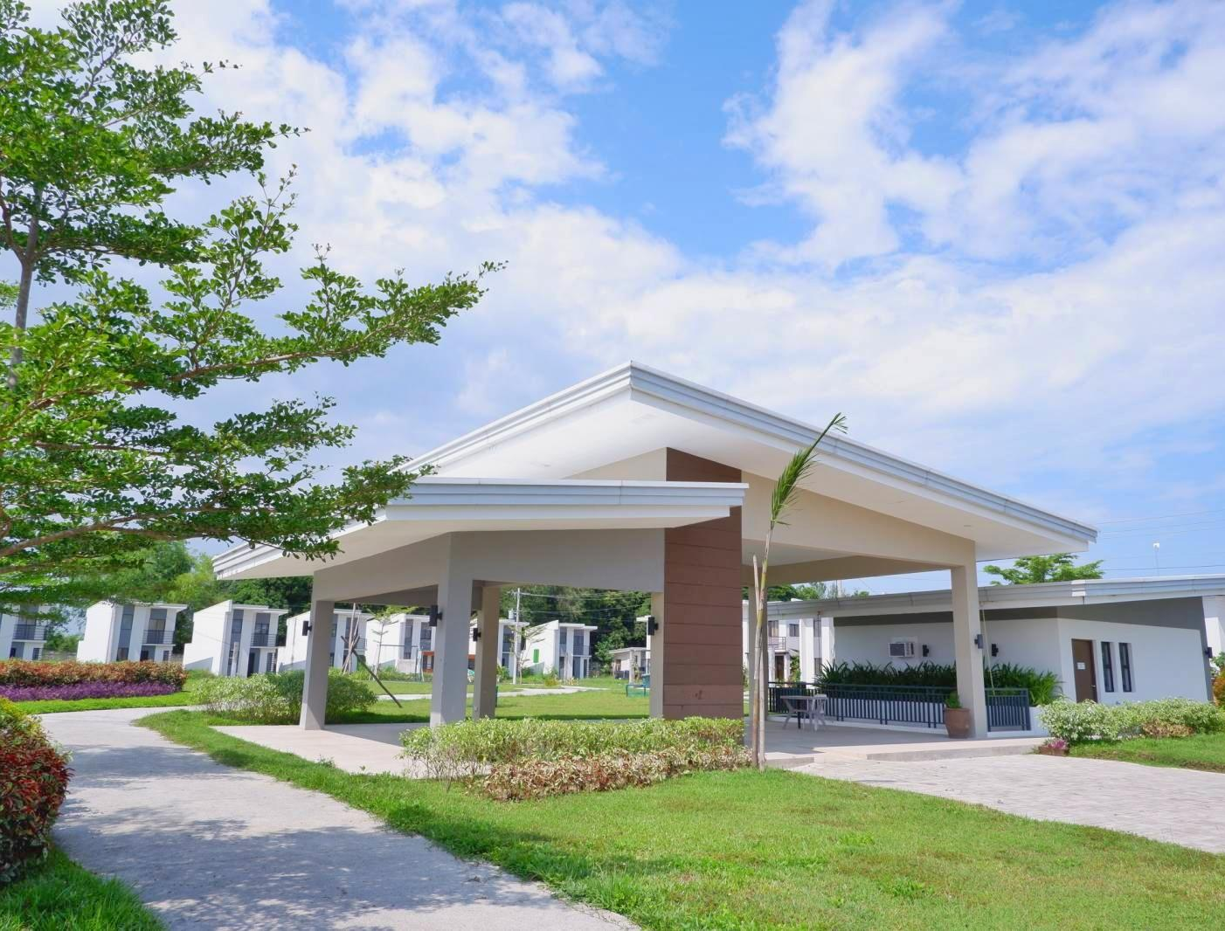
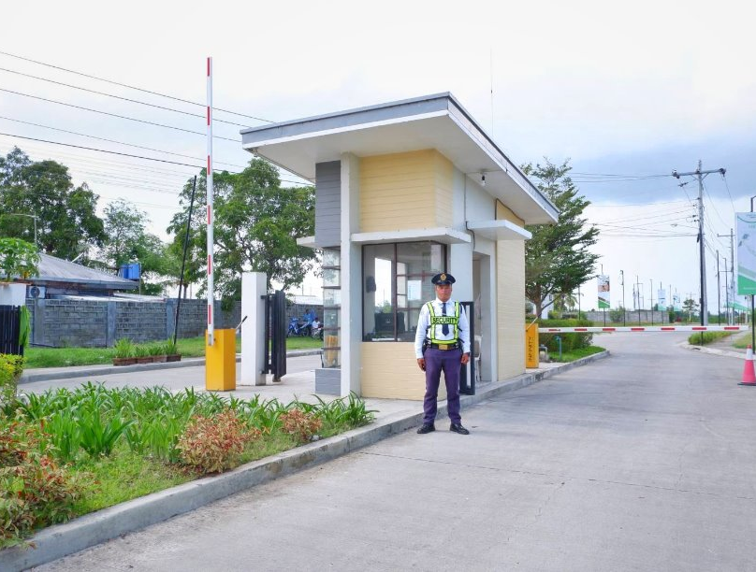
Village Pavilion
Guard House/Village Entrance

Slide 9
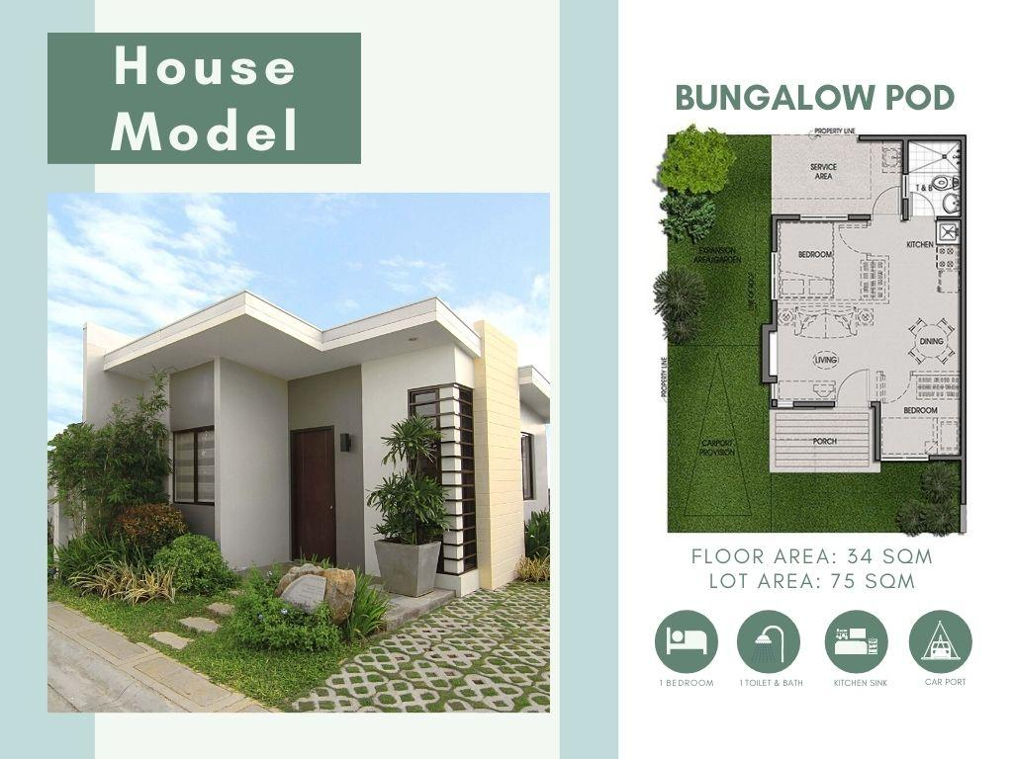

Slide 16
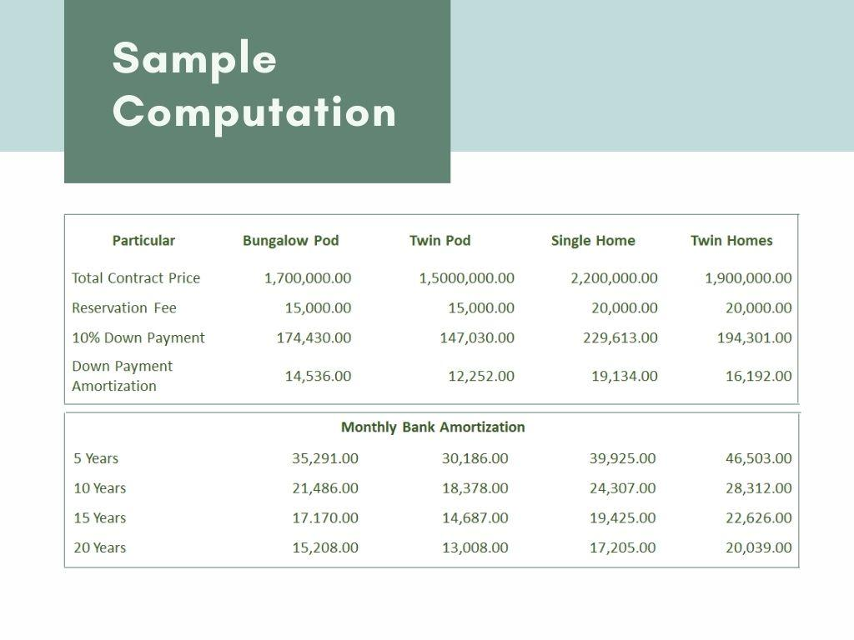
UNIT TYPE​​ | TCP​ (Non-VAT)​​ | 10% DP IN 18 MONTHS​ w/ VAT and OC​ |  | ​BANK FINANCING​​
 |  | TOTAL DP | MONTHLY DP​​ | 10 YEARS​​ | 15 YEARS​​ | 20 YEARS​​
Single Home 60​​ | 3,000,000​ | 334,288.50​ | 17,460.57​ | 35,712.57​ | 27,890.06​ | 24,237.05​
 | 3,170,000 | 353,231.52 | 18,235.08 | 36,097.85 | 27,693.23 | 23,702.39
 | 3,199,000 | 356,462.97 | 18,414.61 | 36,428.08 | 27,946.58 | 23,919.23
Sample Computation (LOI period only)
UNIT TYPE​​ | TCP ​​ (Non-VAT)​​ | 10% DP IN 24 or 30 MONTHS​ w/ VAT and OC​ (select units only)​ |  | ​ BANK FINANCING​​
 |  | TOTAL DP​​ | MONTHLY DP​​ | 10 YEARS​​ | 15 YEARS​​ | 20 YEARS​​
Single Home 60​​ | 3,000,000​ | 334,288.50​ | 13,095.35 | 35,712.57​ | 27,890.06​ | 24,237.05​
 | 3,170,000 | 353,231.52 | 13,676.31 | 36,097.85 | 27,693.23 | 23,702.39
 | 3,199,000 | 356,462.97 | 11,048.77 - 13,810.69 | 36,428.08 | 27,946.58 | 23,919.23

Slide 17
Barangay San Jose, San Miguel, Iloilo
Sector 1A
LTS #: 030116
(BP 220 – Max Selling price of 1.7M)
Sector 1B
LTS #: 030117
(BP 220 – Max Selling price of 1.7M)
Advertising Approval: HLURB WVR-AA-2016/01-0124
Amaia Land Corp.
Sales Office: Door A & B, JC Building, Delgado Street, Iloilo

