Slide 1


Slide 2
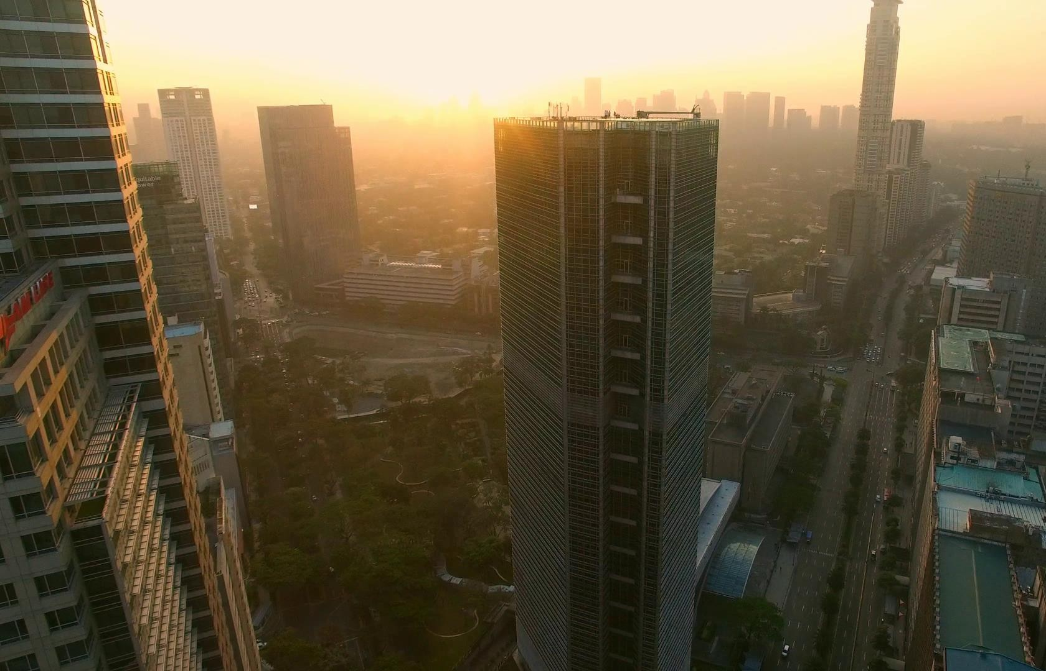


Slide 3

INTEGRATED ARRAY OF REAL ESTATE PRODUCTS

Slide 4
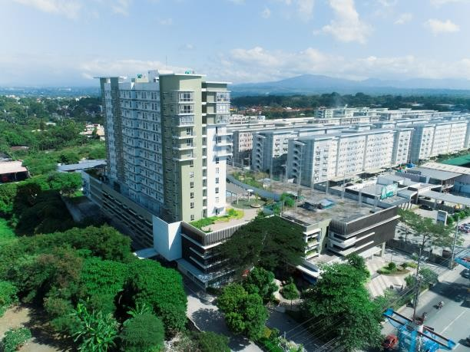
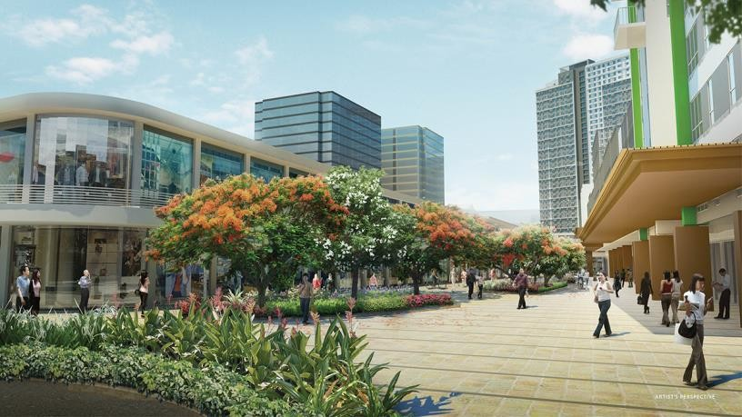
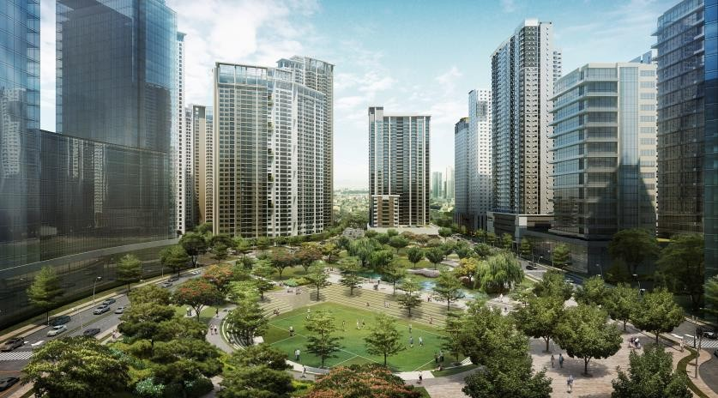



Bagong Pag-asa • Fairview •
Balintawak • New Manila
Balintawak
Bagong Pag-asa
EXTENSIVE PRESENCE IN QUEZON CITY
For presentation purposes only as of January 2020

Slide 5
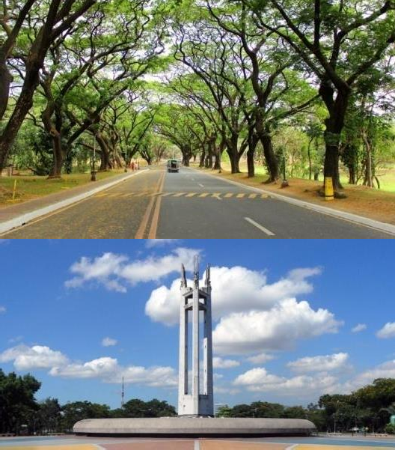
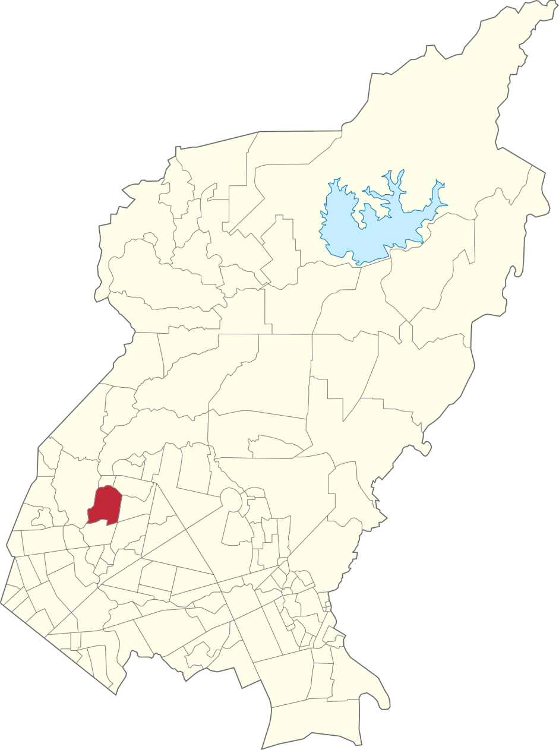

QUEZON CITY
Most populous city in the country (2.9 million as of 2015)
Information and Communications Technology Capital of the Philippines
Economy dominated by small- to-medium enterprises
Multiple upcoming infrastructure developments
Sources: http://www.philstar.com/business/2015/09/19/1501296/phi lippine-cities-over-1m-population-nearly-triple-2025 https://quezoncity.gov.ph/index.php/about-the-city- government/economy

Slide 6

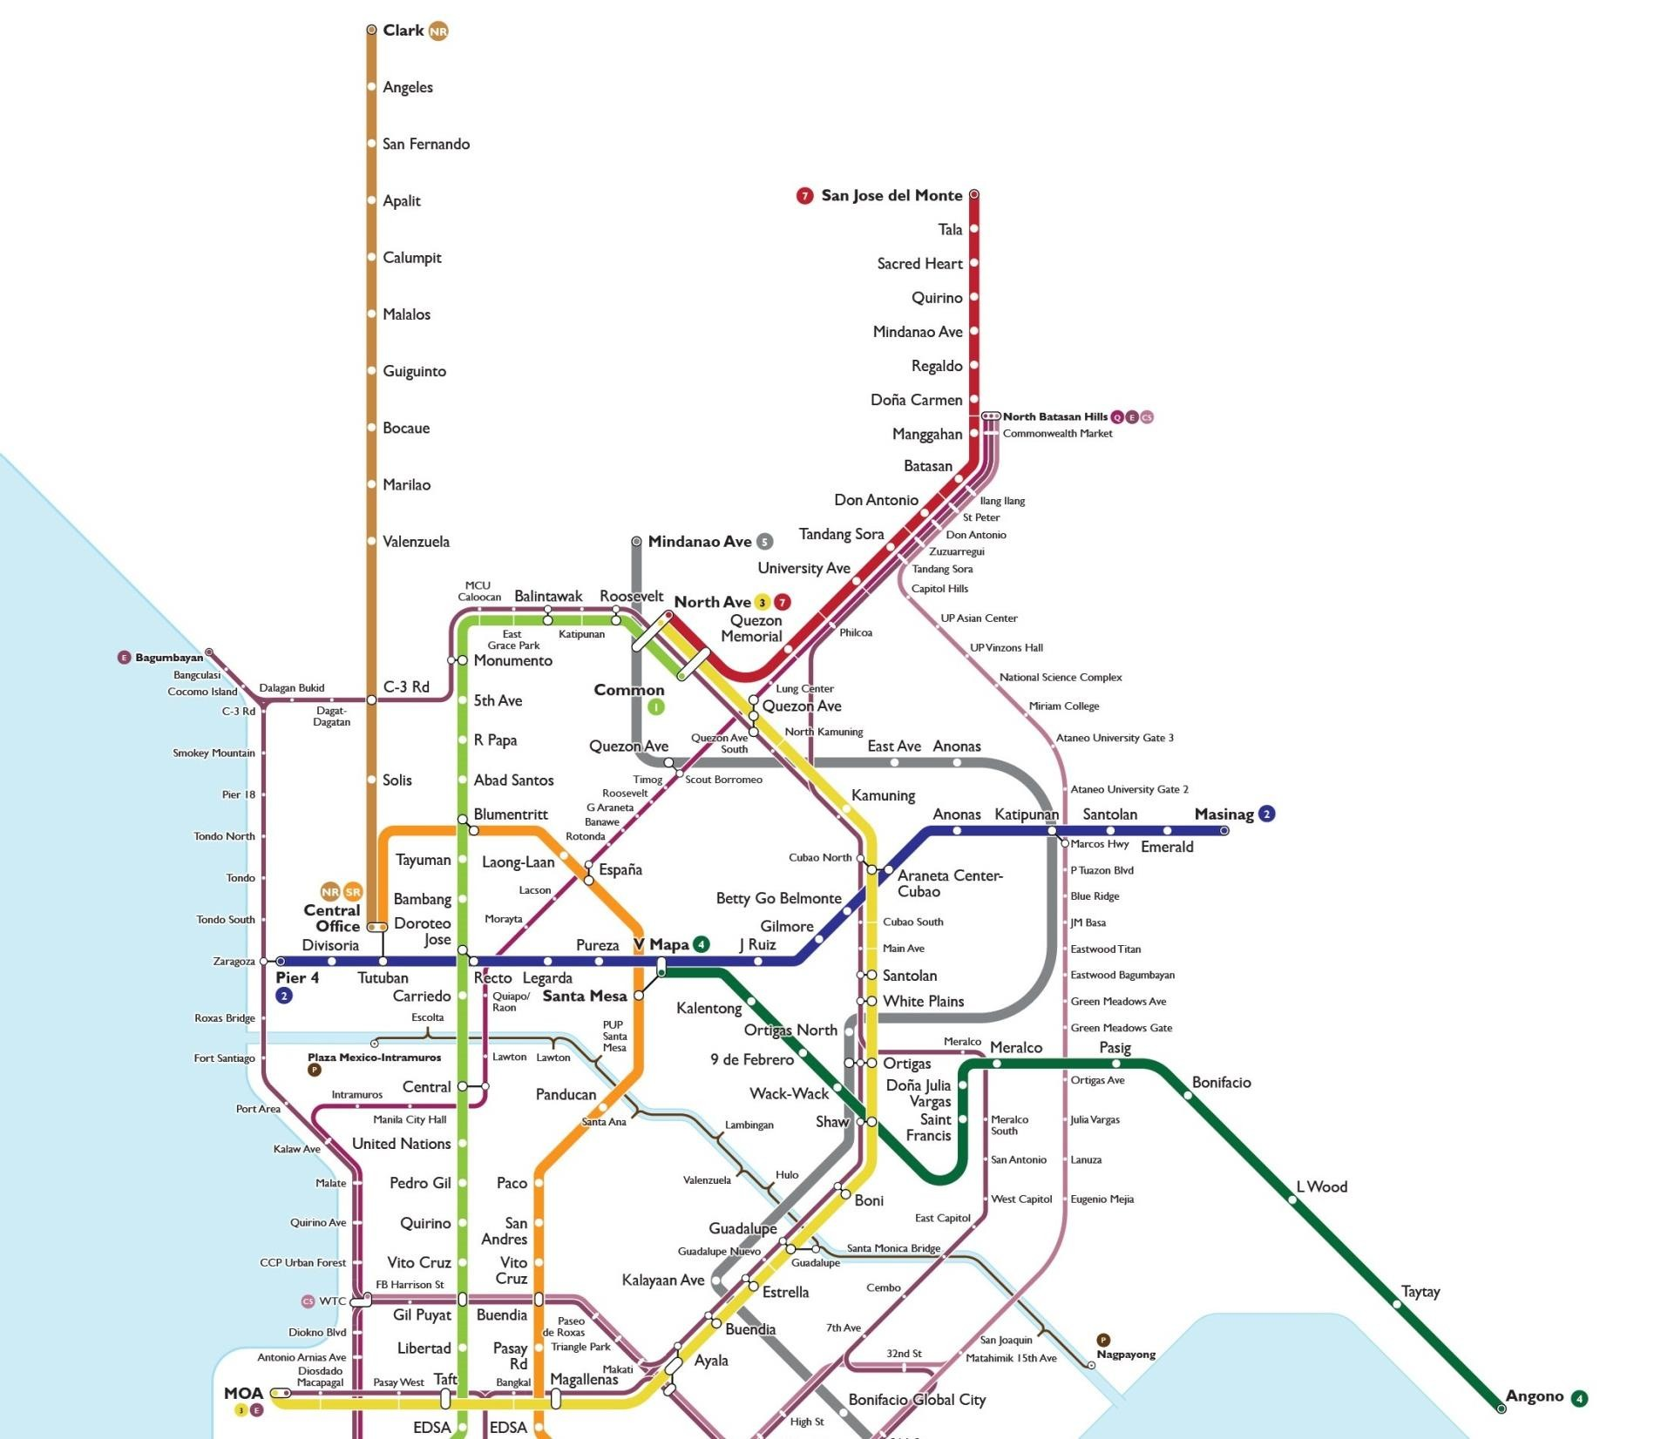
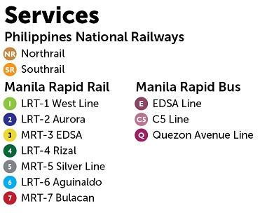
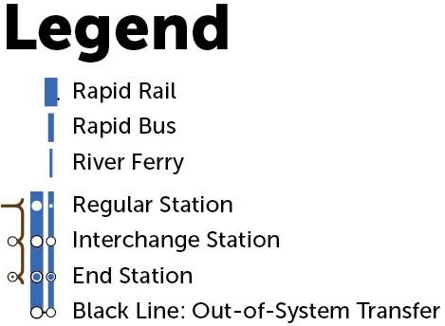
Metro Manila’s Planned Railway Network
QUEZON CITY

Slide 7

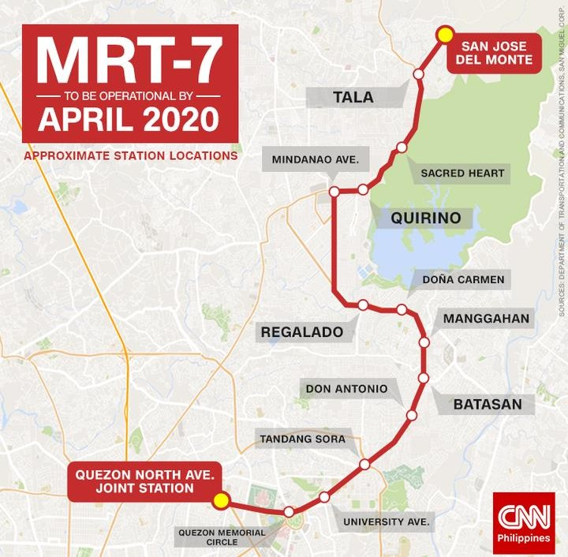
MRT LINE 7
2022
Date of Completion | 2022
No. of Stations | 14
% Completed | 50.69% (As of January 2020)
Source:
https://ppp.gov.ph/ppp_projects/mrt-line-7/

Slide 8
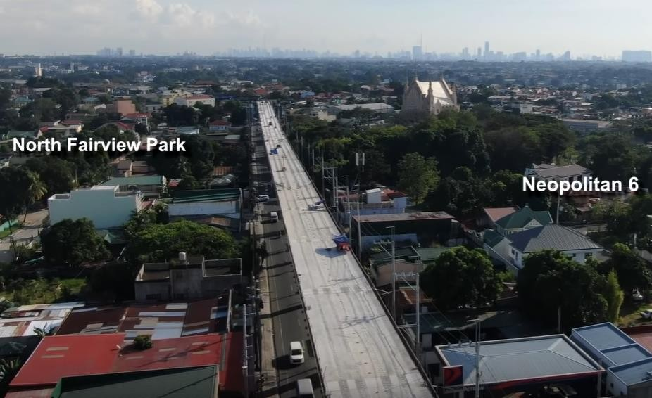
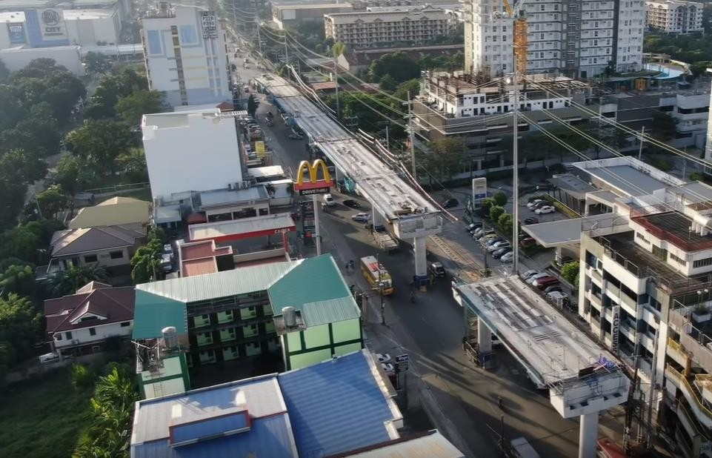
MRT 7 PROGRESS PHOTOS
REGALADO HIGHWAY
QUIRINO HIGHWAY
Source: dmitrivalencia YouTube channel https://www.youtube.com/watch?v=QgNMxdnu6lg&list=PLi_zddSrTDwL-rdPTu6xv0vPr9J3eeZqA&index=2

Slide 9
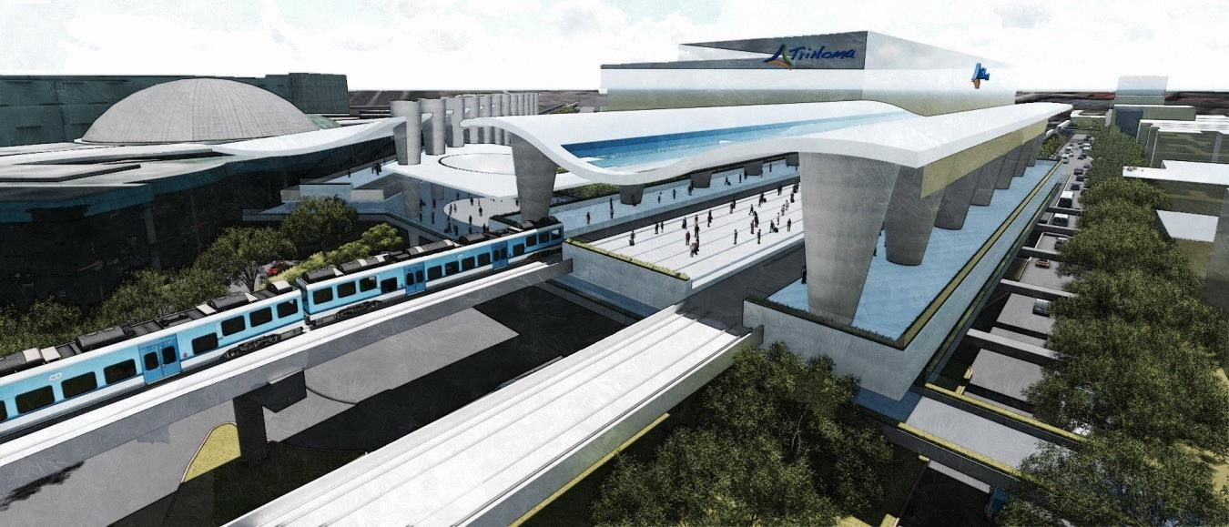
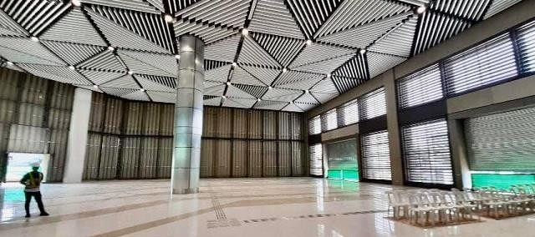
UNIFIED GRAND CENTRAL STATION
Targeted Date of Completion | 2021
Connections | MRT – 3 MRT – 7 LRT – 1 Metro Manila Subway
Source:
https://www.spot.ph/newsfeatures/the-latest-news- features/80256/mrt-lrt-common-station-area-b-a4362- 20191217

Slide 10

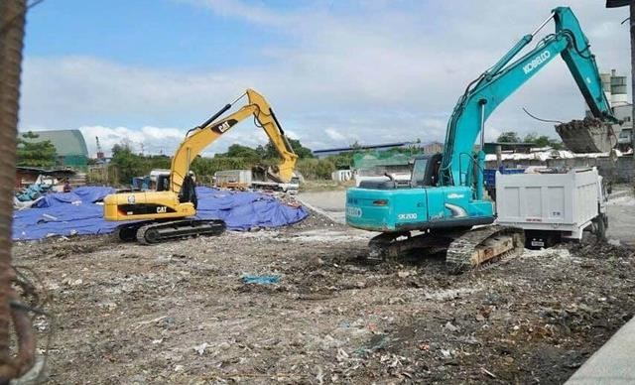
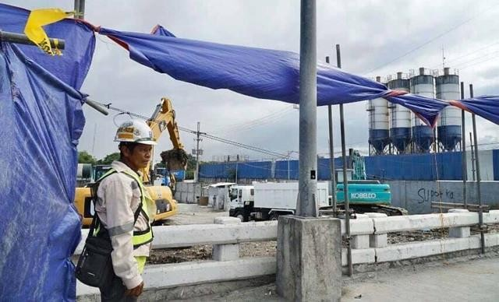
METRO MANILA SUBWAY
Targeted Date of Completion | 2025
Number of Stations | 15
Clearing operations started Q4 2019
Source:
https://www.rappler.com/nation/247681-metro-manila- subway-construction-clearing-phase

Slide 11
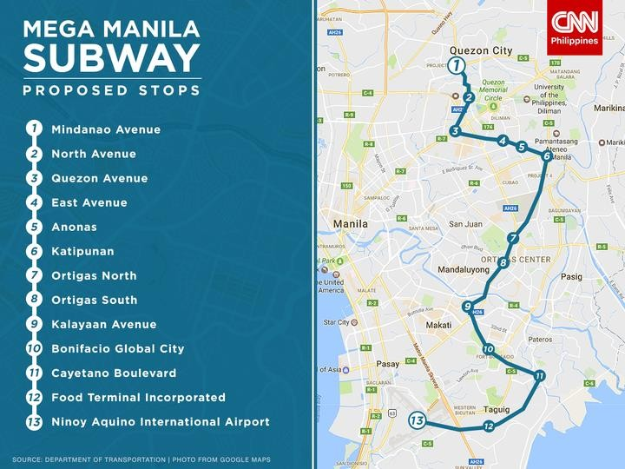

Slide 12
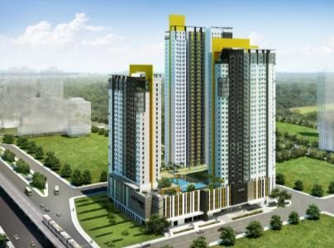

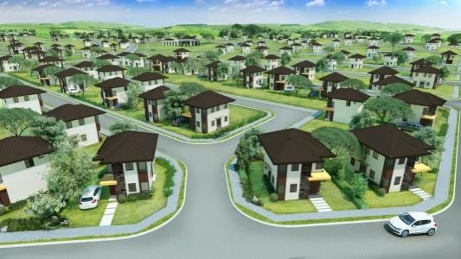


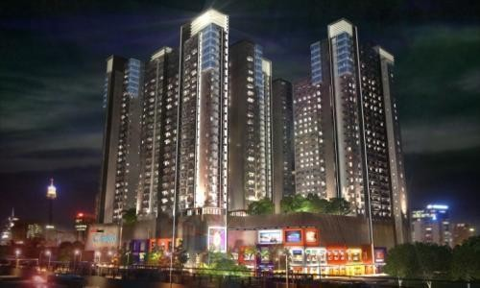


Slide 13
92 Projects
In
25 Locations
For presentation purposes only as of January 2020

Slide 14
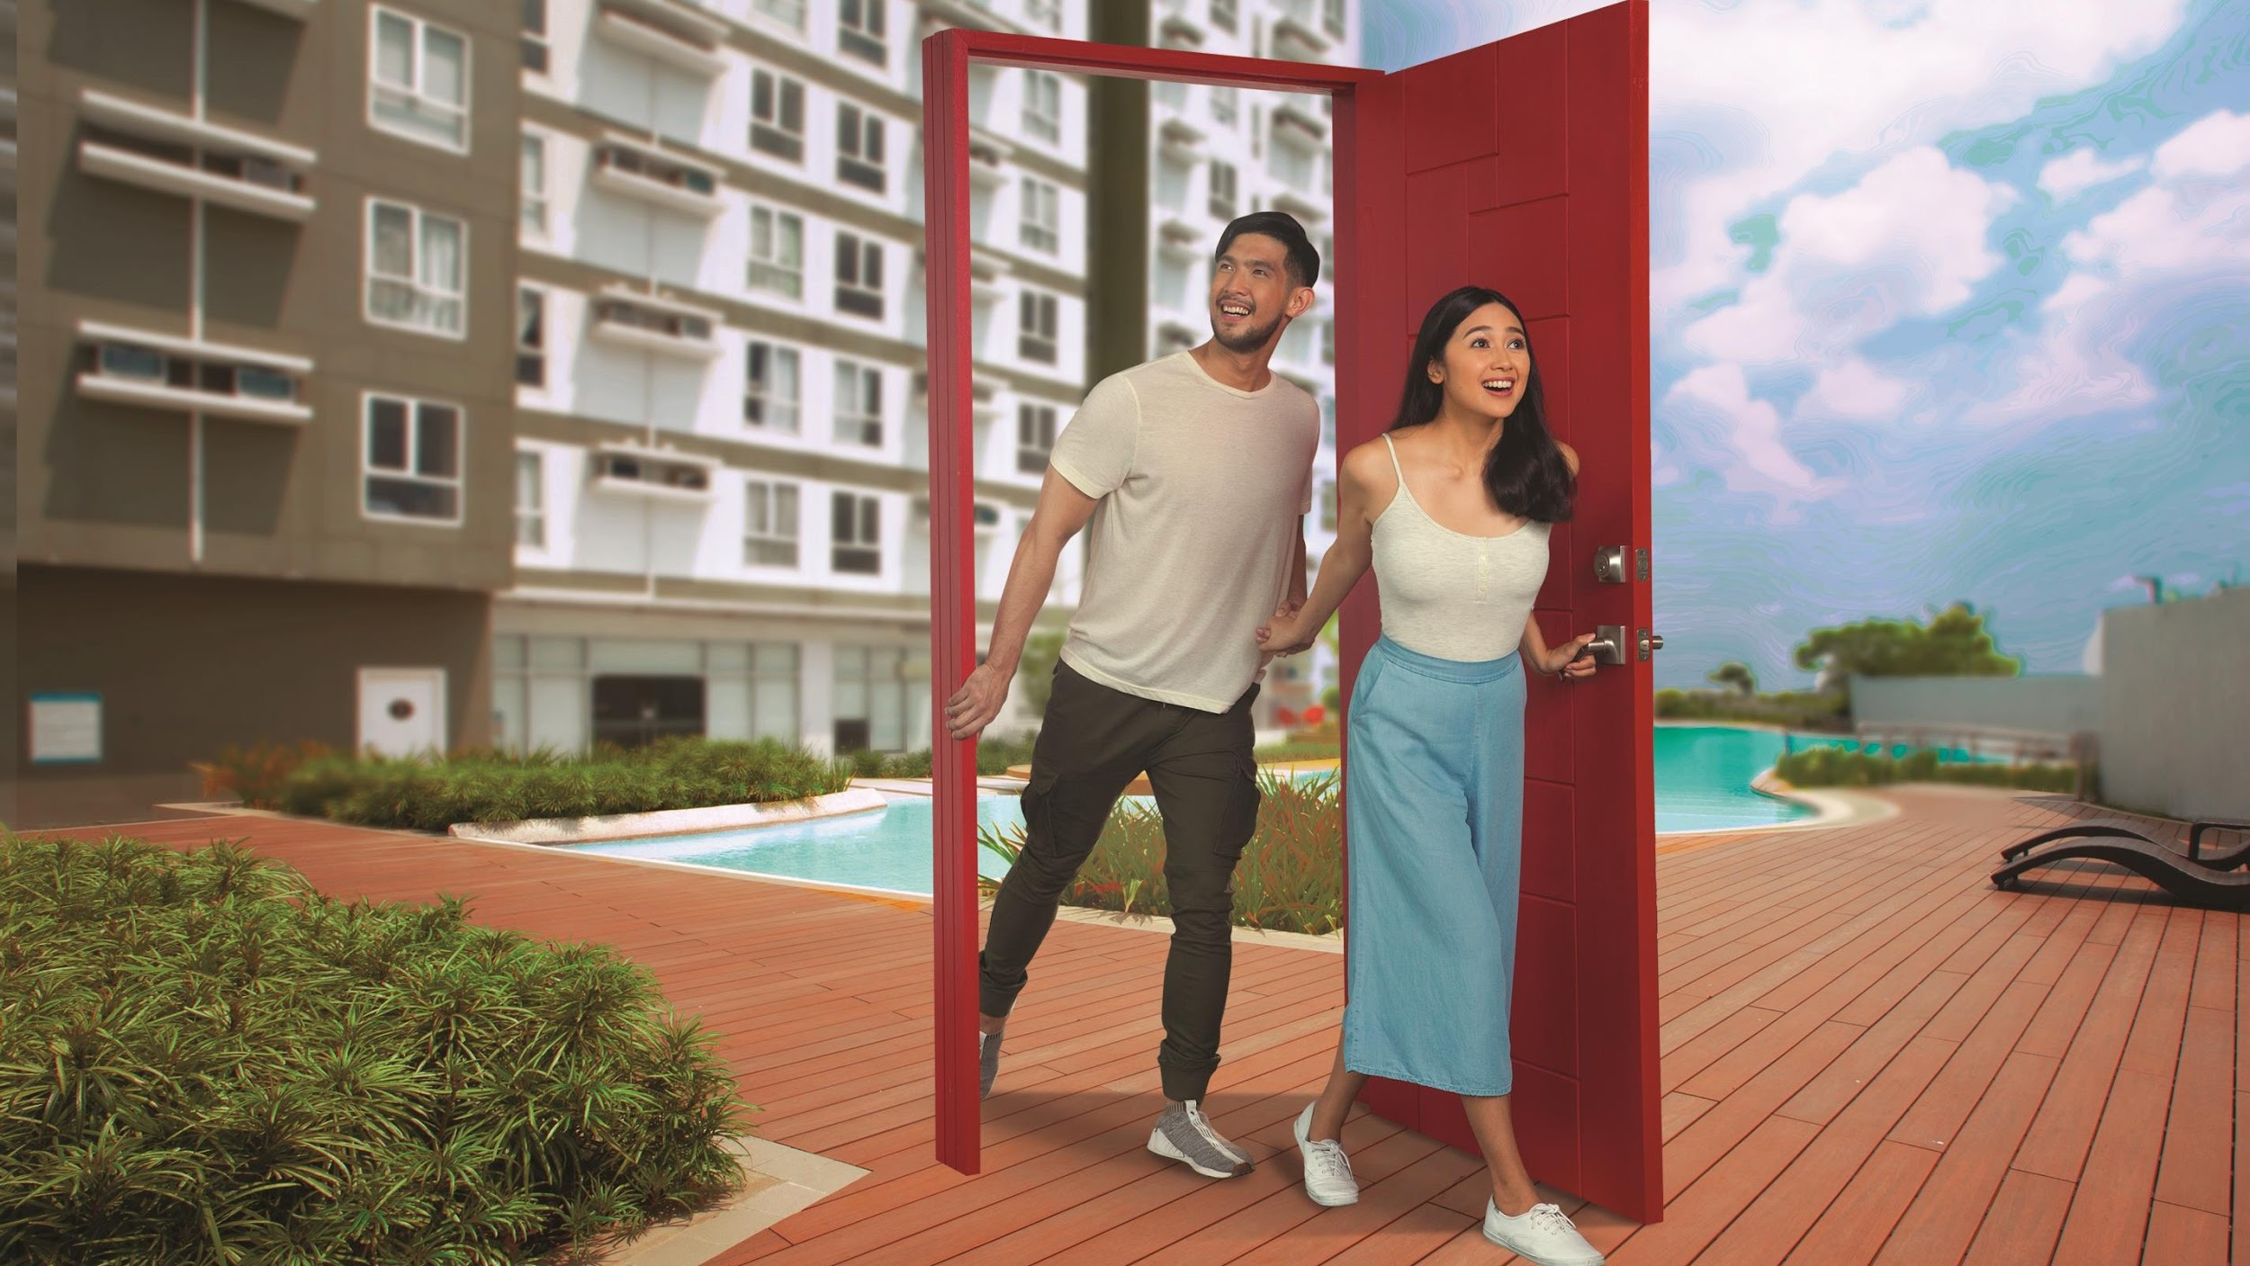

FAIRVIEW, QUEZON CITY

Slide 15
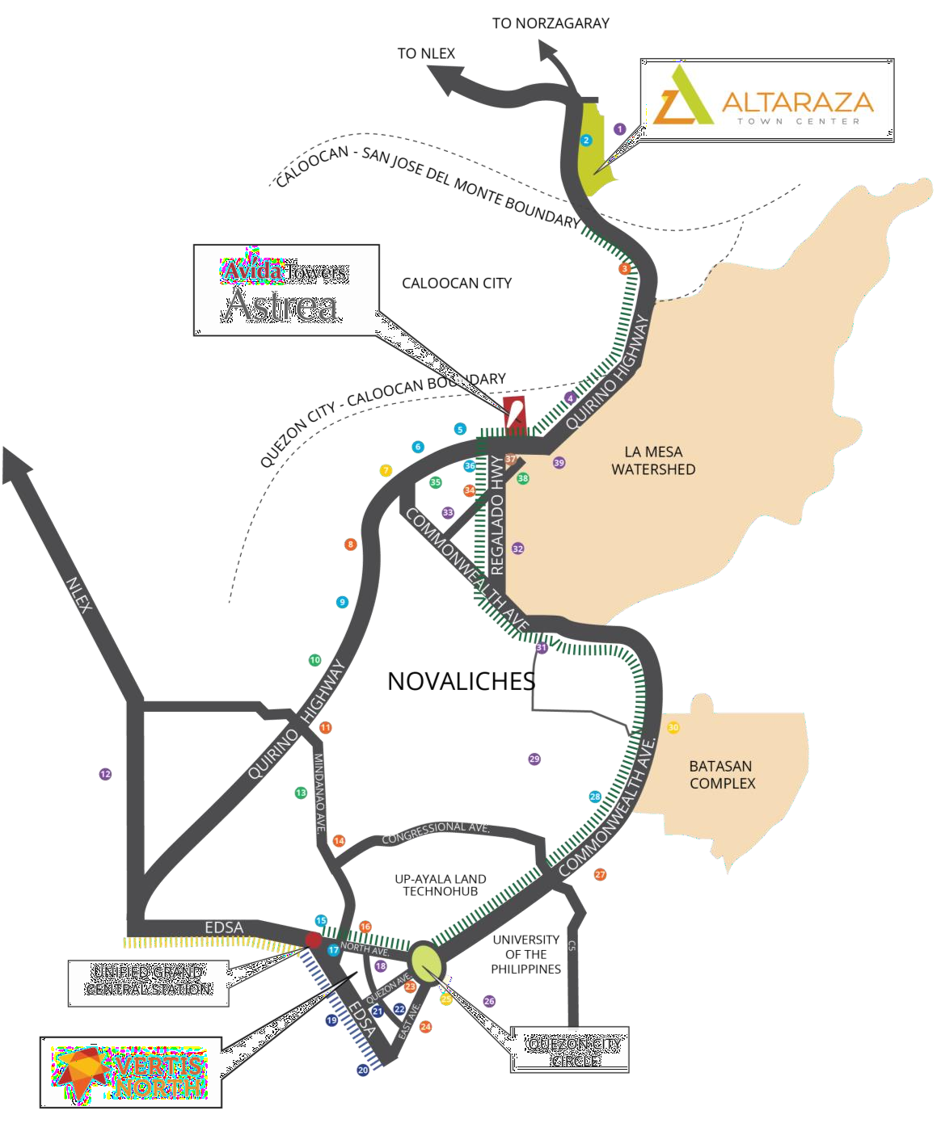
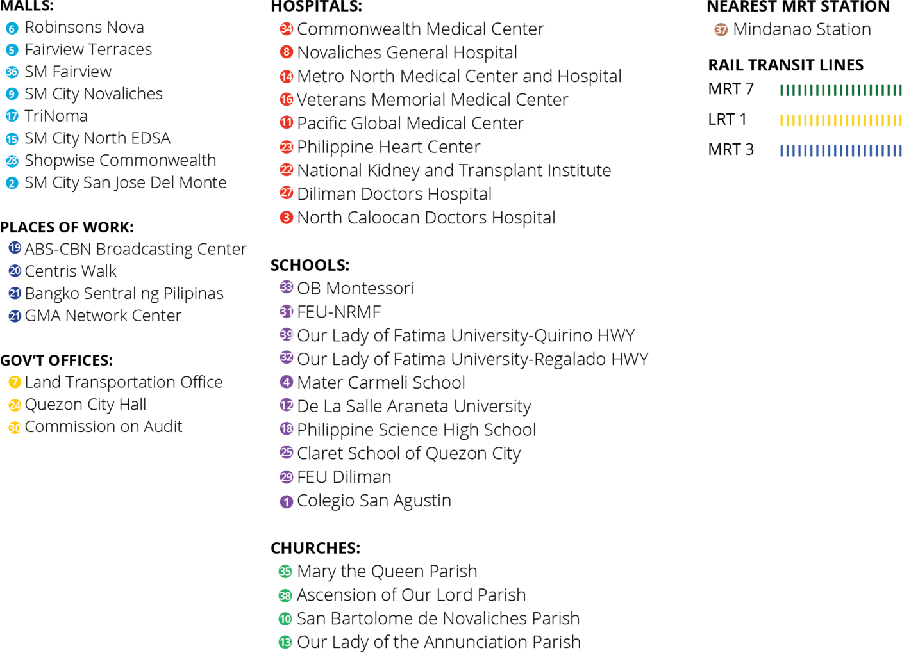
FAIRVIEW
QUEZON CITY’S PROGRESSIVE GROWTH AREA
Strategically located between Altaraza and Vertis North, two Ayala Land Estates, Astrea is a viable choice for people seeking to live in a progressive growth area.

Slide 16
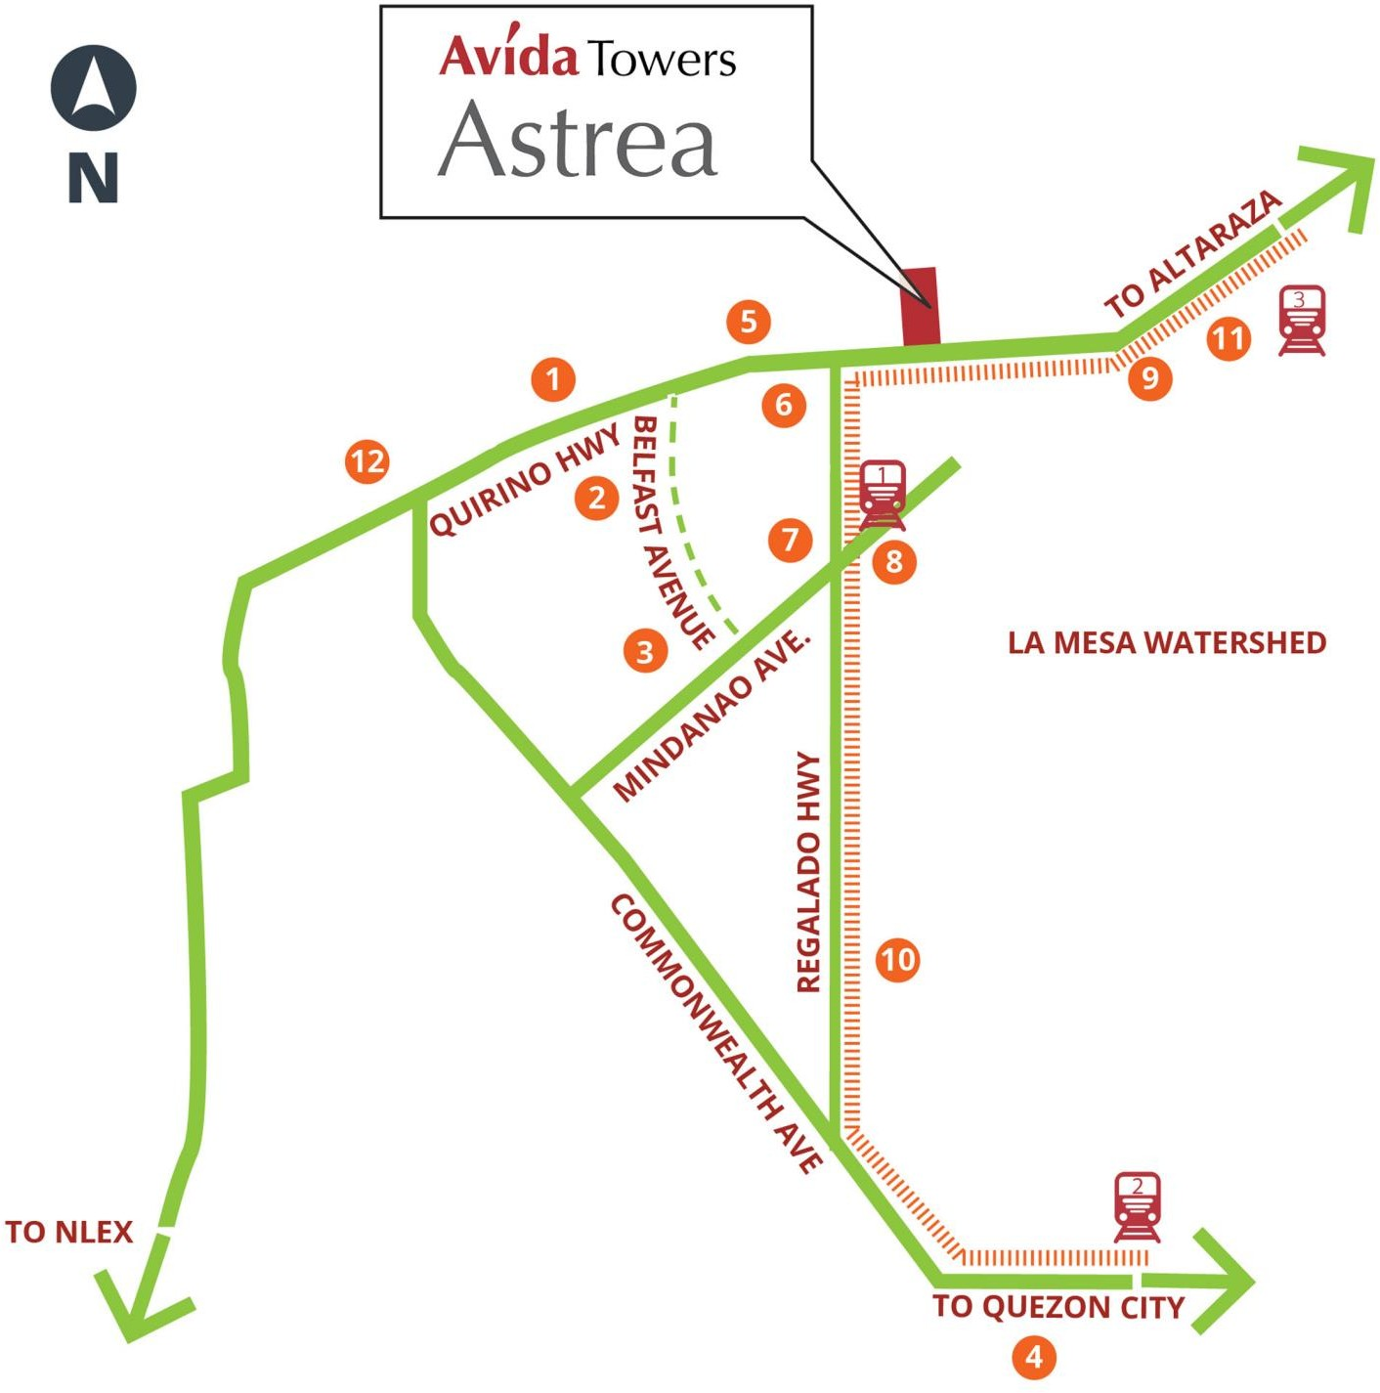
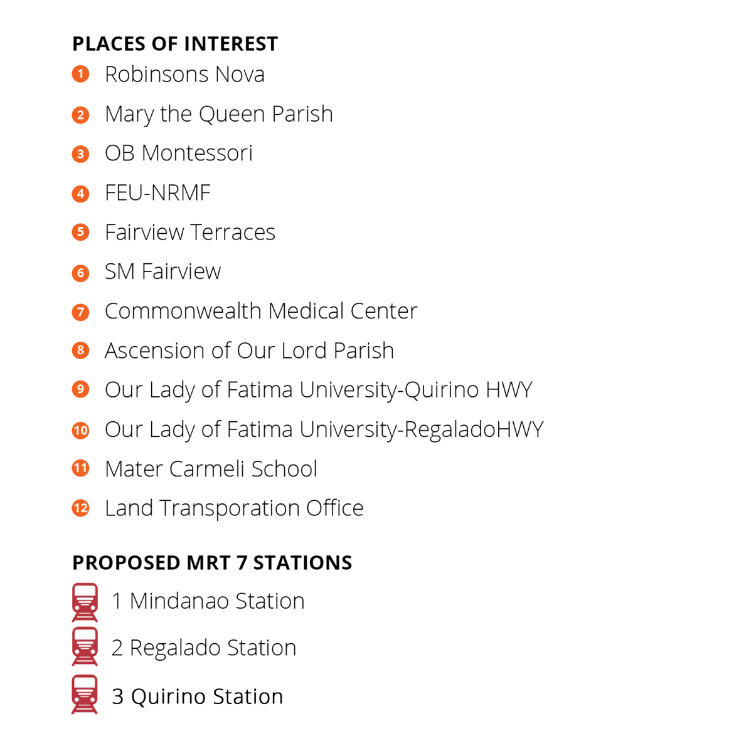
VICINITY MAP
Situated along Quirino Highway, Avida Towers Astrea is minutes away from schools, churches, malls, and the nearby MRT-7 Mindanao Station.

Slide 17
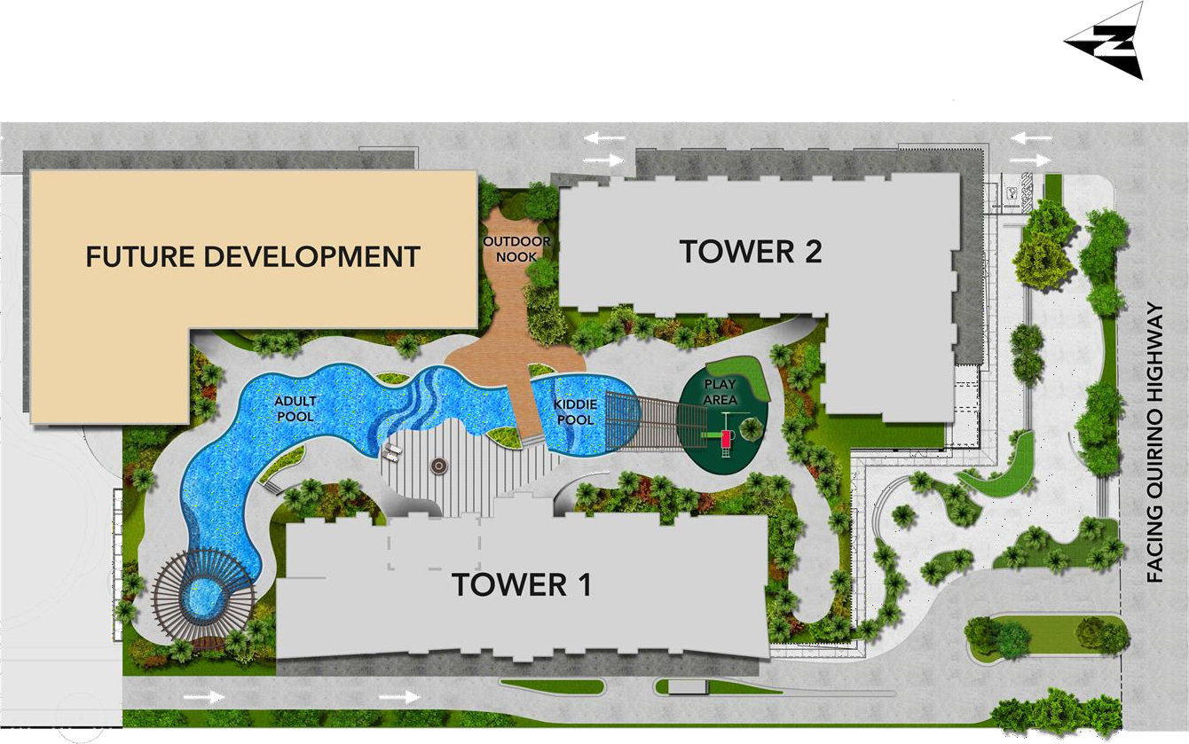
SITE DEVELOPMENT
PLAN
Facing La Mesa Watershed
Project General Information
Launch Date | July 2019 LTS No. 034596
No. of Units | 335 Residential Units 126 Parking Units
Facing Caloocan City
Facing Valenzuela City

Slide 18

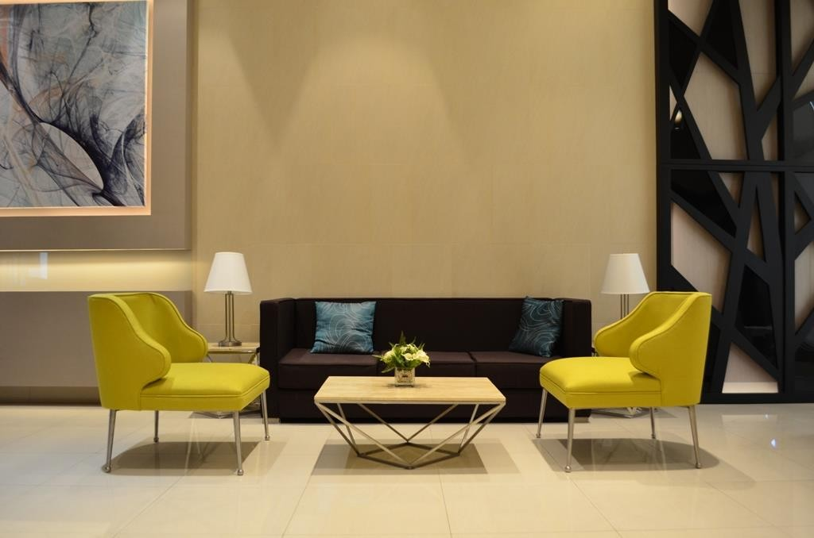
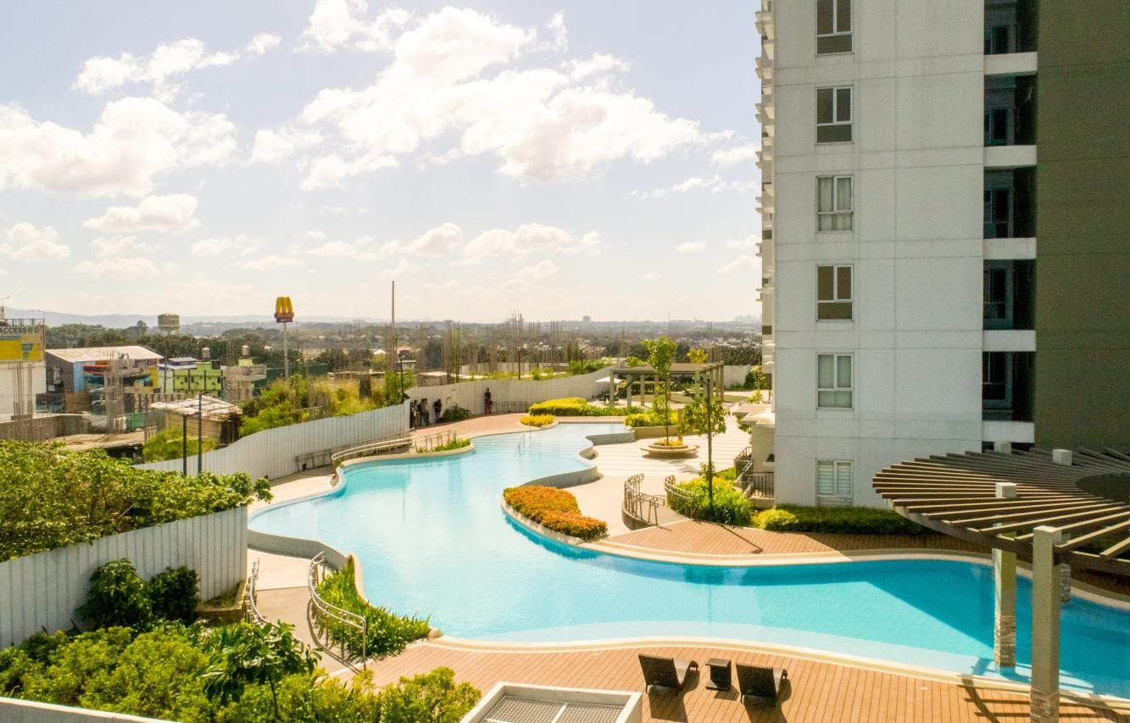
ASTREA TOWER 2 SITE
ASTREA TOWER 1 LOBBY
OPEN YOUR DOORS TO A READY COMMUNITY

Slide 19
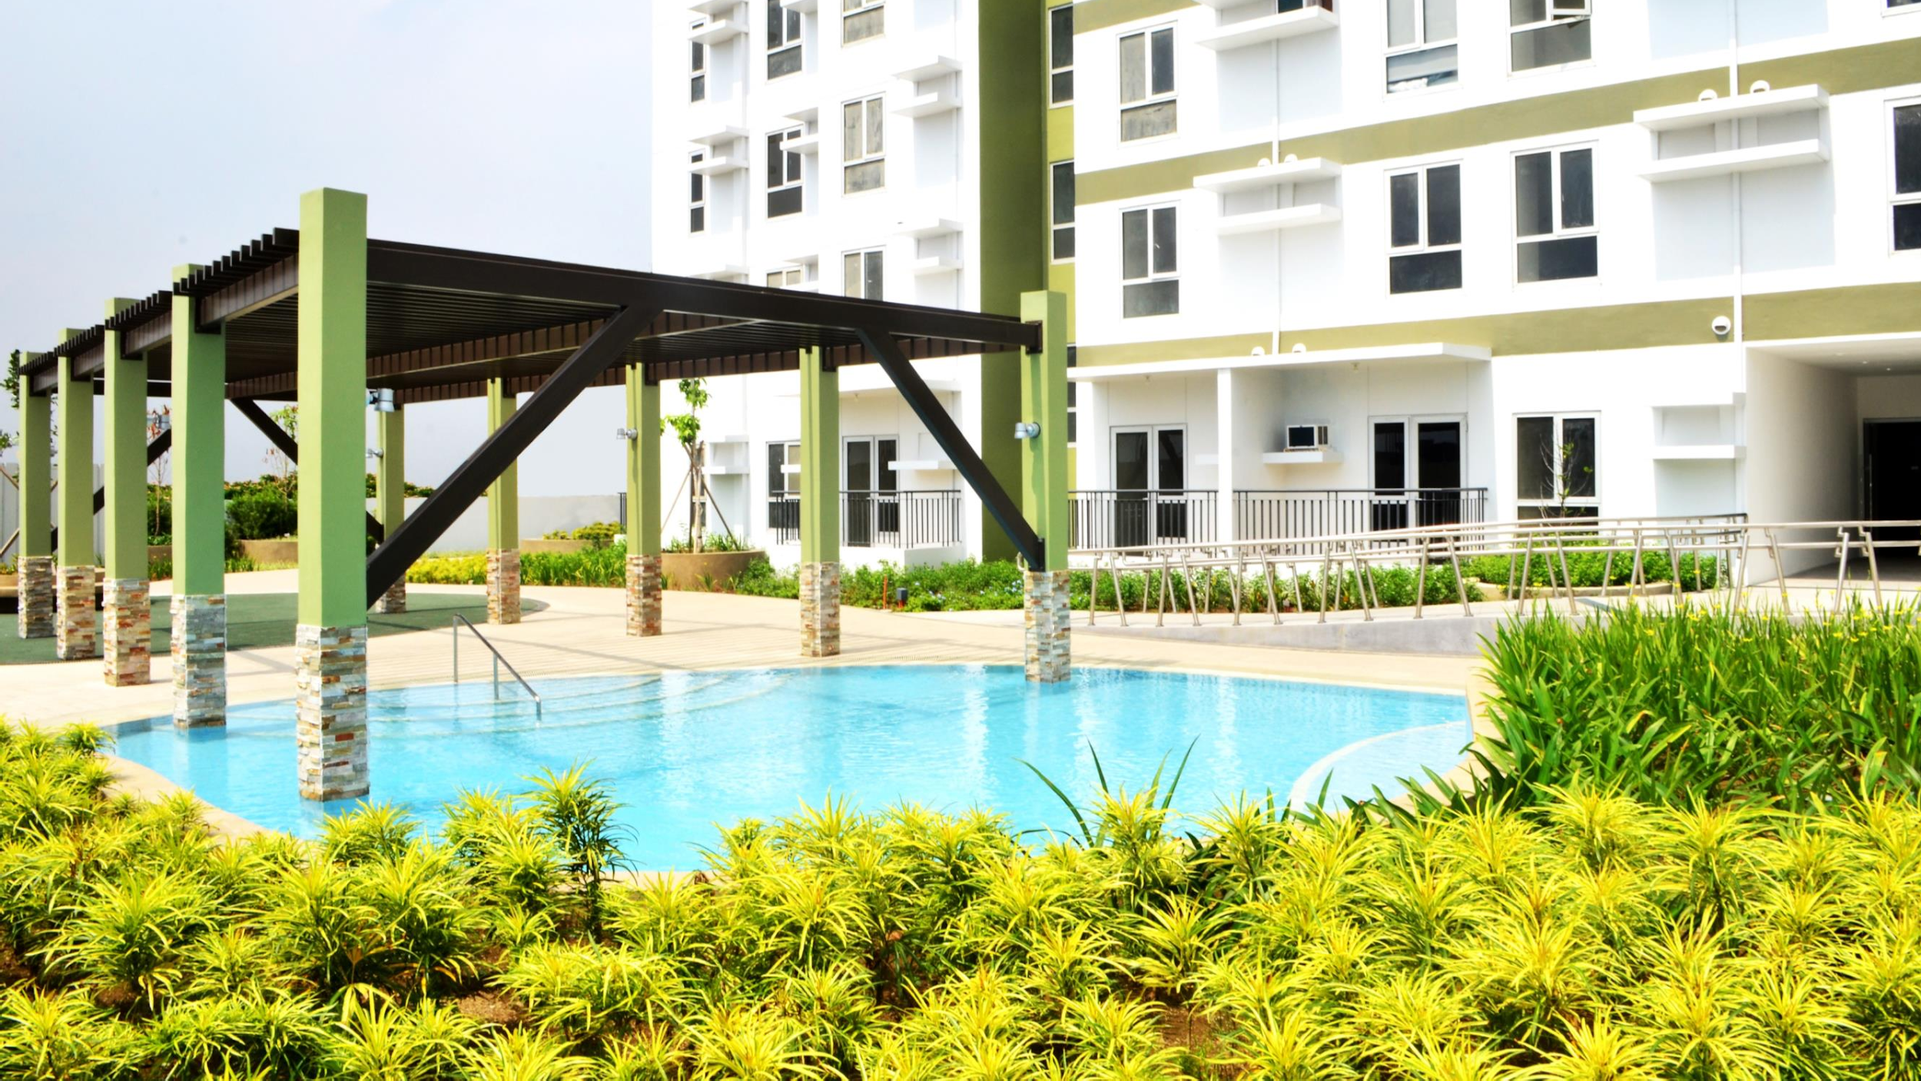
KIDDIE POOL

Slide 20
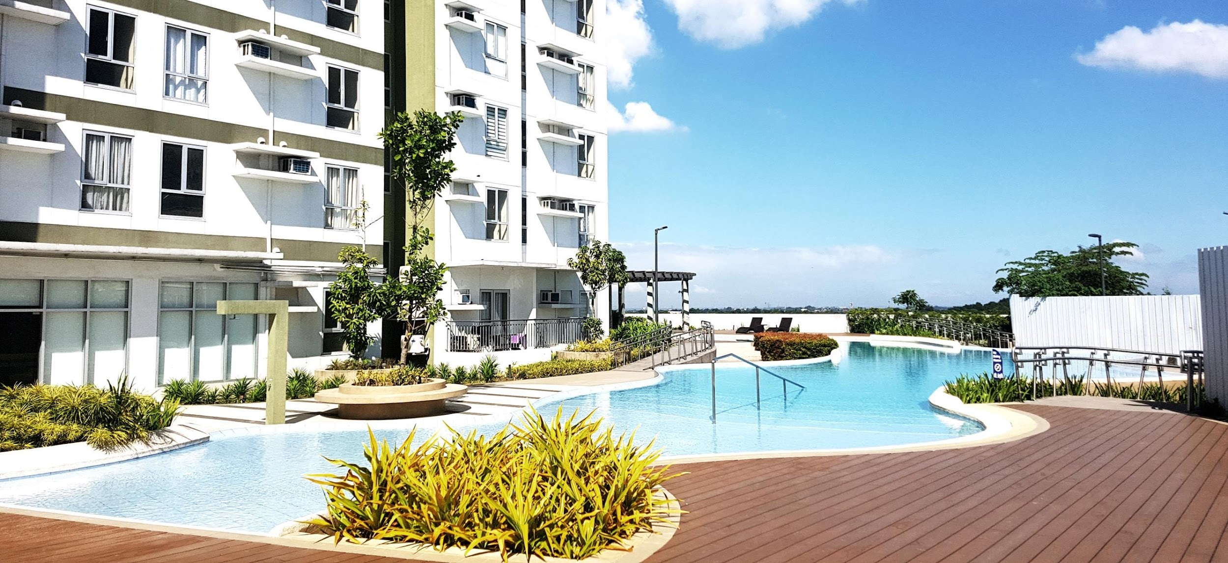
ADULT POOL
Adult Pool

Slide 21
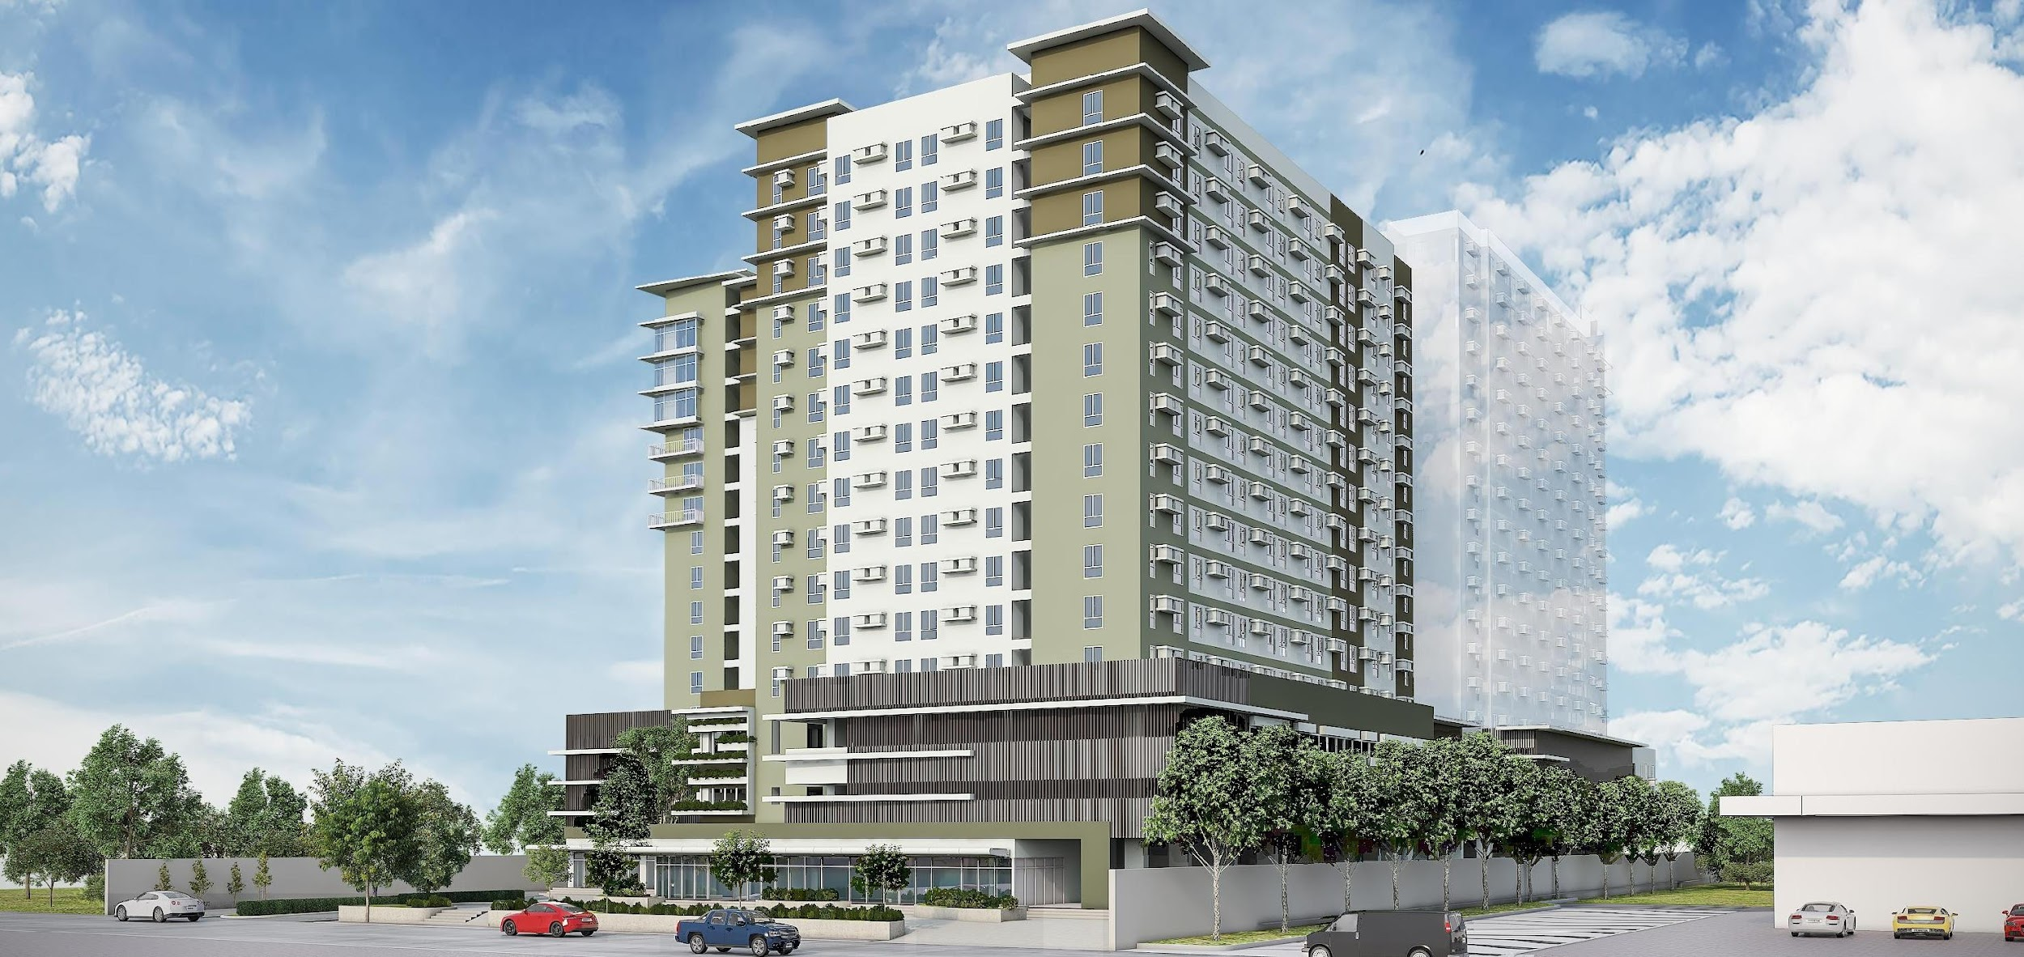
NOW SELLING TOWER 2

Slide 22
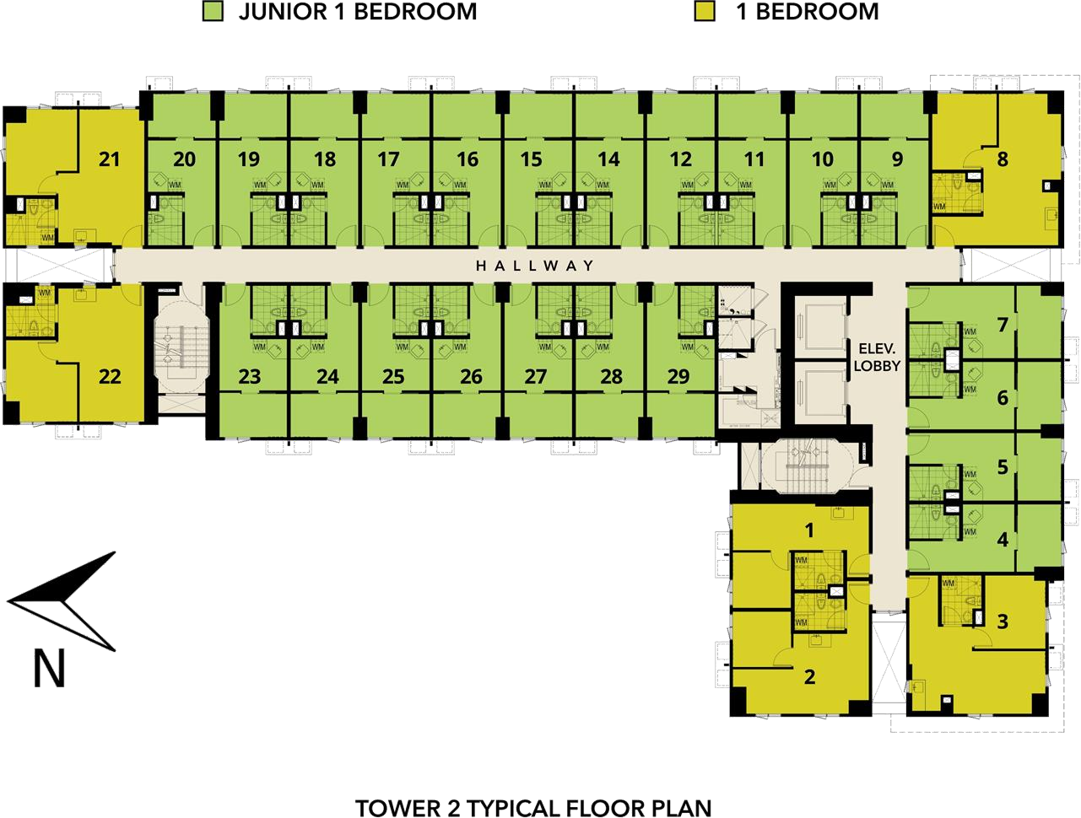
TOWER 2
UNIT MIX
Unit Type | Area | Units | Percentage
Junior 1 BR | 22.6 sqm | 263 | 79%
1 BR | 37.7 sqm | 72 | 21%
Total |  |  | 100%

Slide 23
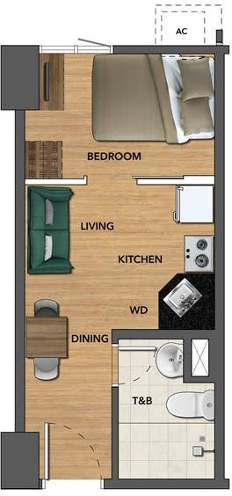
TYPICAL JUNIOR 1 BR
FLOOR PLAN (T2)
Breakdown | Area in sqm. | Area in sq.ft.
Living / Dining / Kitchen | 11.50 | 123.76
Toilet & Bath | 4.10 | 44.13
Bedroom | 7.00 | 75.35
Total Area | 22.6 | 243.24

Slide 24
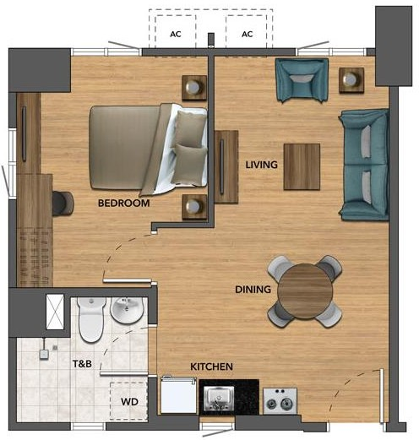
TYPICAL 1 BR
FLOOR PLAN (T2)
Breakdown | Area in sqm. | Area in sq.ft.
Living / Dining / Kitchen | 24.50 | 263.72
Toilet & Bath | 4.80 | 51.67
Bedroom | 8.40 | 90.42
Total Area | 37.7 | 405.81

Slide 25
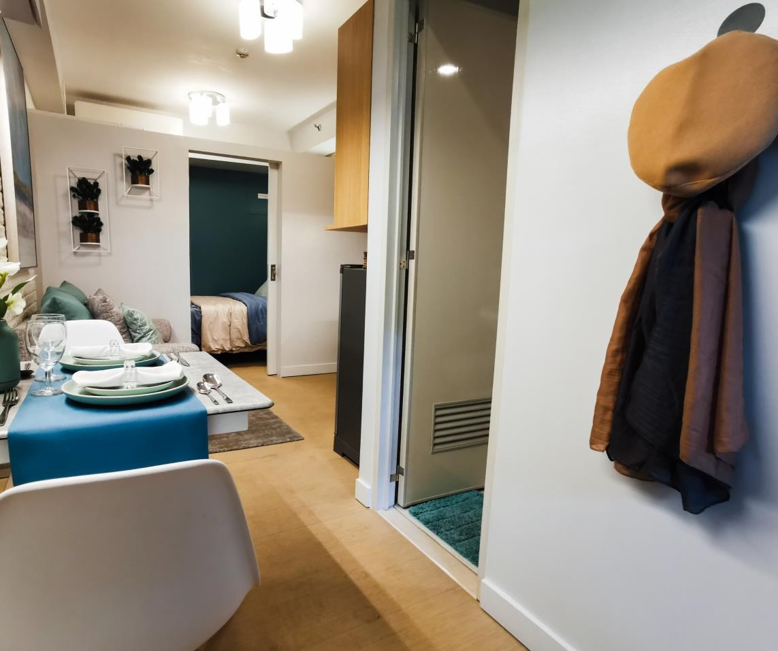
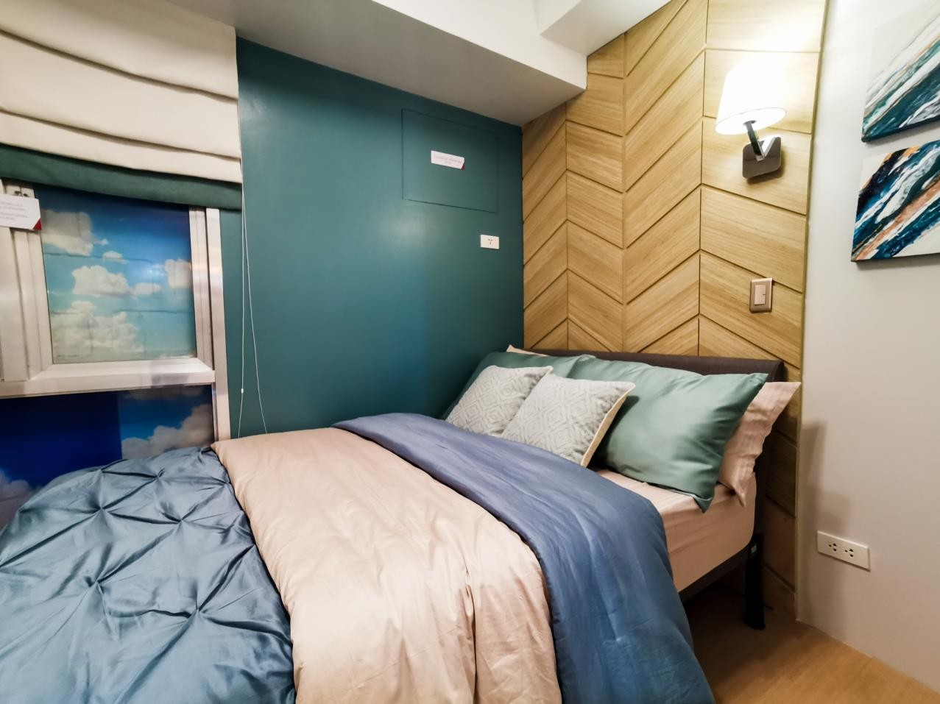
JUNIOR 1 BR MODEL UNIT
LIVING/DINING AREA
BEDROOM

Slide 26

Why buy at

Slide 27
A TRUSTED BRAND
Developed by Avida Land, a subsidiary of Ayala Land
Almost 30 years of experience in developing masterplanned
communities
Building code compliant
100% budgeted
Complies with Ayala standard of quality (Design Council)
Sure
For presentation purposes only as of January 2020

Slide 28
VALUE APPRECIATION
Secured Living Experience
  24/7 security
  CCTV in common areas
  Well-maintained facilities
Land Value appreciation
  Located in Quezon City, one of the most progressive cities in
NCR
Secure
For presentation purposes only as of January 2020

Slide 29
Sensible
VALUE FOR MONEY
Highly accessible location
Well-planned development
  Well maintained amenities
Efficiently-designed units
Entry to an Ayala Land lifestyle
For presentation purposes only as of January 2020

Slide 30


Thank you!
www.avidaland.com

