Slide 2
Notes:
So before we discuss about our project in the buzzling city of Sta. Rosa in the dynamic province of Laguna, Calm Residences…
let me talk about the latest development format of SMDC, your very own eden…

Slide 3
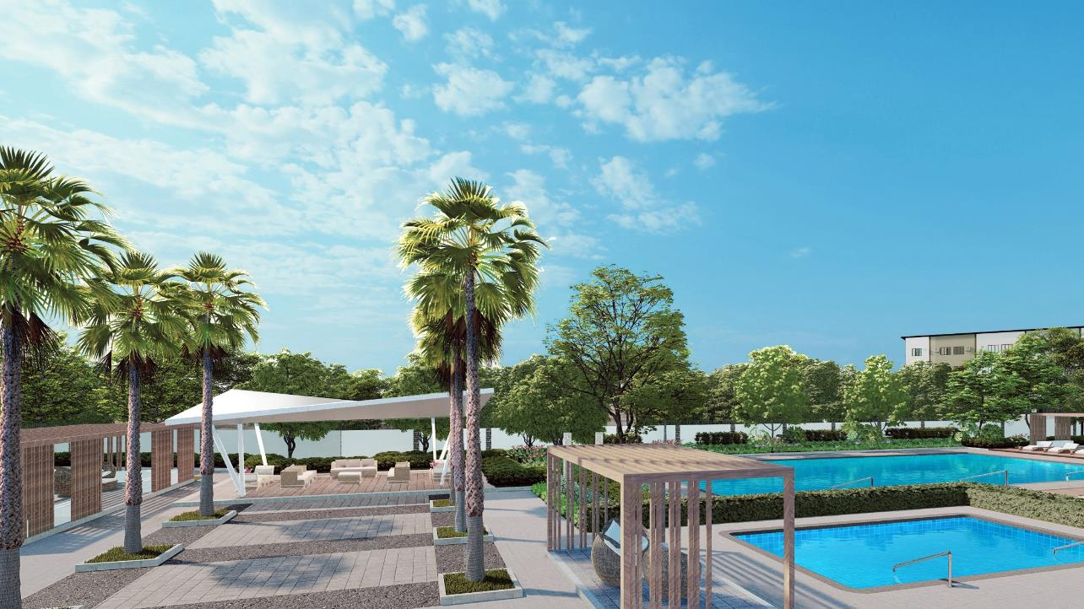
YOUR VERY OWN EDEN
We at SMDC welcome you to your very own Eden.
Your new home is a bastion of tranquility amid the busy and highly progressive city of Santa Rosa, Laguna. A suburban garden community conveniently located right across WalterMart Santa Rosa that is complete with our trademark resort-inspired amenities, hotel-like lobbies, open parks, and play spaces, strong Wi-Fi access, transport-oriented development, and integrated commercial spaces.
Enjoy the peace and quiet of living in a professionally managed community with your safety and security in mind and relish the calm and soothing atmosphere all around that will make you feel like you're living in paradise.
Sit back, relax and embrace the serenity of your own home by the garden at Calm Residences.
Notes:
YOUR VERY OWN EDEN
We at SMDC welcome you to your very own Eden.
Your new home is a bastion of tranquility amid the busy and highly progressive city of Santa Rosa, Laguna. A suburban garden community conveniently located right across WalterMart Santa Rosa that is complete with our trademark resort-inspired amenities, hotel-like lobbies, open parks, and play spaces, strong Wi-Fi access, transport-oriented development, and integrated commercial spaces.
Enjoy the peace and quiet of living in a professionally managed community with your safety and security in mind and relish the calm and soothing atmosphere all around that will make you feel like you're living in paradise.
Sit back, relax and embrace the serenity of your own home by the garden at Calm Residences.

Slide 4
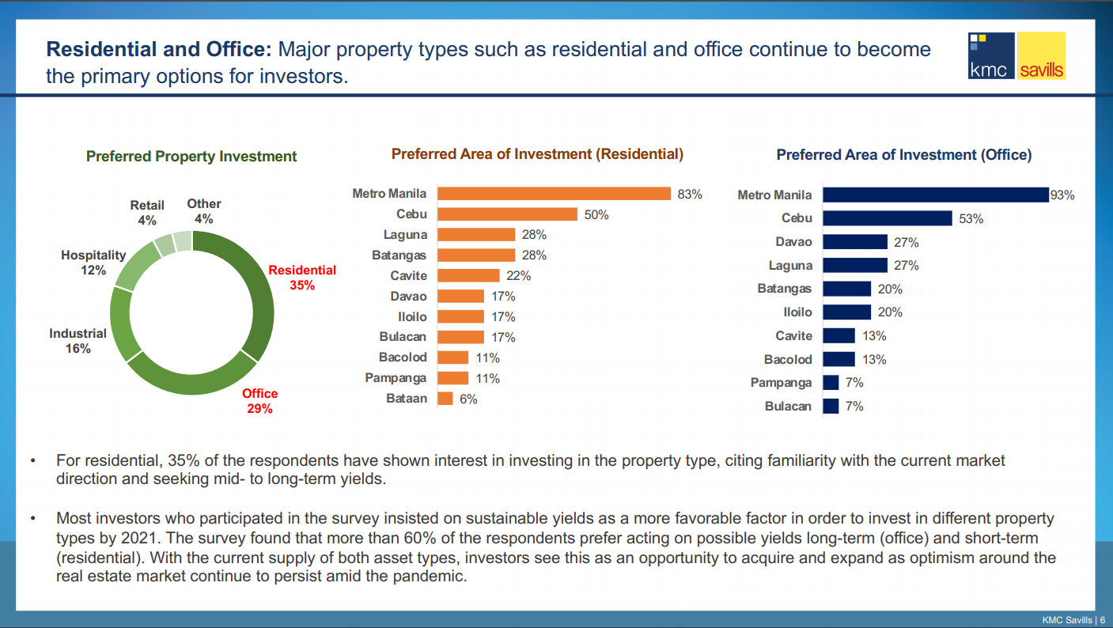
PROVINCE OF LAGUNA
Notes:
So now, let’s move over to the progressive province of Laguna.
Laguna continues to thrive by having large parcels of industrial parks, township developments and government infrastructure projects. This province south of Metro Manila offers some of the investment-worthy properties in this part of the Philippines
As real estate developers continue to decentralize Metro Manila by bringing their expertise to the provinces, we see more activity in places being prioritized for their potential as new investment hubs. One such rural location is Laguna, whose proximity to the National Capital Region makes it a hotspot both for property giants looking for new areas to develop, as well as buyers wishing for a first (or second) home that marries proximity to the metro and the peacefulness of rural living.

Slide 5
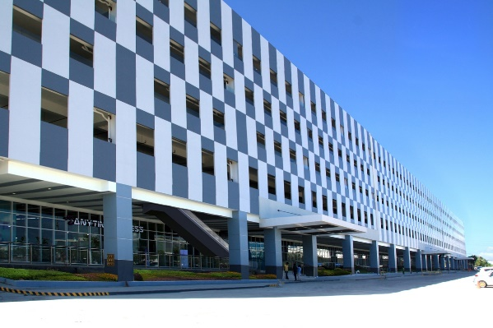
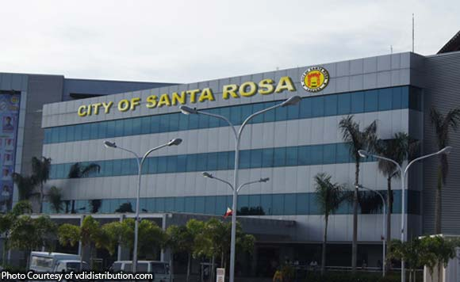
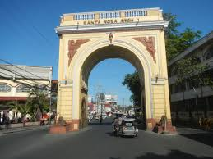
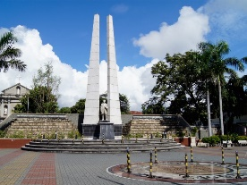
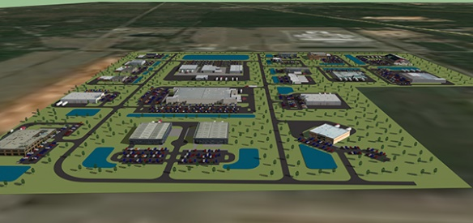
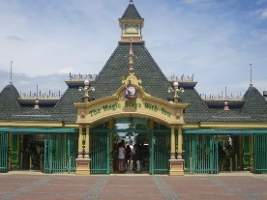
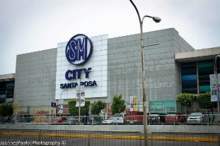
THE LION CITY OF SOUTH LUZON:
CITY OF SANTA ROSA
Investment hub of South Luzon
4 PEZA Accredited Economic Zone
Motor City of the Philippines
IT Hub of Region IV-A: 82nd in the world competitiveness in IT and BPO (THOLONS)
Vibrant, Booming and Fastest Growing Economy
Growing Residential Demand
Close Proximity to Metro Manila
Source:
https://santarosacity.gov.ph/invest-in-santa-rosa/investment-profile/
Notes:
The city of Sta Rosa or more commonly known as the “Lion City of South Luzon” or the “Detroit City of the Philippines” is a first class city that is an investment hub of southern Luzon.
It has 4 PEZA accredited economic zones. This city has Laguna Techno Park, Greenfield Automotive Park, Toyota Special Economic Zone, Lakeside Evozone Nuvali, Daystar Santa Rosa Industrial Park and the Meridian Industrial Complex.
95% of Philippine’s automotive industry is being produced in Sta Rosa like Nissan, Toyota, Honda and Mitsubishi Philippines.
Tholons also named Sta Rosa as the 82nd in the world competitive in IT and BPO because of the multinational companies who placed their offices here such as Convergys, KGB, Teletech, IBM, Concentric and Ubisoft to name a few.
These are the reasons for the buzzling economic growth and growing residential demand in this progressive city of Sta Rosa…
First class city
Industrial Parks:
Laguna Technopark Inc.
Greenfield Automotive Park
Toyota Special Economic Zone
Lakeside Evozone Nuvali
Daystar Santa Rosa Industrial Park
Meridian Industrial Complex
95% of Ph’s automotive industry: Nissan, Toyota, Honda, Mitsubishi
Malls: SM, Rob, Ayala Solenad, Vista, Paseo
BPO: Convergys, KGB, Teletech, IBM, Concentrix, Ubisoft

Slide 6
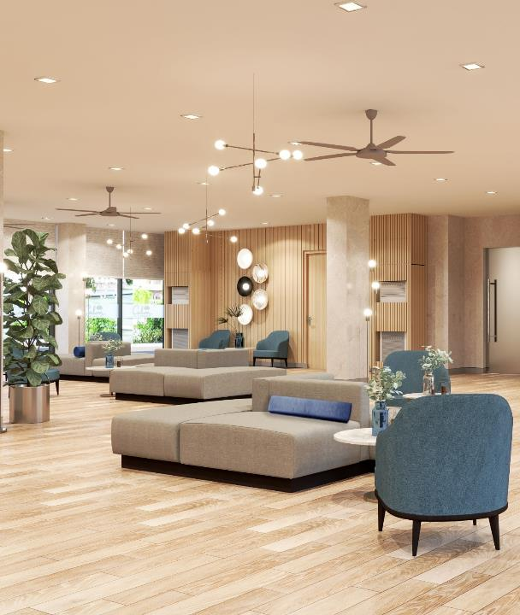
An exclusive, gated tranquil community in the midst of the highly progressive city of Sta. Rosa, Laguna.
Calm Residences is a suburban walkable garden community with easy access to commercial spaces and transport hubs. It features interconnected linear parks, complete resort styled amenities and sports facilities, hotel-like lobbies and lounges with strong Wi-Fi connections for families and working professionals who long to live in a safe, secure and tranquil home for him and his family.
Plans, pricing and details subject to change without prior notice. This material is not for reproduction or distribution without prior consent of the developer.
Notes:
Having said all of these progress and developments in the buzzing city of Sta. Rosa, Laguna, people are definitely looking for an ESCAPE. An escape from their hectic days at work and an escape from their children’s active schedule at school. They need a place that they can call their own. A place where they can relax and savor each moments with their families.
That is why we are introducing to you our latest residential complex development in this vibrant city, Calm Residences…
Calm Residences is an exclusive, gated tranquil community in the midst of the highly progressive city of Sta. Rosa, Laguna. Calm Residences is a suburban walkable garden community with easy access to commercial spaces and transport hubs. It features interconnected linear parks, complete resort styled amenities and sports facilities, hotel-like lobbies and lounges with strong Wi-Fi connections for families and working professionals who long to live in a safe, secure and tranquil home for him and his family.

Slide 7
An exclusive, gated tranquil community in the midst of the highly progressive city of Sta. Rosa, Laguna. Calm Residences is a suburban walkable garden community with easy access to commercial spaces and transport hubs. It features interconnected linear parks, complete resort styled amenities and sports facilities, lobbies and lounges with strong Wi-Fi connections for families and working professionals who long to live in a safe, secure and tranquil home for him and his family.
CALMING SUBURBAN GARDEN COMMUNITY
Lush gardens and open spaces that will provide relaxing environment and contributes to a healthy lifestyle that enhances productivity and creativity.
Ample linear parks that allow breathable and greenery views between buildings that provides natural light flow through units.
Complete amenities for physical and recreational activities that promote camaraderie and healthy lifestyle to all residents.
Resort-styled swimming pools surrounded by greeneries for a refreshing family bonding activities
Safe and secure environment
IDEAL HOMES FOR WORKING FAMILIES
Serene environment that provides utmost relaxation after busy days of work.
Strategically positioned along the enterprise belt of Sta Rosa, Laguna that upholds more quality family time.
Near schools, malls and theme parks for immediate family needs and entertainment.
Child-friendly community that feature ample open play area for kids to enjoy.
Complete resort-styled amenities and recreational facilities for family bonding activities.
Safe and secure community for kids and adults.
SUSTAINABLE MASTER-PLANNED DEVELOPMENT
Well-connected, well-planned, walkable and eco-friendly development.
Walking distance to a mall, theme park and business parks in Sta Rosa for a more convenient lifestyle.
Complete development that will feature an integrated commercial area that will provide the immediate needs of the residents and will reduce carbon footprint.
Bike-friendly community
SMDC’s continues community development programs that promotes a sense of community and camaraderie in the neighborhood.
Thorough flood, traffic, geo-resistivity and soil study to ensure a safe, earthquake resistant and flood-free development.
Safe and secured community that will be managed by a professional property management team.
A LUCRATIVE INVESTMENT
Minimal capital investment thru affordable and flexible payment terms that will provide maximum returns thru rental and property value appreciation.
Complete and connected residential communities will always command high real estate value
Exceptional upkeep and management of the community will ensure that the investment will last a lifetime, and will appreciate over time
A home investment for leasing that will cater to the local upgraders, working professionals and expats from the highly industrialized city of Sta. Rosa
Can be used as serviced-apartment for expats and local staycasioners.
Convenient and hassle-free leasing services
Plans, pricing and details subject to change without prior notice. This material is not for reproduction or distribution without prior consent of the developer.
Notes:
Here are the reason why Calm Residences is the most ideal and serene community in the midst of the buzzling city of Sta Rosa.
First, CALMING SUBURBAN GARDEN COMMUNITY
It offers lush gardens and open spaces that will provide relaxing environment and contributes to a healthy lifestyle that enhances productivity and creativity.
Calm Residences also features complete resort-styled amenities and recreational facilities that promote camaraderie and healthy lifestyle to all residents.
Second, IDEAL HOMES FOR WORKING FAMILIES
It provides a serene environment for utmost relaxation after busy day of work.
Calm Residences is strategically positioned along the enterprise belt of Sta Rosa, that upholds more quality time for the family
A community that is in close proximity to schools, malls and theme parks for every families needs and leisure.
A child-friend community that is safe and secure.
Third, SUSTAINABLE MASTER-PLANNED DEVELOPMENT
Calm Residences is well-connected, well-planned, walkable, bike-friendly and nature-oriented development
Also, SMDC’s continues community development programs that promotes a sense of community and camaraderie in the neighborhood.
Calm Residences is a safe and secure community that will be professionally managed by a professional property management team
And lastly, Calm Residences is A LUCRATIVE INVESTMENT
With minimal investment thru SMDC’s affordable and flexible payment terms, your investment will surely gain maximum returns thru rental business and fast property value appreciation.
A Complete and connected residential community will always command high real estate value
An exceptional upkeep and management of the community will ensure that the investment will last a lifetime, and will appreciate over time
And lastly, we will provide a convenient and hassle-free leasing services thru SMDC Leasing
-next slide

Slide 8
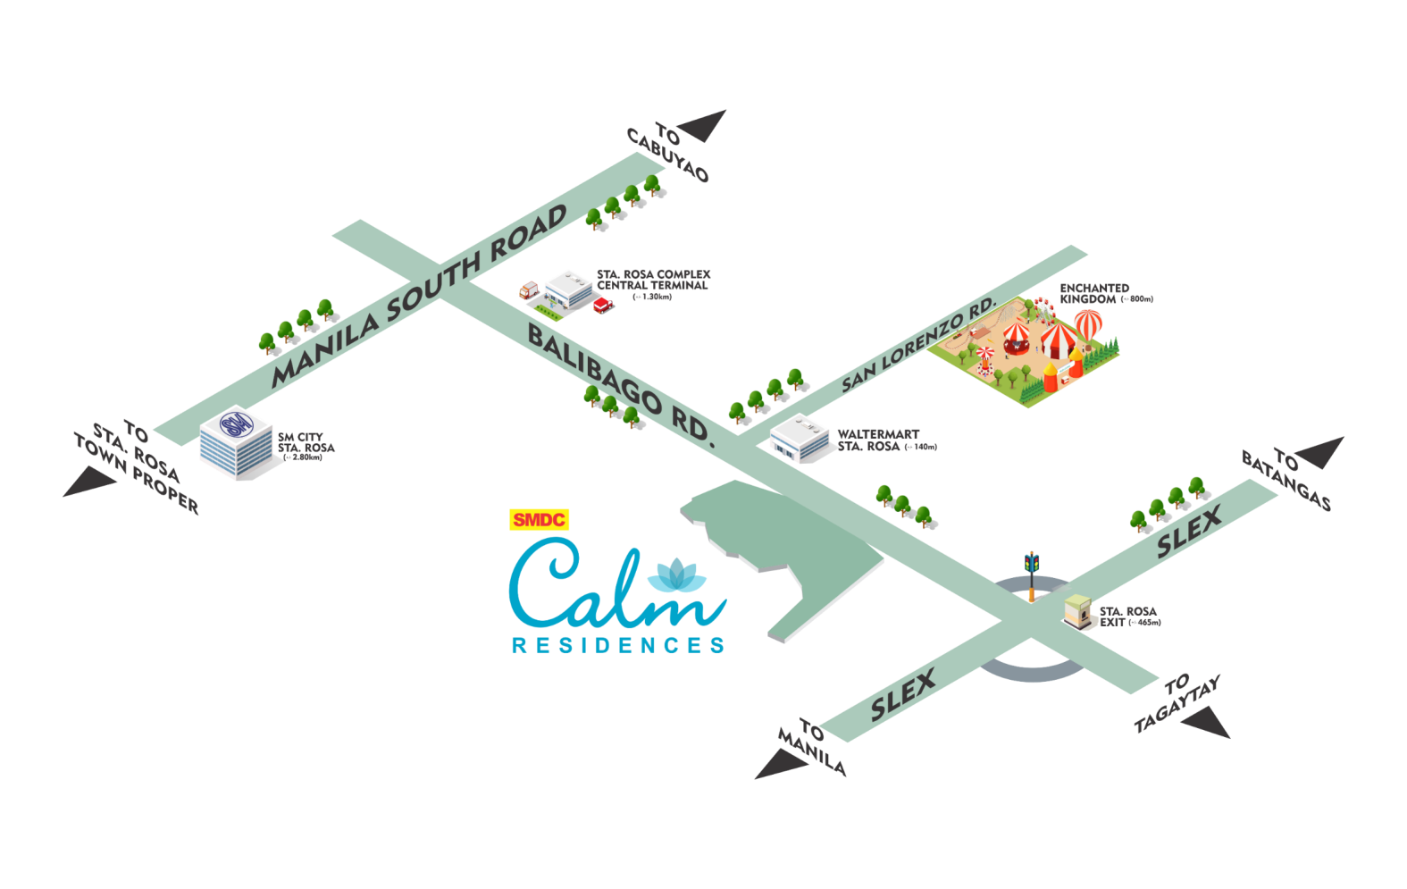
VICINITY MAP
SHOPPING & LEISURE
WalterMart Santa Rosa – Balibago: +/-0.30 kms
Enchanted Kingdom: +/- 1.10 kms
Robinsons Santa Rosa: +/- 5.10 kms
SM City Santa Rosa: +/- 6.30 kms
Vista Mall Santa Rosa: +/- 6.70 kms
Ayala Malls Solenad: +/- 7.20 kms
HOSPITALS
Sta. Rosa Hospital and Medical Center: +/- 0.45 kms
Citi Medical Hospital: +/- 0.65 kms
High Precision Sta. Rosa: +4.1 kms
St. james Hospital: +/- 4.50 kms
Medical City South Luzon: +/- 6.00 kms
SCHOOLS
Laguna Northwestern College: +/- 055 kms
Dominican College of Sta. Rosa: +/- 1.40 kms
Green Fields Integrated School of Laguna, Inc.: +/- 1.90 kms
Our Lady of Assumption College: +/- 3.30 kms
De La Salle University – Laguna Campus: +/- 8.90 kms
Xavier School Nuvali: +/- 11.20 kms
INDUSTRIAL PARKS
Meridian Industrial Complex: +/- 1.10 kms
Daystar Industrial Park: +/- 2.20 kms
Toyota Motor Philippines: +/- 2.70 kms
Greenfield Auto Park: +/- 6.50 kms
Lakeside Evozone: +/- 8.00 kms
Laguna Technopark Inc.: +/- 9.30 kms
Plans, pricing and details subject to change without prior notice. This material is not for reproduction or distribution without prior consent of the developer.
Notes:
Calm Residences is strategically located few meters away from the Sta Rosa – SLEX Exit right along the Balibago – Sta. Rosa - Tagaytay Road. This road is the enterprise belt of Sta Rosa composed of malls, schools, BPO offices and industrial parks. This simply means that all of the life essentials are just within reach from Calm Residences and that will give you more quality time with your family to enjoy a tranquil lifestyle.

Slide 9
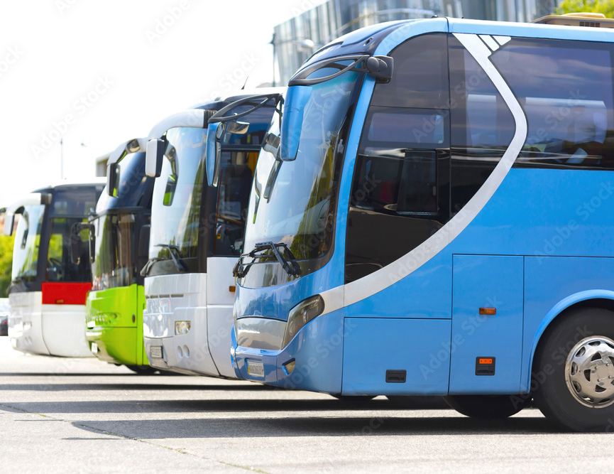
COMMUTER FRIENDLY COMMUNITY
SANTA ROSA INTEGRATED TERMNAL
(3.8 kms)
Bus Routes:
Novaliches, Quezon City by Dela Rosa Transit
Malanday, Valenzula by King of Kings Transport
Prieto Diaz, Bicol by Philtranco
Tabaco, Bicol by Philtranco
Legaspi, Bicol by Philtranco
Silago, Leyte by Philtranco
Ormoc, Leyte by Philtranco
Daet, Camarinez Norte by Philtranco
Naval by Philtranco
Sawang by Philtranco
SM City Lucena, Quezon by DLTB Co.
BALIBAGO COMPLEX TERMINAL
(1.7 kms)
Bus Routes:
Tagaytay
Sta Cruz, Laguna
San Pablo City
Alabang
Cubao – EDSA
LRT Buendia
Lawton
SANTA ROSA INTEGRATED TERMNAL
Jeepney Routes:
Alabang
Muntinlupa
San Pedro, Laguna
Binan, Laguna
Santa Rosa, Laguna
Cabuyao, Laguna
Calamba, Laguna
SANTA ROSA INTEGRATED TERMNAL
UV Express Routes:
SM Molino
SM Bacoor
SM Calamba
Savemore Tagaytay
SM City Manila
SM San Lazaro
SM Cubao
SM Marikina
SM Masinag
SM Taytay
SM Aura
SM Lipa
SM batangas
SM San mateo
SM Southmall
SM Tanza
SM Bicutan
SM BF
SM Sucat
Lucban
Pala-pala
https://www.phbus.com/santa-rosa-laguna-integrated-bus-terminal/
Plans, pricing and details subject to change without prior notice. This material is not for reproduction or distribution without prior consent of the developer.
Notes:
Calm Residences is a commuter friendly community. It is very near to major transport hubs that can bring you to different parts of Metro Manila, Laguna, Tagaytay, Cavite, all the way to Batangas, Quezon Bicol and other parts of Leyte thru RoRo tranit-oriented bus. RoRo means, Roll-on, Roll-off that specially designed ships for carrying wheeled cargo such as cars, trucks and buses.
Shown on your screen are the available routes of major public transportation services that can be found in Balibago Complex Bus Terminal which is approximately 1.7 kms away from Calm Residences.
And of course, the Santa Rosa Integrated Terminal in SM Santa Rosa Lifestyle Complex, approximately 3.8 kms from Calm Residences.

Slide 10
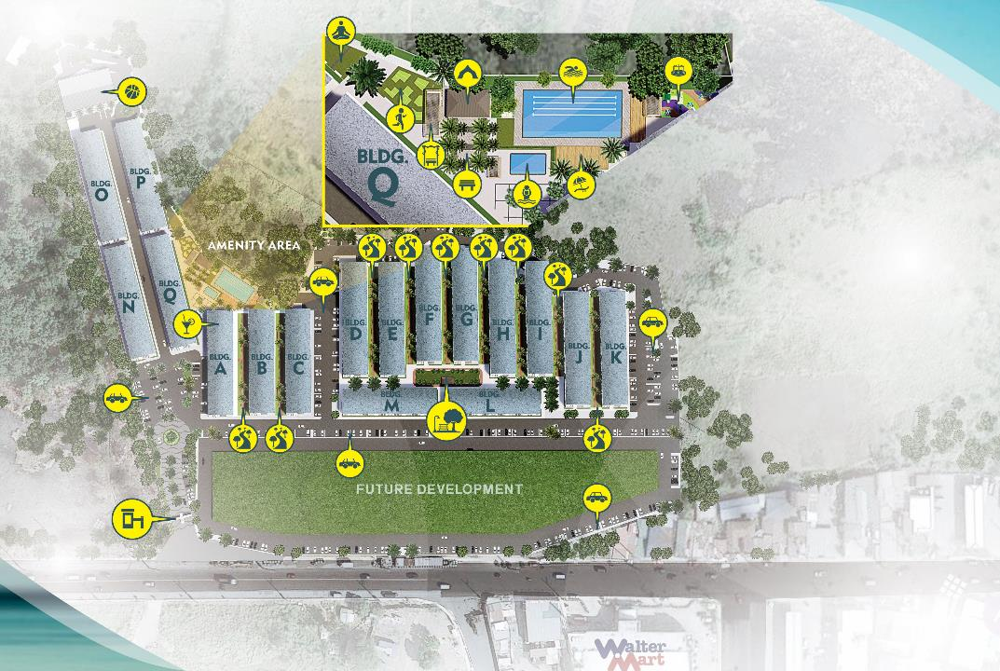
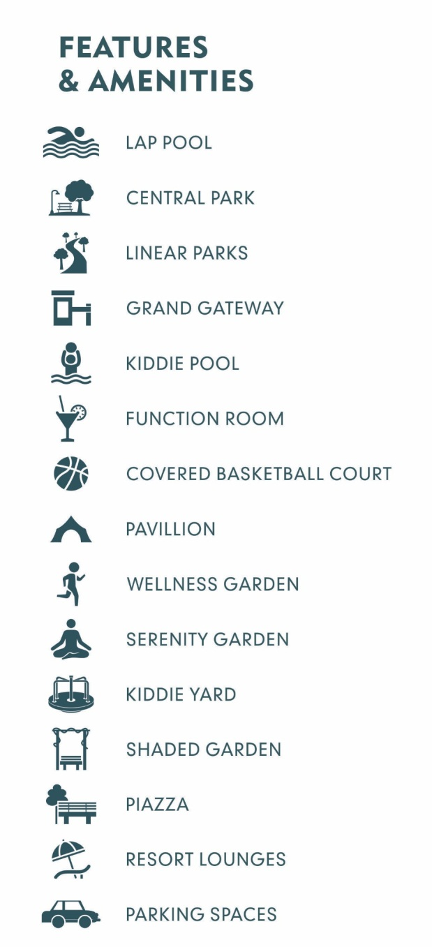
Notes:
Shown on your screens is the Site Development of Calm Residences where you can see the list of amenities that you can choose from to live a healthy and tranquil lifestyle.
Now, let’s discuss each amenities of Calm Residences one-by-one…

Slide 11
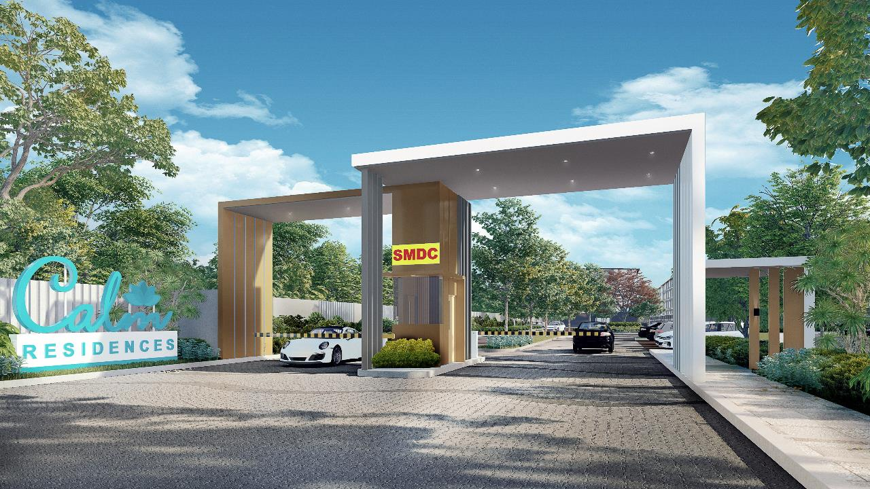
GRAND GATEWAY ARTIST’S PERSPECTIVE
Plans, pricing and details subject to change without prior notice. This material is not for reproduction or distribution without prior consent of the developer.
Notes:
Welcome to Calm Residences…
After your hectic days at work, you can now enjoy the refreshing amenities at Calm Residences. This will give you a healthier and calming lifestyle for you and your family to savor.
Upon entering this safe and secure development, you will be greeted by our security officers that are always ready to protect this tranquil neighborhood 24 hours a day and 7 days a week.
This development is also a bike-friendly community surrounded by bike and jogging paths with designated bike racks to encourage our residents not just to bike within the community but also to reduce carbon foot print by using their bicycles in going to nearby places instead of using public transportation or driving their own cars.
Residents of Calm Residences will feel that they live in a secured premium homes in a sustainable community that will meet their needs as a start-up family or for residents living on their own.

Slide 12
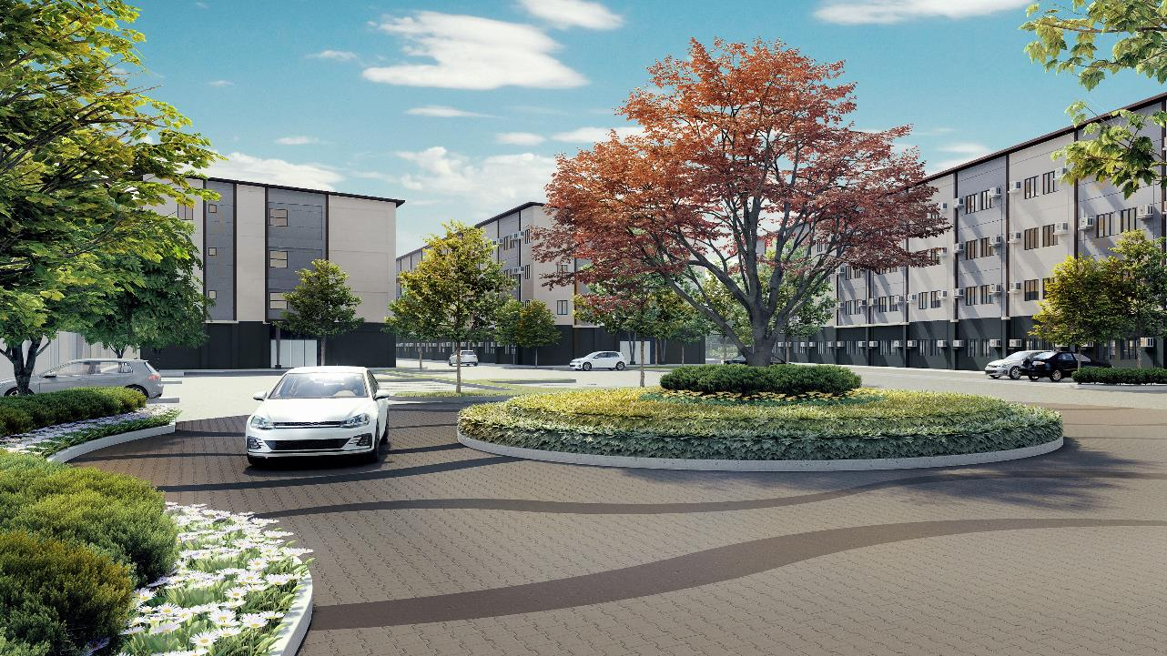
GRAND ROTUNDA ARTIST’S PERSPECTIVE
Plans, pricing and details subject to change without prior notice. This material is not for reproduction or distribution without prior consent of the developer.
Notes:
Another refreshing welcome upon entering this community is our grand rotunda that is full of endemic plants and trees to provide us with refreshing atmosphere .

Slide 13
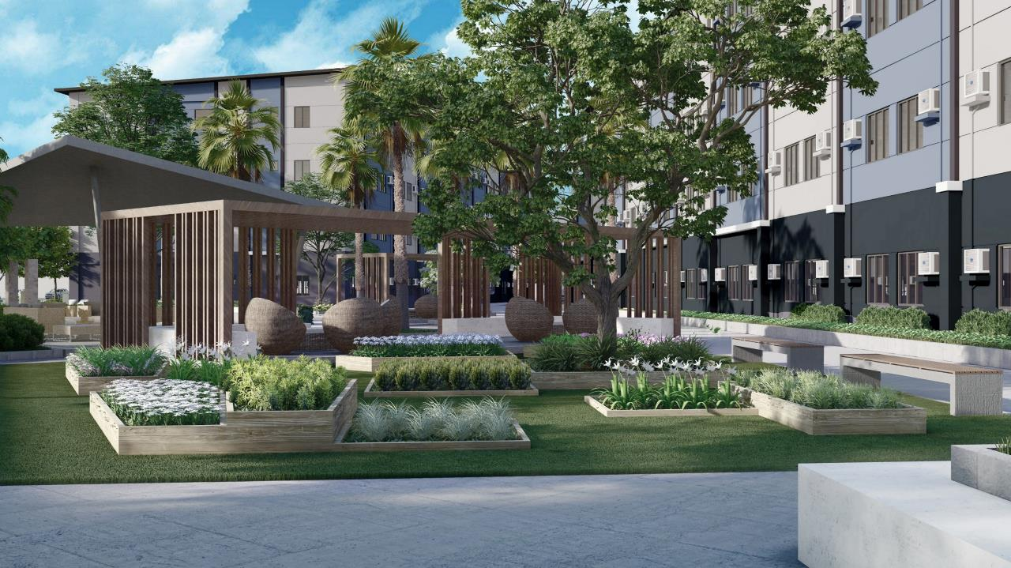
SERENITY GARDEN ARTIST’S PERSPECTIVE
Plans, pricing and details subject to change without prior notice. This material is not for reproduction or distribution without prior consent of the developer.
Notes:
Live healthy by enjoying fresh natural air in our serenity garden.
This garden is surrounded by fresh herb plans that are truly refreshing and rejuvenating.

Slide 14
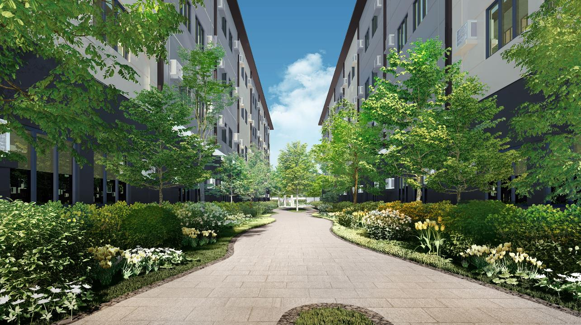
LINEAR PARK ARTIST’S PERSPECTIVE
. Plans, pricing and details subject to change without prior notice. This material is not for reproduction or distribution without prior consent of the developer.
Notes:
Our linear parks allow breathable and greenery views between buildings that provides natural light flow through units. This contributes to a healthy lifestyle that enhances productivity and creativity.
As part of the green spaces, there are also planting areas that have shade tolerant plants and fruit bearing trees that gives visual pleasure to the people.

Slide 15
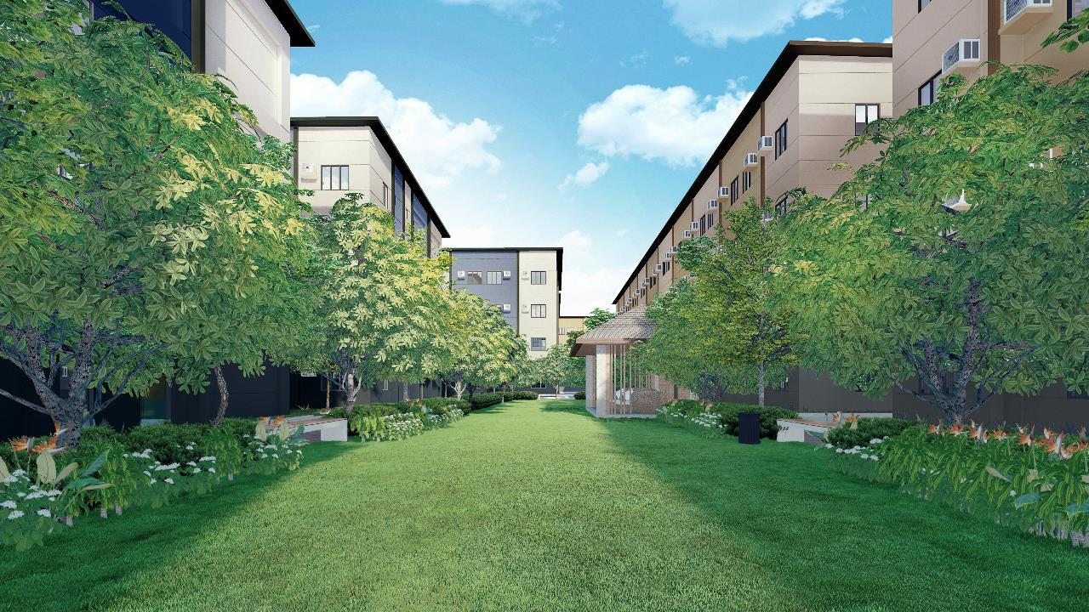
CENTRAL GARDEN ARTIST’S PERSPECTIVE
Plans, pricing and details subject to change without prior notice. This material is not for reproduction or distribution without prior consent of the developer.
Notes:
Surrounded with lush gardens, this is a healthy place to breathe fresh air. Our central garden is an ideal area for different family or individual activities to commune with nature.

Slide 16
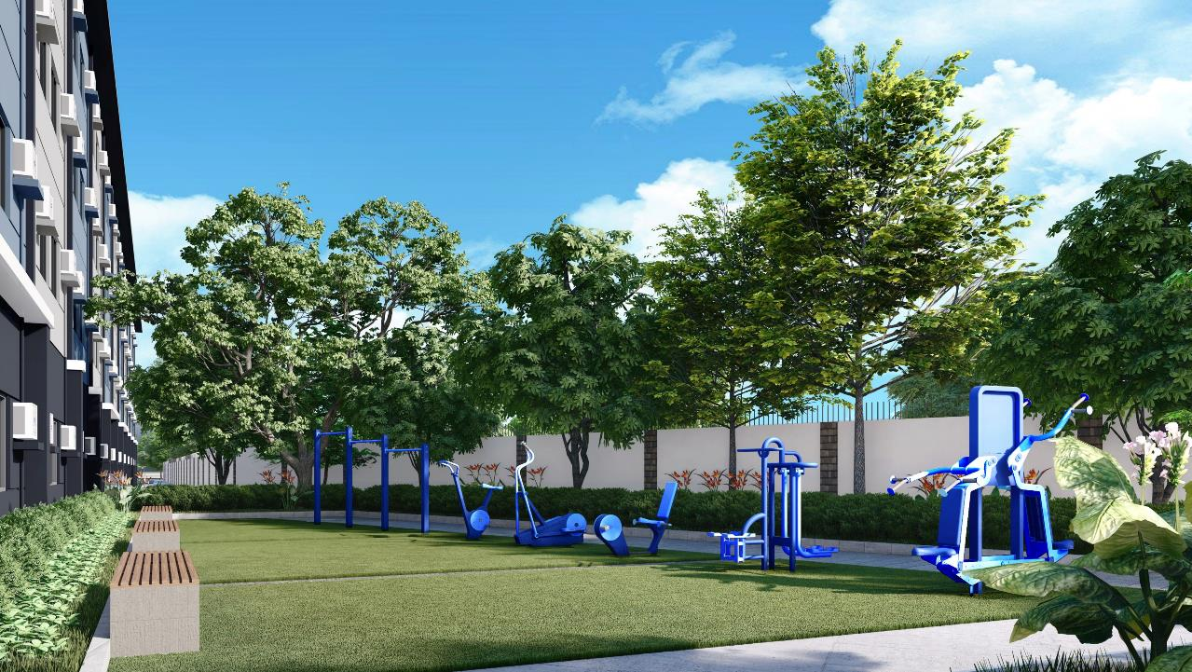
WELLNESS GARDEN ARTIST’S PERSPECTIVE
Plans, pricing and details subject to change without prior notice. This material is not for reproduction or distribution without prior consent of the developer.
Notes:
Now, if you want to be more physically fit and healthy, we have our wellness garden that is equipped with outdoor gym equipment. This area is also perfect for outdoor workouts such as yoga, zumba and tai chi. A healthy environment to enjoy your physical workouts while communing with nature…

Slide 17
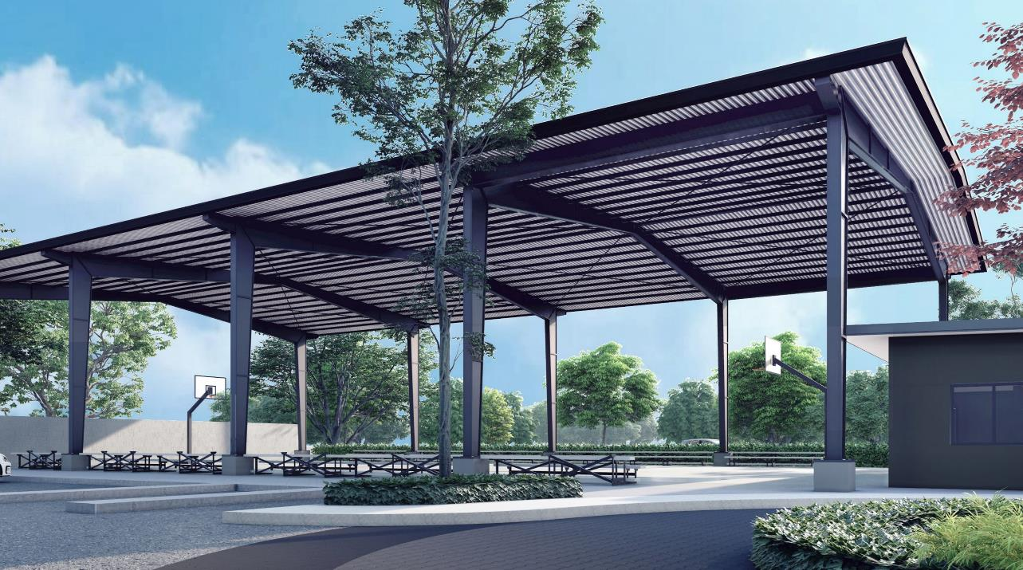
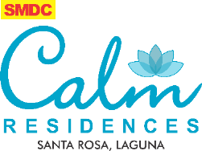
COVERED BASKETBALL COURT ARTIST’S PERSPECTIVE
Plans, pricing and details subject to change without prior notice. This material is not for reproduction or distribution without prior consent of the developer.
Notes:
We also have a covered basketball court where you can play ball with your family, friends and neighbors anytime of the day.

Slide 18
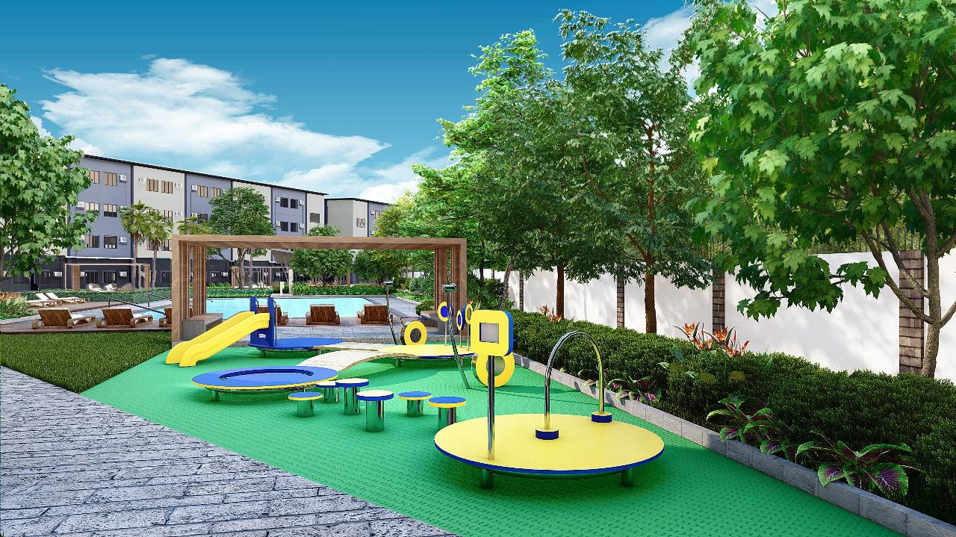
KID’S ZONE ARTIST’S PERSPECTIVE
KID’S ZONE ARTIST’S PERSPECTIVE
Plans, pricing and details subject to change without prior notice. This material is not for reproduction or distribution without prior consent of the developer.
Notes:
Calm Residences is a family-oriented and child-friendly community. We provide specific amenities for our children to enjoy their childhood by playing and interacting with other kids. This is our kid’s zone…

Slide 19
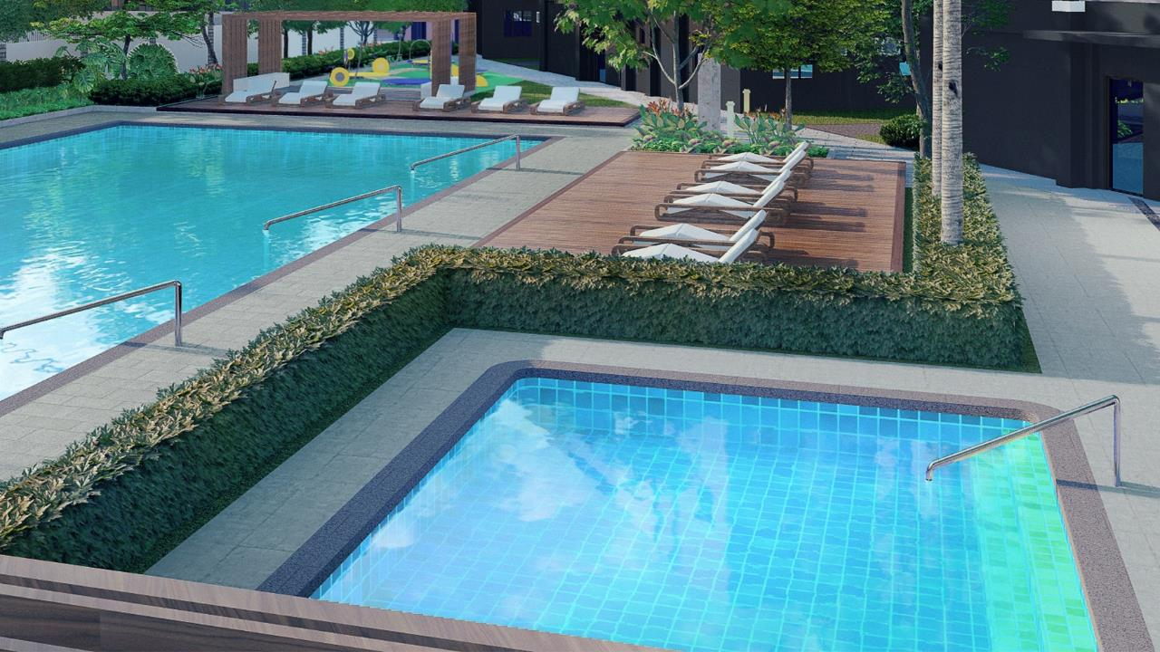
KIDDIE POOL ARTIST’S PERSPECTIVE
Plans, pricing and details subject to change without prior notice. This material is not for reproduction or distribution without prior consent of the developer.
Notes:
And our kiddie pool for them to paddle and enjoy the refreshing waters.

Slide 20
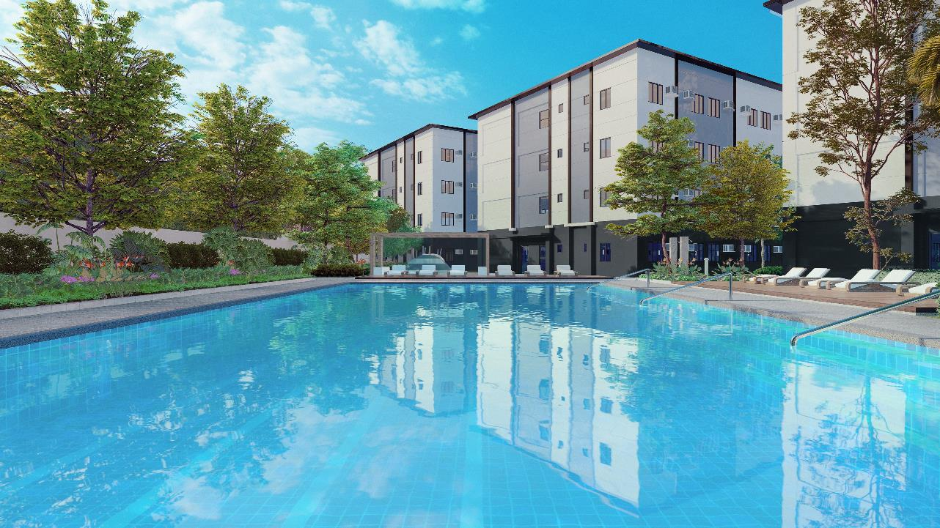
SWIMMING POOL ARTIST’S PERSPECTIVE
Plans, pricing and details subject to change without prior notice. This material is not for reproduction or distribution without prior consent of the developer.
Notes:
We also have our resort-styled swimming pools for adults, perfect for pool laps or just relaxing in our pool lounges.

Slide 21
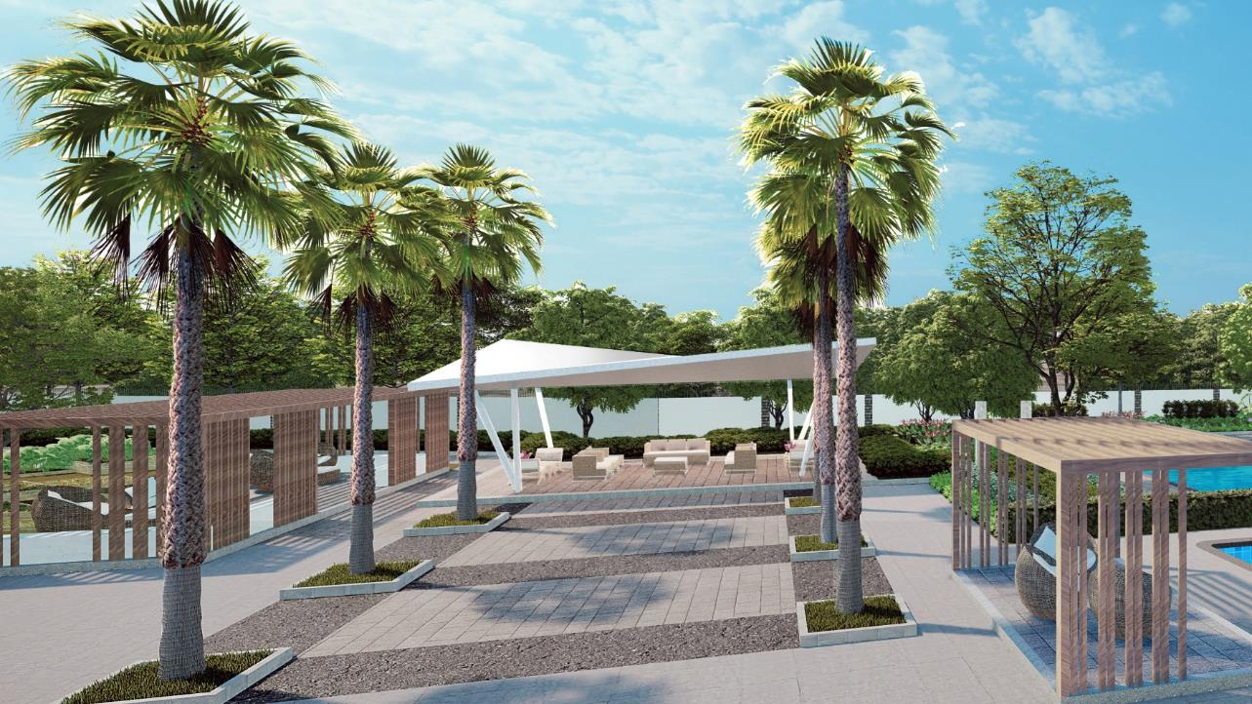
PAVILION ARTIST’S PERSPECTIVE
Plans, pricing and details subject to change without prior notice. This material is not for reproduction or distribution without prior consent of the developer.
Notes:
We also promote camaraderie and sense of neighborhood here in Calm Residences. Residents can mingle and interact with their neighbors in different convergence nodes in this community. They can celebrate momentous events and parties in our pavilion or just meet and greet in our piazza.

Slide 22
GAZEBO ARTIST’S PERSPECTIVE
Plans, pricing and details subject to change without prior notice. This material is not for reproduction or distribution without prior consent of the developer.
Notes:
We will also provide an alfresco co-working lounge for our hardworking residents who prefer to work-from-home while enjoying fresh air surrounded by lush gardens.

Slide 23
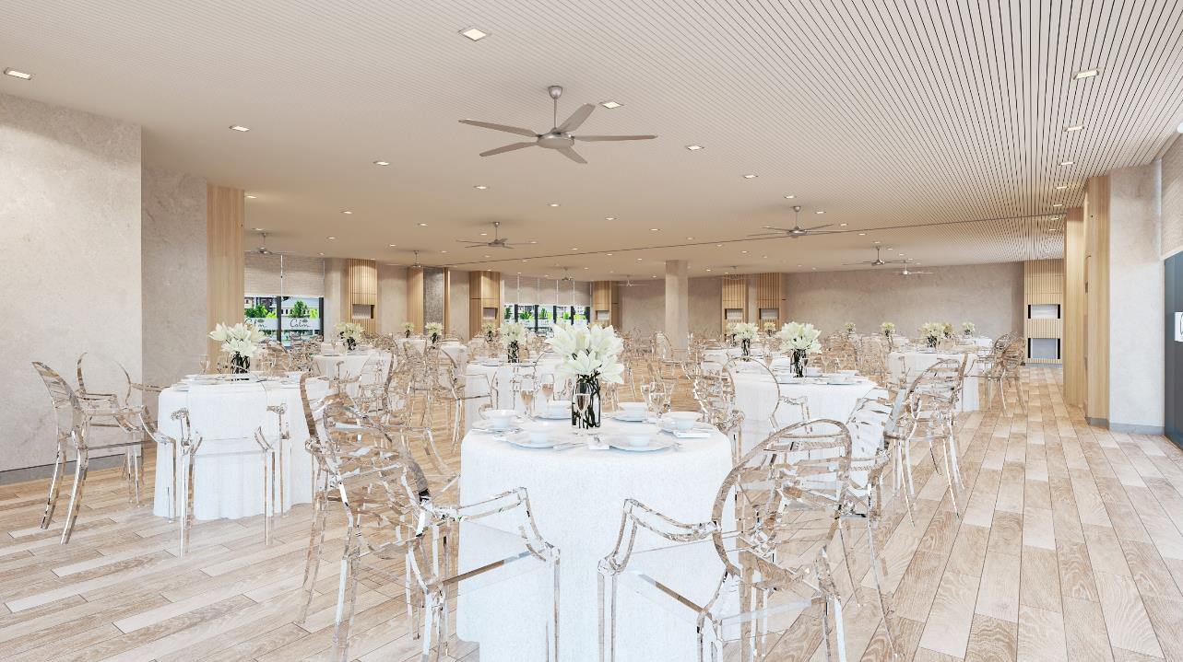
FUNCTION ROOM ARTIST’S PERSPECTIVE
Plans, pricing and details subject to change without prior notice. This material is not for reproduction or distribution without prior consent of the developer.
Notes:
And aside from these amenities, we will also provide a dedicated function room for your private events and intimate occasions.

Slide 24
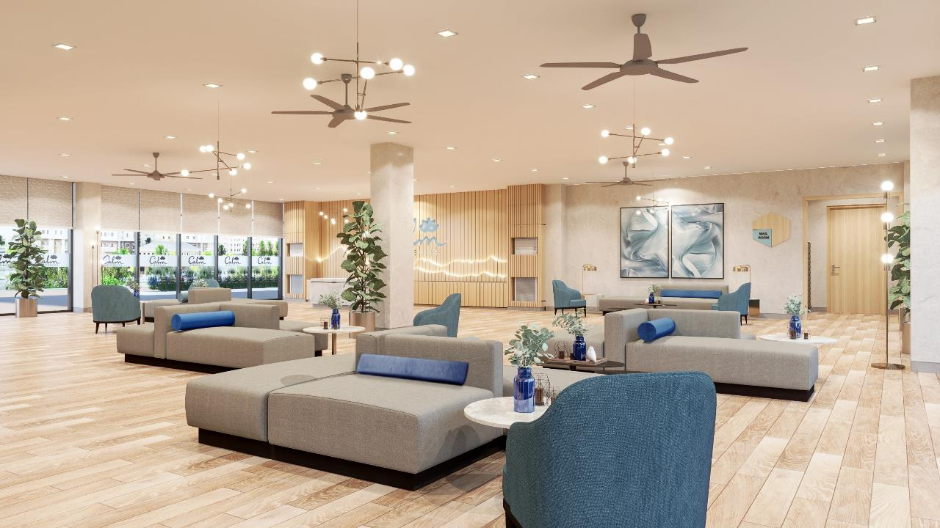
GRAND LOBBY ARTIST’S PERSPECTIVE
Plans, pricing and details subject to change without prior notice. This material is not for reproduction or distribution without prior consent of the developer.
Notes:
As part of a luxurious and calming lifestyle, we also provide hotel-like lobbies that will greet our residents warm welcome every time you come home. They could also welcome and entertain their guests in our lobby lounge area fully equipped with strong wi-fi connectivity
The inspiration for Calm Residences hotel-like lobby is based on the thought of being relaxed and reduce worries and anxieties from triggers that cause us stress, hence, using calming color patted with minimal to no striking color accents helps reduce such triggers, and for the plan, we opted to use group seating to accommodate guests which is why we maximize the space more. We also used plants and artworks to liven up the space. We also played with lighting to be used as an accent for the receptionist wall where the logo will be placed

Slide 25
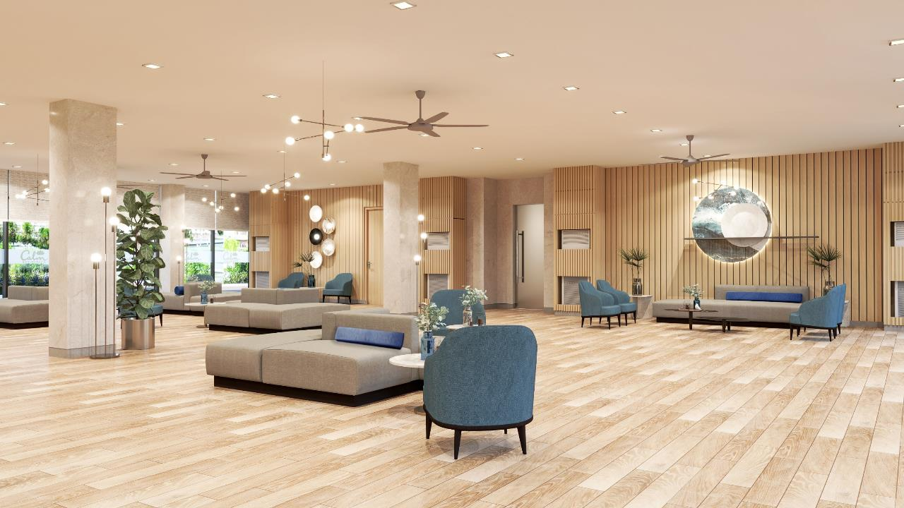
SMDC Leasing Range of Services
Property Listing Management
Unit viewing arrangements
Negotiation of lease terms
Preparation of lease contract
Tenant move-in/out assistance
Basic Home Repair Services
Quality Customer Service
Stringent Safety and Security
First Rate Facility Management
Spotless Cleanliness
Transparent Transaction
Plans, pricing and details subject to change without prior notice. This material is not for reproduction or distribution without prior consent of the developer.
Notes:
Have peace of mind living in a safe and secure community.
Greenmist Property Management Corporation ensures the first-rate upkeep, protection and management of the property so homeowners can maximize their investments. For clients thinking of renting out their units, SMDC offers hassle-free leasing services through Prime Key Leasing.
They will provide services such as:
Property Listing
Unit viewing arrangements
Negotiation of lease terms
Preparation of lease contract
Tenant Move in and out assistance
Property Inventory Monitoring

Slide 26
TECHNICAL DETAILS

Slide 27
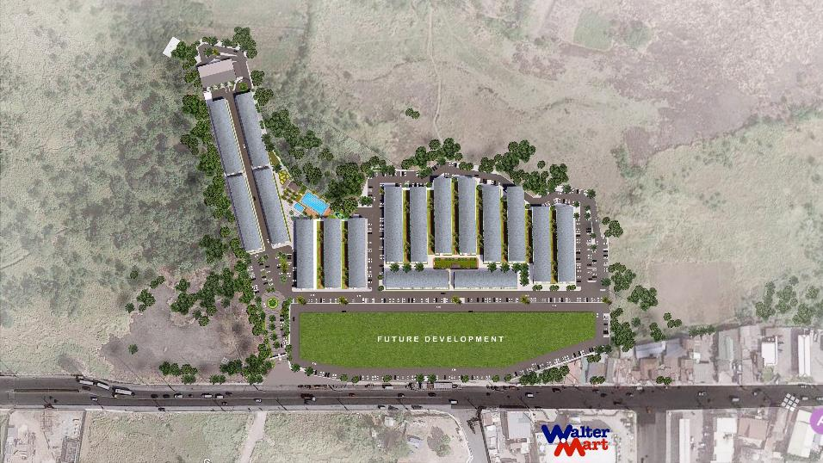
SITE DEVELOPMENT PLAN
City of Santa Rosa, Laguna

Slide 28
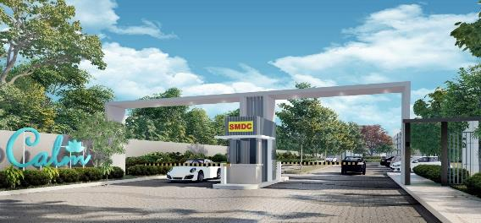
PROJECT OVERVIEW
PROJECT DETAILS
Architectural Theme | Modern Contemporary
Owner / Developer | Vancouver Lands Inc.
Total Land Area | 57,217 sqm
No. of Towers/Buildings | 17 Buildings
No. of Floors/Tower | 4 Floors per Building
Ave. Number of Units Per Building | Ave. of 173 units (46 units per floor)
Total No. of Units | 2,949 units
Residential Units | Studio Unit – 24 units Studio End Unit – 118 units 1 Bedroom Unit – 2,807 units
Parking Slots | Saleable - 487 Parking Slots PWD – 9 Parking slots Service – 1 Parking Slot
Target Turnover Date: | October 2024 – Buildings A - H April 2026 – Buildings I - Q
* For training purposes only. Plans, pricing and details subject to change without prior notice. This material is not for reproduction or distribution without prior consent of the developer.
Notes:
Calm Residences is seated in a 5.7 hectare prime property located along Balibago Road, Barangay Pulong Sta Cruz, Sta Rosa. The busiest thoroughfare and the industrial belt of Laguna.
This development is composed of 17 mid-rise buildings with 4 storey each building.
There will be an average of 173 units per floor with a total of 2,949 units for the entire development.
We offer Studio and Studio end units with an average floor area of 17 to 23 sqm. And of course, most of the units that we are offering at Calm Residences are 1 Bedroom units with an average size of 24.41 sqm. These units are ideal for young couples, newly weds and start-up families.
Estimated date of turnover of this development is on October 2024.
- Next slide
A four-storey midrise residential development composed of 17 buildings situated on a 5.7 hectare land located along Balibago Road, Pulong Sta. Cruz, Sta. Rosa, Laguna

Slide 29
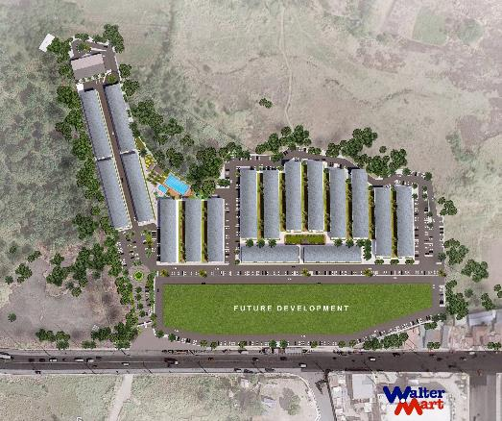
PROJECT OVERVIEW
LAUNCH DETAILS
Target Launch | October 2021
Target Completion | October 2024
Buildings | Buildings D, E, F, G & H (5 Bldgs)
Total No. Of Units | 918 units
Building D | 184 units
Building E | 183 units
Building F | 184 units
Building G | 183 units
Building H | 184 units
Unit Mix
Studio | 6 units
Studio End | 35 units
One Bedroom | 877 units
O
O
P
N
Q
F
G
D
E
H
I
A
B
C
J
K
M
L
Plans, pricing and details subject to change without prior notice. This material is not for reproduction or distribution without prior consent of the developer.
Notes:
Calm Residences is seated in a 5.7 hectare prime property located along Balibago Road, Barangay Pulong Sta Cruz, Sta Rosa. The busiest thoroughfare and the industrial belt of Laguna.
This development is composed of 17 mid-rise buildings with 4 storey each building.
There will be an average of 173 units per floor with a total of 2,949 units for the entire development.
We offer Studio and Studio end units with an average floor area of 17 to 23 sqm. And of course, most of the units that we are offering at Calm Residences are 1 Bedroom units with an average size of 24.41 sqm. These units are ideal for young couples, newly weds and start-up families.
Estimated date of turnover of this development is on October 2024.
- Next slide
A four-storey midrise residential development composed of 17 buildings situated on a 5.7 hectare land located along Balibago Road, Pulong Sta. Cruz, Sta. Rosa, Laguna

Slide 30
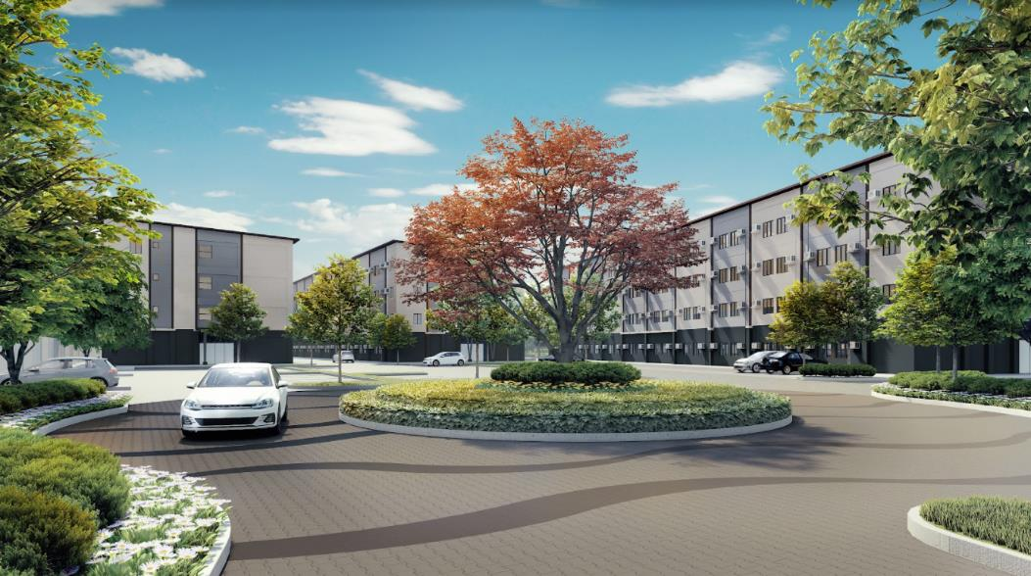
BUILDING DETAILS
Plans, pricing and details subject to change without prior notice. This material is not for reproduction or distribution without prior consent of the developer.
Notes:
For our development and building features:
We will have more than ____ hectare allocated for amenities and landscaped areas
24-hour security services with CCTV cameras in common areas
Cistern water tanks to save power in pumping water supplies to residential units
1 High speed elevator per Tower
1 Grand lobby at Tower A
Back-up power generator system
Fire alarm and sprinkler system
Centralized mailroom
Centralized garbage collection and disposal system
Rain Catchment System for Landscaping
LED Lights in common areas
Property Management Office
And Leasing Services thru Prime Key Leasing
- Next slide

Slide 31
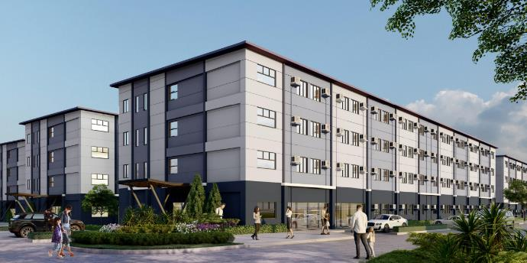
BUILDING CHART
4th Floor
3rd Floor
2nd Floor
Ground Floor
Note: All floors are for residential use
Plans, pricing and details subject to change without prior notice. This material is not for reproduction or distribution without prior consent of the developer.
Notes:
Calm Residences is seated in a 5.7 hectare prime property located along Balibago Road, Barangay Pulong Sta Cruz, Sta Rosa. The busiest thoroughfare and the industrial belt of Laguna.
This development is composed of 17 mid-rise buildings with 4 storey each building.
There will be an average of 173 units per floor with a total of 2,949 units for the entire development.
We offer Studio and Studio end units with an average floor area of 17 to 23 sqm. And of course, most of the units that we are offering at Calm Residences are 1 Bedroom units with an average size of 24.41 sqm. These units are ideal for young couples, newly weds and start-up families.
Estimated date of turnover of this development is on October 2024.
- Next slide
A four-storey midrise residential development composed of 17 buildings situated on a 5.7 hectare land located along Balibago Road, Pulong Sta. Cruz, Sta. Rosa, Laguna

Slide 32
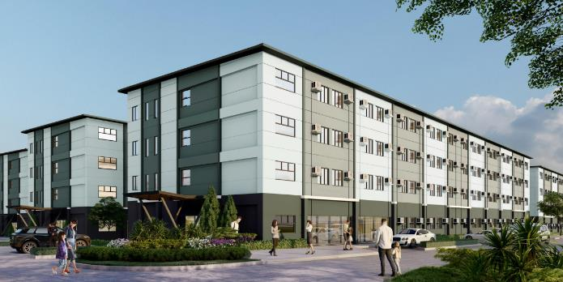
BUILDING CHART – BUILDING D
FLOOR | NO. OF UNITS
Ground Floor | 46 units
2nd to 4th Floor | 46 units per floor
Total | 184 units
UNIT TYPE | UNIT AREA | NO. OF UNITS
One Bedroom | 24.41 – 24.99 sqm | 175 units
Studio End | 23.51 sqm | 7 units
Studio | 17.63 – 18.21 sqm | 2 units
Plans, pricing and details subject to change without prior notice. This material is not for reproduction or distribution without prior consent of the developer.
Notes:
Calm Residences is seated in a 5.7 hectare prime property located along Balibago Road, Barangay Pulong Sta Cruz, Sta Rosa. The busiest thoroughfare and the industrial belt of Laguna.
This development is composed of 17 mid-rise buildings with 4 storey each building.
There will be an average of 173 units per floor with a total of 2,949 units for the entire development.
We offer Studio and Studio end units with an average floor area of 17 to 23 sqm. And of course, most of the units that we are offering at Calm Residences are 1 Bedroom units with an average size of 24.41 sqm. These units are ideal for young couples, newly weds and start-up families.
Estimated date of turnover of this development is on October 2024.
- Next slide
A four-storey midrise residential development composed of 17 buildings situated on a 5.7 hectare land located along Balibago Road, Pulong Sta. Cruz, Sta. Rosa, Laguna

Slide 33
BUILDING CHART – BUILDING E
FLOOR | NO. OF UNITS
Ground Floor | 45 units
2nd to 4th Floor | 46 units per floor
Total | 183 units
UNIT TYPE | UNIT AREA | NO. OF UNITS
One Bedroom | 24.41 – 24.99 sqm | 176 units
Studio End | 23.51 sqm | 7 units
Plans, pricing and details subject to change without prior notice. This material is not for reproduction or distribution without prior consent of the developer.
Notes:
Calm Residences is seated in a 5.7 hectare prime property located along Balibago Road, Barangay Pulong Sta Cruz, Sta Rosa. The busiest thoroughfare and the industrial belt of Laguna.
This development is composed of 17 mid-rise buildings with 4 storey each building.
There will be an average of 173 units per floor with a total of 2,949 units for the entire development.
We offer Studio and Studio end units with an average floor area of 17 to 23 sqm. And of course, most of the units that we are offering at Calm Residences are 1 Bedroom units with an average size of 24.41 sqm. These units are ideal for young couples, newly weds and start-up families.
Estimated date of turnover of this development is on October 2024.
- Next slide
A four-storey midrise residential development composed of 17 buildings situated on a 5.7 hectare land located along Balibago Road, Pulong Sta. Cruz, Sta. Rosa, Laguna

Slide 34
BUILDING CHART – BUILDING F
FLOOR | NO. OF UNITS
Ground Floor | 46 units
2nd to 4th Floor | 46 units per floor
Total | 184 units
UNIT TYPE | UNIT AREA | NO. OF UNITS
One Bedroom | 24.41 – 24.99 sqm | 175 units
Studio End | 23.51 sqm | 7 units
Studio | 17.63 – 18.21 sqm | 2 units
Plans, pricing and details subject to change without prior notice. This material is not for reproduction or distribution without prior consent of the developer.
Notes:
Calm Residences is seated in a 5.7 hectare prime property located along Balibago Road, Barangay Pulong Sta Cruz, Sta Rosa. The busiest thoroughfare and the industrial belt of Laguna.
This development is composed of 17 mid-rise buildings with 4 storey each building.
There will be an average of 173 units per floor with a total of 2,949 units for the entire development.
We offer Studio and Studio end units with an average floor area of 17 to 23 sqm. And of course, most of the units that we are offering at Calm Residences are 1 Bedroom units with an average size of 24.41 sqm. These units are ideal for young couples, newly weds and start-up families.
Estimated date of turnover of this development is on October 2024.
- Next slide
A four-storey midrise residential development composed of 17 buildings situated on a 5.7 hectare land located along Balibago Road, Pulong Sta. Cruz, Sta. Rosa, Laguna

Slide 35
BUILDING CHART – BUILDING G
FLOOR | NO. OF UNITS
Ground Floor | 45 units
2nd to 4th Floor | 46 units per floor
Total | 183 units
UNIT TYPE | UNIT AREA | NO. OF UNITS
One Bedroom | 24.41 – 24.99 sqm | 176 units
Studio End | 23.51 sqm | 7 units
Plans, pricing and details subject to change without prior notice. This material is not for reproduction or distribution without prior consent of the developer.
Notes:
Calm Residences is seated in a 5.7 hectare prime property located along Balibago Road, Barangay Pulong Sta Cruz, Sta Rosa. The busiest thoroughfare and the industrial belt of Laguna.
This development is composed of 17 mid-rise buildings with 4 storey each building.
There will be an average of 173 units per floor with a total of 2,949 units for the entire development.
We offer Studio and Studio end units with an average floor area of 17 to 23 sqm. And of course, most of the units that we are offering at Calm Residences are 1 Bedroom units with an average size of 24.41 sqm. These units are ideal for young couples, newly weds and start-up families.
Estimated date of turnover of this development is on October 2024.
- Next slide
A four-storey midrise residential development composed of 17 buildings situated on a 5.7 hectare land located along Balibago Road, Pulong Sta. Cruz, Sta. Rosa, Laguna

Slide 36
BUILDING CHART – BUILDING H
FLOOR | NO. OF UNITS
Ground Floor | 46 units
2nd to 4th Floor | 46 units per floor
Total | 184 units
UNIT TYPE | UNIT AREA | NO. OF UNITS
One Bedroom | 24.41 – 24.99 sqm | 175 units
Studio End | 23.51 sqm | 7 units
Studio | 17.63 – 18.21 sqm | 2 units
Plans, pricing and details subject to change without prior notice. This material is not for reproduction or distribution without prior consent of the developer.
Notes:
For Building H, it’s the same with Building F

Slide 37
DEVELOPMENT & BUILDING FEATURES
Gated community with 24/7 security
CCTV for common areas
Mailroom located at the ground floor near the elevator
Garbage room in every floor
Wifi ready lobby & function rooms
Property Management Services
Prime Key Leasing
Power by Meralco
Plans, pricing and details subject to change without prior notice. This material is not for reproduction or distribution without prior consent of the developer.
Notes:
Calm Residences is seated in a 5.7 hectare prime property located along Balibago Road, Barangay Pulong Sta Cruz, Sta Rosa. The busiest thoroughfare and the industrial belt of Laguna.
This development is composed of 17 mid-rise buildings with 4 storey each building.
There will be an average of 173 units per floor with a total of 2,949 units for the entire development.
We offer Studio and Studio end units with an average floor area of 17 to 23 sqm. And of course, most of the units that we are offering at Calm Residences are 1 Bedroom units with an average size of 24.41 sqm. These units are ideal for young couples, newly weds and start-up families.
Estimated date of turnover of this development is on October 2024.
- Next slide
A four-storey midrise residential development composed of 17 buildings situated on a 5.7 hectare land located along Balibago Road, Pulong Sta. Cruz, Sta. Rosa, Laguna

Slide 38
FLOOR PLANS AND UNIT LAYOUTS
Plans, pricing and details subject to change without prior notice. This material is not for reproduction or distribution without prior consent of the developer.
Notes:
For our development and building features:
We will have more than ____ hectare allocated for amenities and landscaped areas
24-hour security services with CCTV cameras in common areas
Cistern water tanks to save power in pumping water supplies to residential units
1 High speed elevator per Tower
1 Grand lobby at Tower A
Back-up power generator system
Fire alarm and sprinkler system
Centralized mailroom
Centralized garbage collection and disposal system
Rain Catchment System for Landscaping
LED Lights in common areas
Property Management Office
And Leasing Services thru Prime Key Leasing
- Next slide

Slide 39
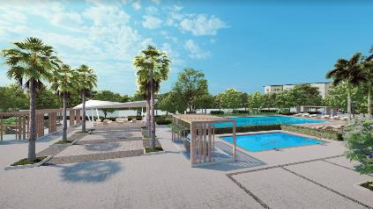
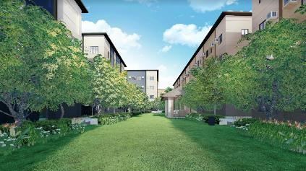
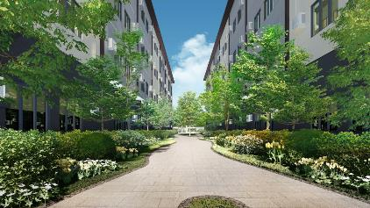
VIEWPOINTS
Amenity View
Central Park View
Linear Park View
Plans, pricing and details subject to change without prior notice. This material is not for reproduction or distribution without prior consent of the developer.
Notes:
For our building floor plans, this is our ground floor plan for Building A where we can found our hotel-like grand lobby and our mail room
- Next slide

Slide 40
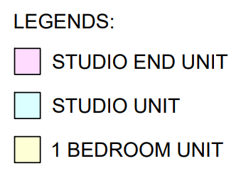
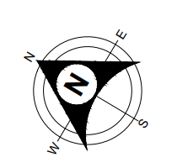
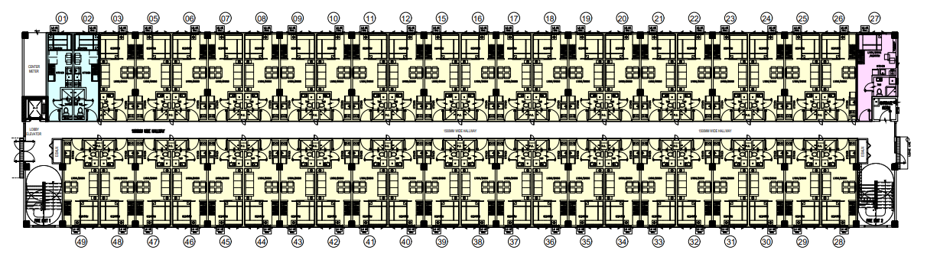
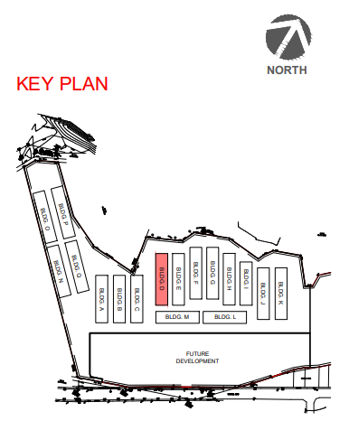
BUILDING D – GROUND FLOOR PLAN
Linear Park View
Residential View
Plans, pricing and details subject to change without prior notice. This material is not for reproduction or distribution without prior consent of the developer.
Notes:
For our building floor plans, this is our ground floor plan for Building A where we can found our hotel-like grand lobby and our mail room
- Next slide

Slide 41
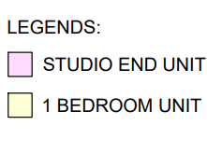
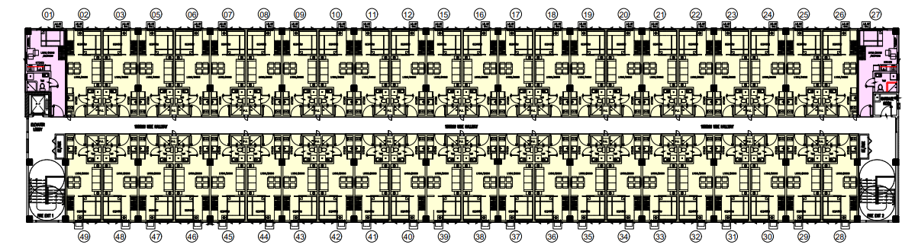
BUILDING D – 2ND TO 4TH FLOOR PLAN
Linear Park View
Residential View
Plans, pricing and details subject to change without prior notice. This material is not for reproduction or distribution without prior consent of the developer.
Notes:
For our building floor plans, this is our ground floor plan for Building A where we can found our hotel-like grand lobby and our mail room
- Next slide

Slide 42
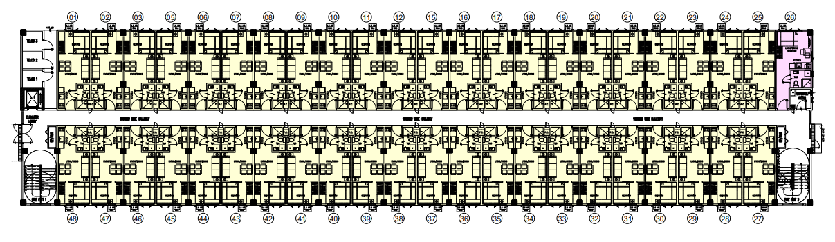
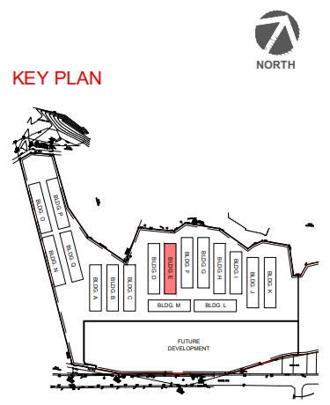
BUILDING E – GROUND FLOOR PLAN
Linear Park View
01 - 23
Central Park View
24 - 26
Central Park View
Linear Park View
Plans, pricing and details subject to change without prior notice. This material is not for reproduction or distribution without prior consent of the developer.
Notes:
For our building floor plans, this is our ground floor plan for Building A where we can found our hotel-like grand lobby and our mail room
- Next slide

Slide 43
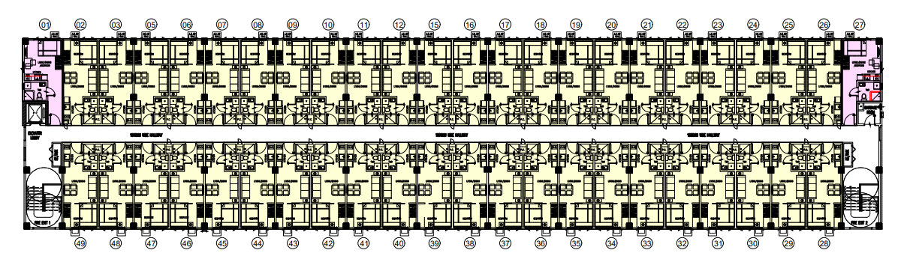
BUILDING E – 2ND TO 4TH FLOOR PLAN
Linear Park View
01 - 24
Central Park View
25 - 27
Central Park View
Linear Park View
Plans, pricing and details subject to change without prior notice. This material is not for reproduction or distribution without prior consent of the developer.
Notes:
For our building floor plans, this is our ground floor plan for Building A where we can found our hotel-like grand lobby and our mail room
- Next slide

Slide 44
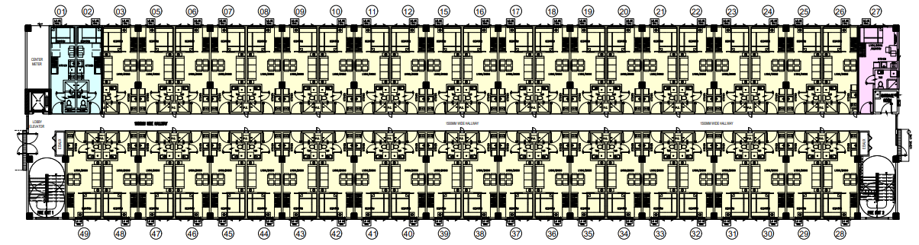
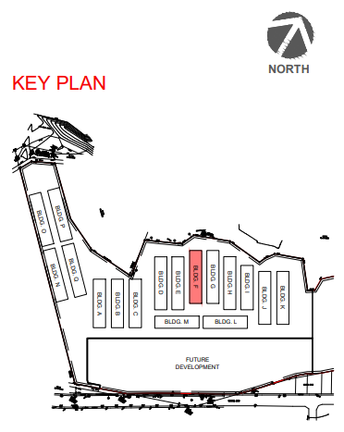
BUILDING F – GROUND FLOOR PLAN
Linear Park View
Central Park View
Linear Park View
Plans, pricing and details subject to change without prior notice. This material is not for reproduction or distribution without prior consent of the developer.
Notes:
For our building floor plans, this is our ground floor plan for Building A where we can found our hotel-like grand lobby and our mail room
- Next slide

Slide 45
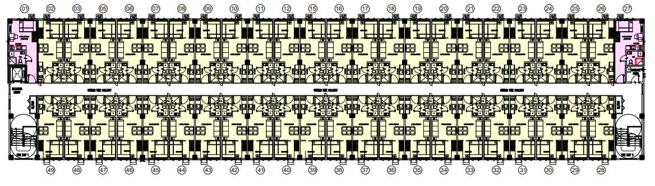
BUILDING F – 2ND TO 4TH FLOOR PLAN
Linear Park View
Central Park View
Linear Park View
Plans, pricing and details subject to change without prior notice. This material is not for reproduction or distribution without prior consent of the developer.
Notes:
For our building floor plans, this is our ground floor plan for Building A where we can found our hotel-like grand lobby and our mail room
- Next slide

Slide 46
BUILDING G – GROUND FLOOR PLAN
Linear Park View
Central Park View
Linear Park View
Plans, pricing and details subject to change without prior notice. This material is not for reproduction or distribution without prior consent of the developer.
Notes:
For our building floor plans, this is our ground floor plan for Building A where we can found our hotel-like grand lobby and our mail room
- Next slide

Slide 47
BUILDING G – 2ND TO 4TH FLOOR PLAN
Linear Park View
Central Park View
Linear Park View
Plans, pricing and details subject to change without prior notice. This material is not for reproduction or distribution without prior consent of the developer.
Notes:
For our building floor plans, this is our ground floor plan for Building A where we can found our hotel-like grand lobby and our mail room
- Next slide

Slide 48
BUILDING H – GROUND FLOOR PLAN
Linear Park View
Linear Park View
30 - 49
Central Park View
28 - 29
Plans, pricing and details subject to change without prior notice. This material is not for reproduction or distribution without prior consent of the developer.
Notes:
For our building floor plans, this is our ground floor plan for Building A where we can found our hotel-like grand lobby and our mail room
- Next slide

Slide 49
BUILDING H – 2ND TO 4TH FLOOR PLAN
Linear Park View
Linear Park View
30 - 49
Central Park View
28 - 29
Plans, pricing and details subject to change without prior notice. This material is not for reproduction or distribution without prior consent of the developer.
Notes:
For our building floor plans, this is our ground floor plan for Building A where we can found our hotel-like grand lobby and our mail room
- Next slide

Slide 50
UNIT LAYOUT – STUDIO
* For training purposes only. Plans, pricing and details subject to change without prior notice. This material is not for reproduction or distribution without prior consent of the developer.

Slide 51
UNIT LAYOUT – STUDIO
* For training purposes only. Plans, pricing and details subject to change without prior notice. This material is not for reproduction or distribution without prior consent of the developer.

Slide 52
UNIT LAYOUT – STUDIO END
* For training purposes only. Plans, pricing and details subject to change without prior notice. This material is not for reproduction or distribution without prior consent of the developer.

Slide 53
UNIT LAYOUT - ONE BEDROOM
* For training purposes only. Plans, pricing and details subject to change without prior notice. This material is not for reproduction or distribution without prior consent of the developer.

Slide 54
UNIT LAYOUT - ONE BEDROOM
No Column
With 2 Columns
Plans, pricing and details subject to change without prior notice. This material is not for reproduction or distribution without prior consent of the developer.

Slide 55
UNIT LAYOUT - ONE BEDROOM
* For training purposes only. Plans, pricing and details subject to change without prior notice. This material is not for reproduction or distribution without prior consent of the developer.

Slide 56
UNIT LAYOUT - ONE BEDROOM
* For training purposes only. Plans, pricing and details subject to change without prior notice. This material is not for reproduction or distribution without prior consent of the developer.

Slide 57
UNIT DELIVERABLES
TYPICAL UNIT FINISHES
Wall Finish | Living, Dining, Kitchen & Bedroom: Semi-gloss paint finish Toilet & Bath: Semi-gloss paint finish with 1.2m-high tiles on shower area and tiled baseboard
Floor Finish | Ceramic tiles
Doors | Main Entrance: Laminated wood door Bedroom: Laminated wood door Toilet & Bath: PVC door
Windows | Aluminum casement window
Toilet & Bath | Water closet Lavatory Soap Holder Tissue Holder Shower Assembly Fixtures
Kitchen | Polished tiles on concrete kitchen countertop
Plans, pricing and details subject to change without prior notice. This material is not for reproduction or distribution without prior consent of the developer.

Slide 58
LAUNCH PAYMENT TERMS
Applicable to all residential units only
STANDARD PAYMENT TERMS
Payment Term | Particulars | Discount
Spot Cash | 100% Spot Cash in 30 Days | 10.00%
Deferred Cash | 100% in 39 months | 2.00%
Spot DP | 10% Spot / 90% in 39 months | 2.00%
 | 20% Spot / 80% in 39 months | 4.00%
 | 50% Spot / 50% in 39 months | 5.00%
Spread DP | 15% in 39 months / 85% through Cash or Bank | -
 | 20% in 39 months / 80% through Cash or Bank | -
Easy Payment Scheme | 10% Spot / 10% in 38 months / 80% through Cash or Bank | 0.50%
 | 20% Spot / 10% in 38 months / 70% through Cash or Bank | 1.00%
SPECIAL PAYMENT TERMS
Payment Term | Particulars | Discount
Spread DP | 10% in 39 months / 90% through cash or bank | -
Reservation Fee – P15,000
Other Charges – 6.5%
* For training purposes only. Plans, pricing and details subject to change without prior notice. This material is not for reproduction or distribution without prior consent of the developer.

Slide 59
PRICING OF RESIDENTIAL UNITS
Applicable to all residential units only
Reservation Fee – P15,000
BUILDINGS D, E, F, G & H
Unit Type | Area | Total List Price |  |  | Monthly Amortization
 |  | Average | Lowest | Highest | Average | Lowest | Highest
Studio | 17.63 – 18. 21 sqm | P2.6m | P2.5m | P2.6m | P6,900 | P6,800 | P7,200
Studio End Unit | 23.51 sqm | P3.1m | P3.1m | P3.1m | P8,400 | P8,300 | P8,600
One Bedroom Unit | 24.41 – 26.93 sqm | P3.2m | P3.2m | P3.6m | P9,000 | P8,600 | P10,800
* For training purposes only. Plans, pricing and details subject to change without prior notice. This material is not for reproduction or distribution without prior consent of the developer.

Slide 60
SAMPLE COMPUTATION
Pricing
Reservation Fee – P15,000
Other Charges – 6.5%
In Php / Subject to change without prior notice
 | SPOT CASH | DEFERRED CASH | SPOT DP |  |  | SPREAD DP |  | EASY PAYMENT SCHEME
 | 100% Spot Cash in 30 Days (w/ 10% Discount) | 100% in 39 months (w/ 2% Discount) | 10% Spot / 90% in 39 months (w/ 2% Discount) | 20% Spot / 80% in 39 months (w/ 4% Discount) | 50% Spot / 50% in 39 months (w/ 5% Discount) | 15% in 39 months / 85% through Cash or Bank | 20% in 39 months / 80% through Cash or Bank | 10% Spot / 10% in 38 months / 80% through Cash or Bank (w/ 0.5% Discount) | 20% Spot / 10% in 38 months / 70% through Cash or Bank (w/ 1% Discount)
TLP | P3.2m
Discount | P319k | P64k | P64k | P128k | P160k | - | - | P16k | P32k
NLP | P2.9m | P3.1m | P3.1m | P3.1m | P3.0m | P3.2m | P3.2m | P3.2m | P3.2m
TAP | P3.1m | P3.3m | P3.3m | P3.3m | P3.2m | P3.4m | P3.4m | P3.4m | P3.4m
Spot | P3.0m | - | P318k | P638k | P1.6m | - | - | P323k | P658k
MA | - | P85k | P77k | P67k | P41k | P13k | P17k | P9k | P9k
BAL | - | - | - | - | - | P2.9m | P2.7m | P2.7m | P2.4m
Plans, pricing and details subject to change without prior notice. This material is not for reproduction or distribution without prior consent of the developer.

Slide 61
TRANSFER PROMO TERM TO ANOTHER SLIDE,
PUT SPECIAL EFFECT
SAMPLE COMPUTATION
Pricing
 | PROMO TERM
 | 10% in 39 months / 90% through Cash or Bank
TLP | P3.2m
Discount | -
NLP | P3.2m
TAP | P3.4m
Spot | -
MA | P8k
BAL | P3.1m
In Php / Subject to change without prior notice
Reservation Fee – P15,000
Other Charges – 6.5%
Plans, pricing and details subject to change without prior notice. This material is not for reproduction or distribution without prior consent of the developer.

Slide 62
SHOWROOM
Location:
2nd Floor, SM City Santa Rosa
Along Old National Highway, Brgy. Tagapo
Santa Rosa, Laguna

Slide 63
FAQs
What is Calm Residences Ph1?
Calm Residences is a midrise residential development which offers a tranquil environment in the midst of the busy and highly progressive City of Sta. Rosa, Laguna.
Where is Calm Residences Ph1?
Calm Residences is located along Balibago Road, Pulong Sta. Cruz, Sta. Rosa, Laguna
Who is the developer of Calm Residences Ph1?
Calm Residences is developed by Vancouver Lands Inc. (VLI). It is a wholly owned subsidiary of SM Development Corporation, the leading developer of condominiums in the Central Business Districts of Metro Manila.
How many buildings?
17 midrise buildings
How many floors will Calm Residences Ph1 have?
The buildings belonging to first phase of Calm Residences will have four (4) physical floor levels
What is the ceiling height of the unit?
2.40m - Kitchen and T&B
2.80m - Other Areas
What is the hallway or corridor width?
1.50m
How many elevators are there
1 per building (8 people capacity)
How many garbage rooms are there
1 located at the end of each floor of all buildings
Plans, pricing and details subject to change without prior notice. This material is not for reproduction or distribution without prior consent of the developer.

Slide 64
A tranquil community in the midst of the busy and highly progressive city of Sta. Rosa, Laguna.
SUSTAINABLE MASTER-PLANNED DEVELOPMENT
IDEAL HOMES FOR WORKING FAMILIES
CALMING SUBURBAN GARDEN COMMUNITY
LUCRATIVE INVESTMENT
Plans, pricing and details subject to change without prior notice. This material is not for reproduction or distribution without prior consent of the developer.
Notes:
So to sum it up:
Calm Residences is a tranquil environment in the midst of the busy and highly progressive city of Sta. Rosa, Laguna. Calm Residences is a suburban garden community that features complete amenities and modern facilities for families and working professionals who deserve a safe, secure, convenient and calming lifestyle.
And here are the important things that we should always remember about Calm Residences:
CALMING SUBURBAN GARDEN COMMUNITY
It offers lush gardens and open spaces that will provide relaxing environment and contributes to a healthy lifestyle that enhances productivity and creativity.
Calm Residences also features complete resort-styled amenities and recreational facilities that promote camaraderie and healthy lifestyle to all residents.
IDEAL HOMES FOR WORKING FAMILIES
It provides a serene environment for utmost relaxation after busy day of work.
Calm Residences is strategically positioned along the enterprise belt of Sta Rosa, that upholds more quality time for the family
A community that is in close proximity to schools, malls and theme parks for every families needs and leisure.
A child-friend community that is safe and secure.
SUSTAINABLE MASTER-PLANNED DEVELOPMENT
Calm Residences is well-connected, well-planned, walkable, bike-friendly and nature-oriented development
Also, SMDC’s continues community development programs that promotes a sense of community and camaraderie in the neighborhood.
Calm Residences is a safe and secure community that will be professionally managed by a professional property management team
A LUCRATIVE INVESTMENT
With minimal investment thru SMDC’s affordable and flexible payment terms, your investment will surely gain maximum returns thru rental business and fast property value appreciation.
Calm Residences is a home investment for leasing that will cater to the local upgraders, working professionals and expats from the highly industrialized city of Sta. Rosa
And lastly, we will provide a convenient and hassle-free leasing services thru SMDC Leasing
So again, Calm Residences is your tranquil community in the midst of the buzzing city of Sta. Rosa, Laguna.
Again, this is Ryan De Guzman from SMDC Marketing.
Thank you and happy selling, Calm Residences…

Slide 65
DHSUD PLS No.
380, 381 382, 383, 384, 385, 386, 387, 449, 450, 451, 452, 453, 454, 455, 456 & 457
(Phase 1 – Building A, Building B, Building C, Building D, Building E, Building F, Building G, Building H, Building I, Building J, Building K, Building L, Building M, Building N, Building O, Building P & Building Q)
Balibago Road, Pulong Sta. Cruz, Sta. Rosa City, Laguna
TARGET TURNOVER:
Buildings A to H – October 2024
Buildings I to Q – April 2026

Slide 66
FOR INQUIRIES AND PREPARED BY:
JUDY DE PAZ
YOUR SMDC PROPERTY SPECIALIST
09278509682
depazjudy.smdc@gmail.com
Plans, pricing and details subject to change without prior notice. This material is not for reproduction or distribution without prior consent of the developer.
Notes:
So to sum it up:
Calm Residences is a tranquil environment in the midst of the busy and highly progressive city of Sta. Rosa, Laguna. Calm Residences is a suburban garden community that features complete amenities and modern facilities for families and working professionals who deserve a safe, secure, convenient and calming lifestyle.
And here are the important things that we should always remember about Calm Residences:
CALMING SUBURBAN GARDEN COMMUNITY
It offers lush gardens and open spaces that will provide relaxing environment and contributes to a healthy lifestyle that enhances productivity and creativity.
Calm Residences also features complete resort-styled amenities and recreational facilities that promote camaraderie and healthy lifestyle to all residents.
IDEAL HOMES FOR WORKING FAMILIES
It provides a serene environment for utmost relaxation after busy day of work.
Calm Residences is strategically positioned along the enterprise belt of Sta Rosa, that upholds more quality time for the family
A community that is in close proximity to schools, malls and theme parks for every families needs and leisure.
A child-friend community that is safe and secure.
SUSTAINABLE MASTER-PLANNED DEVELOPMENT
Calm Residences is well-connected, well-planned, walkable, bike-friendly and nature-oriented development
Also, SMDC’s continues community development programs that promotes a sense of community and camaraderie in the neighborhood.
Calm Residences is a safe and secure community that will be professionally managed by a professional property management team
A LUCRATIVE INVESTMENT
With minimal investment thru SMDC’s affordable and flexible payment terms, your investment will surely gain maximum returns thru rental business and fast property value appreciation.
Calm Residences is a home investment for leasing that will cater to the local upgraders, working professionals and expats from the highly industrialized city of Sta. Rosa
And lastly, we will provide a convenient and hassle-free leasing services thru SMDC Leasing
So again, Calm Residences is your tranquil community in the midst of the buzzing city of Sta. Rosa, Laguna.
Again, this is Ryan De Guzman from SMDC Marketing.
Thank you and happy selling, Calm Residences…

