Slide 1




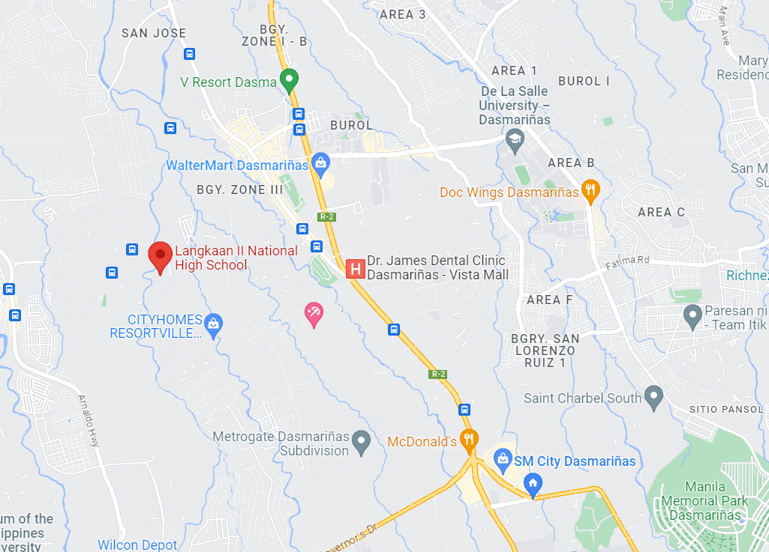
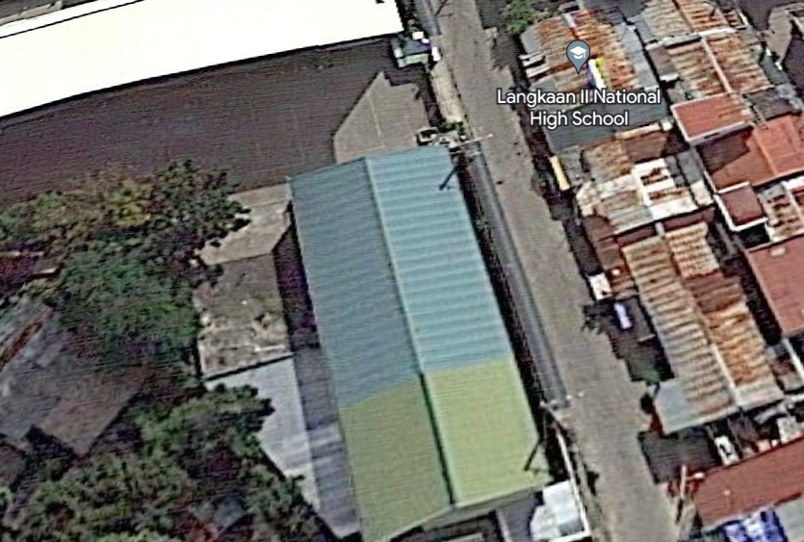
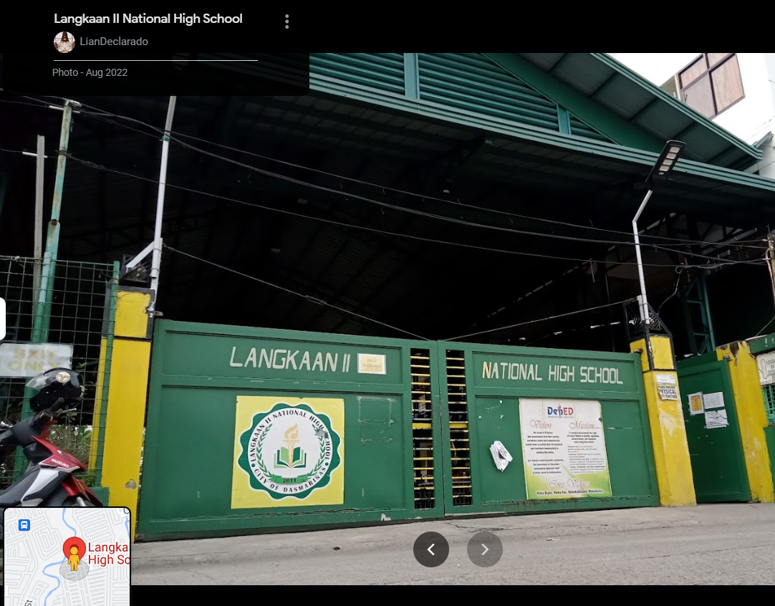
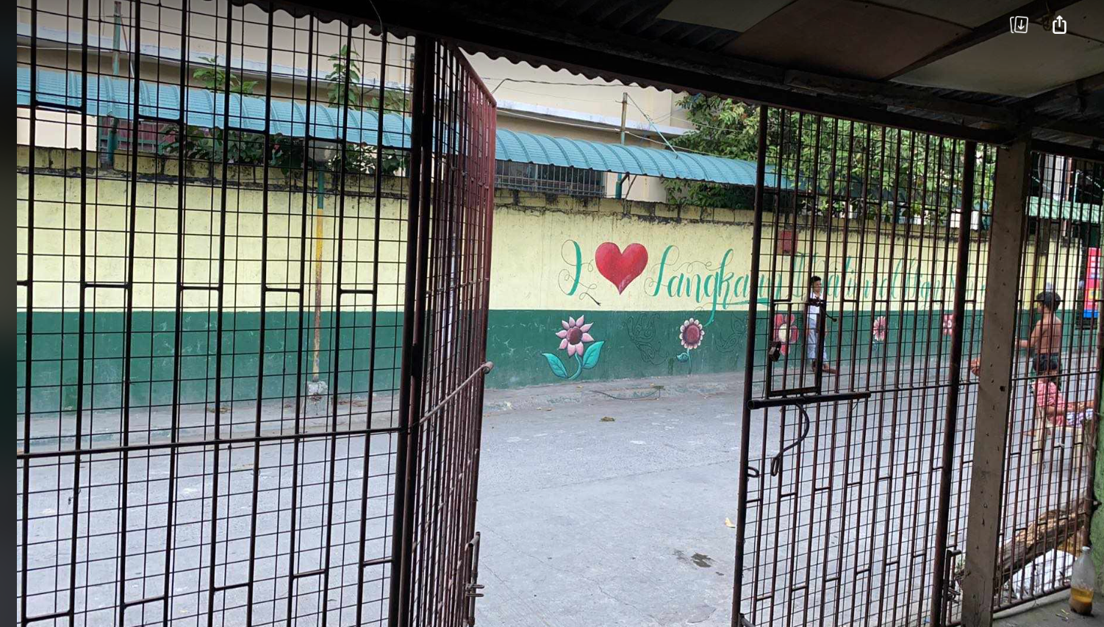
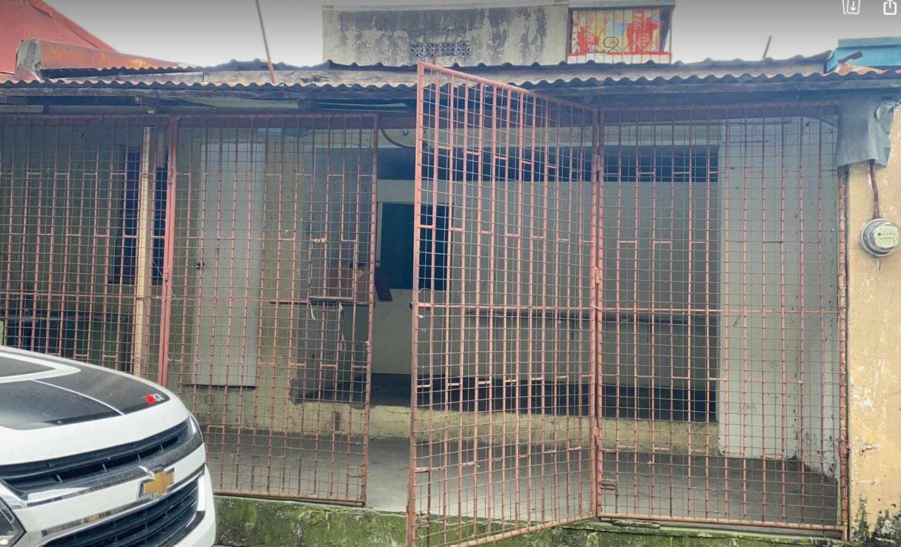
City Homes Resortville Subd.
R5 – Dasmarinas City
House & Lot (with COMMERCIAL SPACE)
CONTACT DETAILS:
+63 906 542 4225
+63 917 821 8027
Nearby places
PROPERTY DESCRIPTIONS:
52 SQM House & Lot
Clean title and updated Real Property Tax
Currently with monthly passive income
Just across/opposite of Langkaan II National High School
Can be converted to commercial building or both (house & commercial properly building)
Langkaan II National HS
This Property
Taken inside the property
Front

