Slide 1


Slide 2

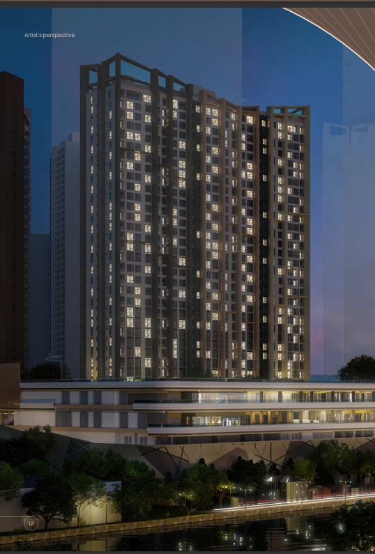

Slide 3
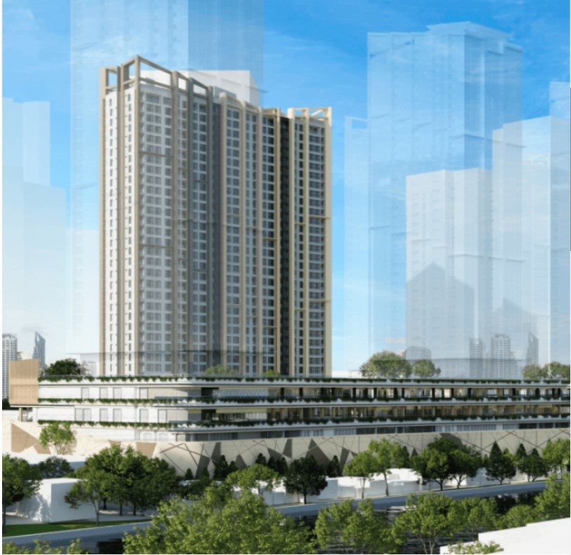
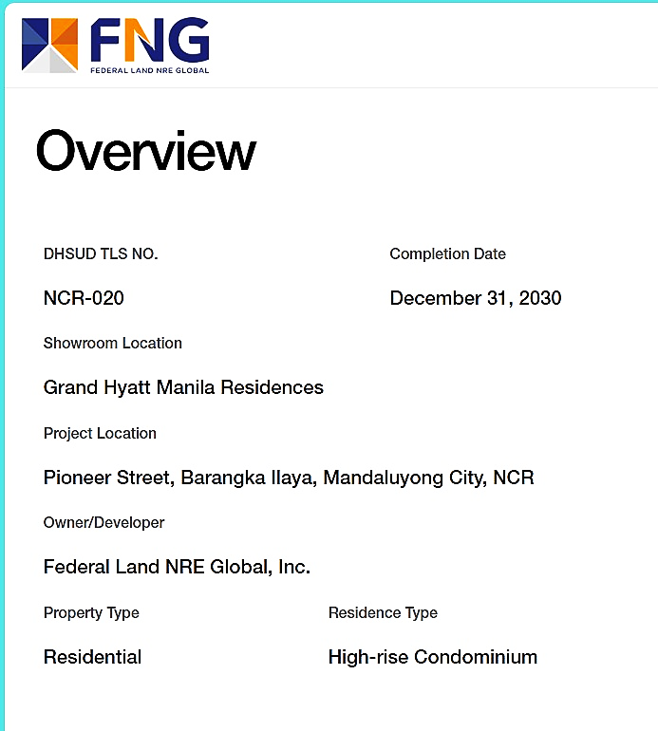
OVERVIEW

Slide 4

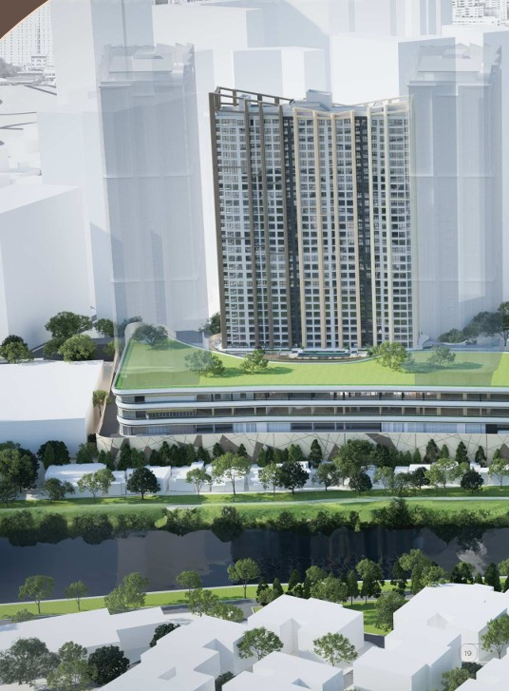

The Observatory situated in Madaluyong City and across the river from BGC, present a modern retreat In a strategically advantageous locale, emphasizing convenient and comfort. THE OBSERVATORY integrate the modernity with a inviting retreat, promising a holistic urban living experience.

Slide 5
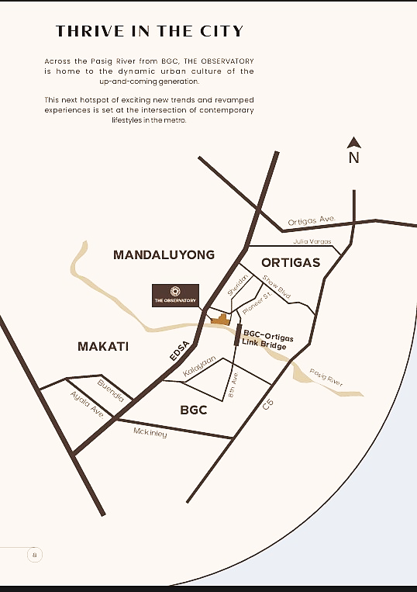
THRIVE IN THE CITY
From BGC to The Observatory pioneer street Mandaluyong City.
Its approximately 7.2km, 14min. Fastest route the unusual traffic.
2.3km – 7min
From Ortigas Center to The Observatory, Mandaluyong City.
Its approximately 2.3km, 7min. Fastest route the unusual traffic
5.5km – 11min
From Makati to The Observatory, Mandaluyong City.
Its approximately 5.5km, 11min. Fastest route the unusual traffic.
7.2km – 14min

Slide 6
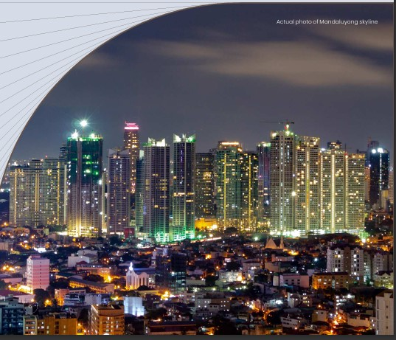
THE CONTEMPORARY
URBAN RETREAT
The Observatory - Federal Land NRE Global Inc- FNG
The Observatory FNG - Sora Tower
Federal Land NRE Global Inc. (FNG) is a powerhouse joint venture between Federal Land Inc. and Nomura Real Estate Development Co., Ltd -- two real estate giants in the Philippines and Japan. FNG has been formed in the spirit of equal partnership and respect between the Philippines and Japan to create new value
Federal Land, Inc. and Nomura Real Estate Development Co., Ltd. are set to reimagine urban landscapes and set new standards of excellence in the Philippine real estate industry.

Slide 7
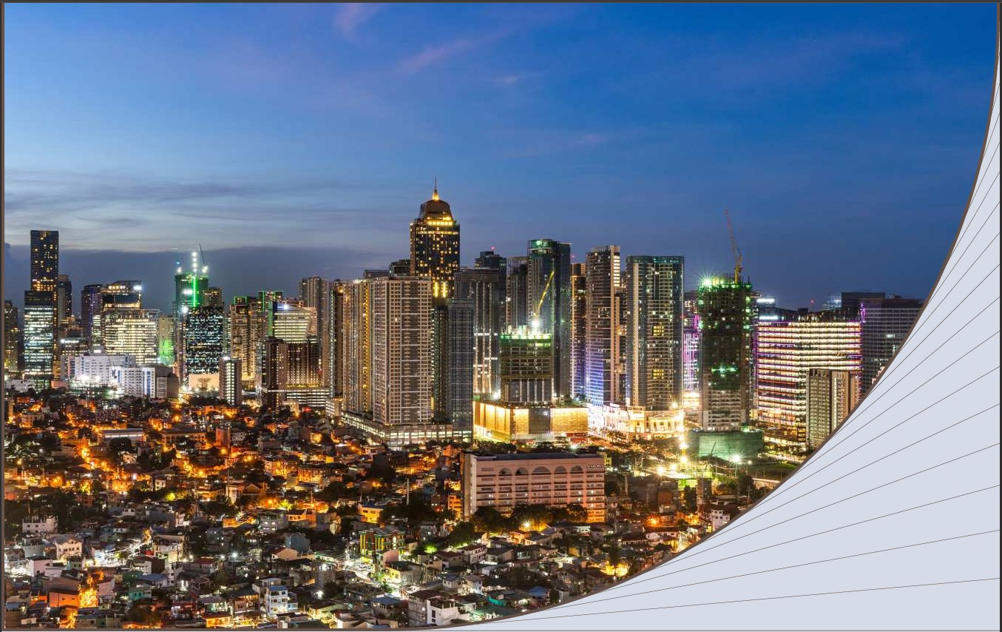
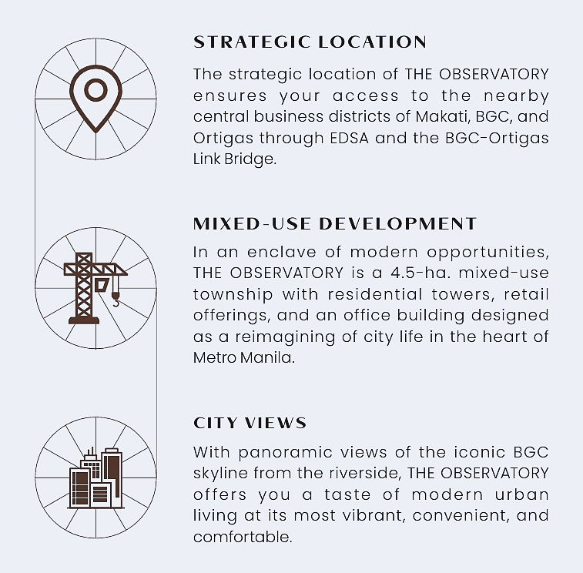

Slide 8
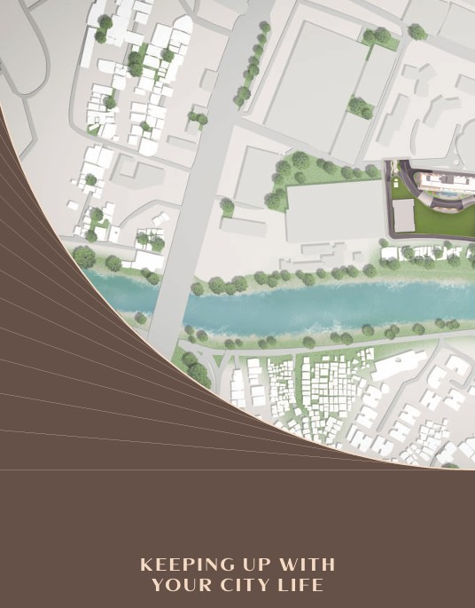
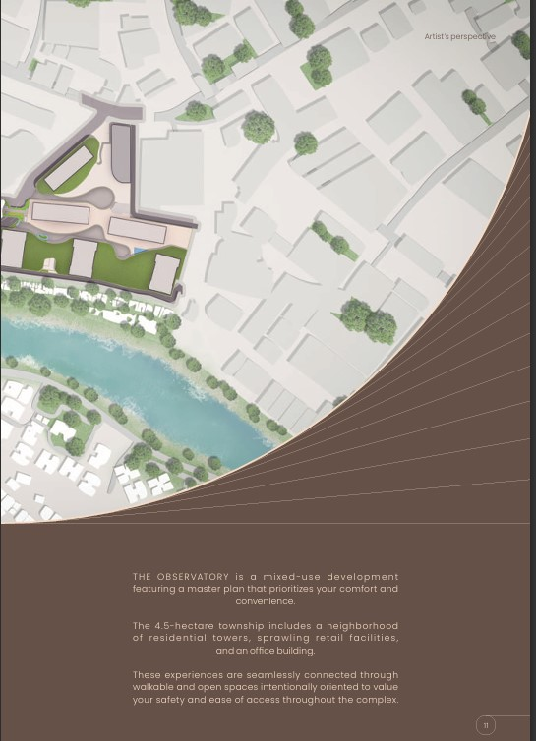
KEEPING UP WITH
YOUR CITY LIFE

Slide 9
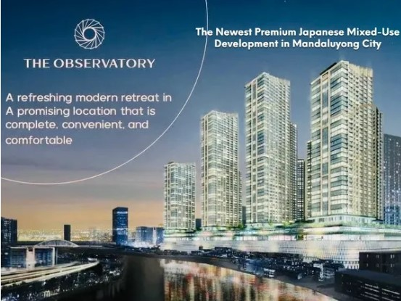
We are Now Accepting Sales for The Observatory - SORA Tower (1st Tower)
The Observatory, situated in Mandaluyong City, presents a modern retreat in a strategically advantageous locale, emphasizing convenience and comfort. With unit sizes spanning from compact studios at ±26-33 sqm to expansive penthouses at ±155-202 sqm, this development caters to diverse preferences. Historical data from Leechiu Property Consultants reveal a consistent price increase in vertical developments in Mandaluyong, highlighting the area’s investment potential. The Observatory Mandaluyong integrates modernity with an inviting retreat, promising a holistic urban living experience.

Slide 10
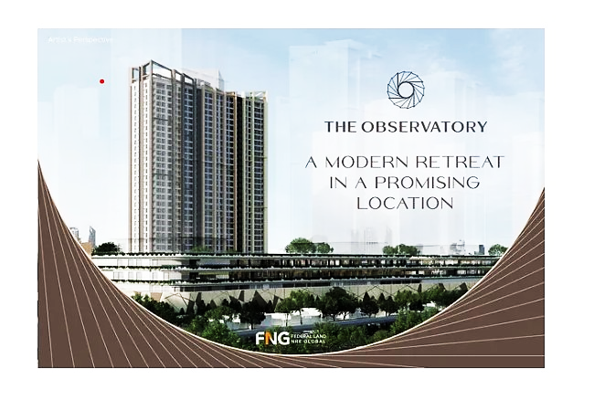
The Observatory - SORA Tower
Escape to a modern retreat in the heart of the city.
Introducing The Observatory, a mixed-use development strategically located along major CBDs in Metro Manila. It offers breathtaking views of the BGC skyline, thoughtfully curated amenities, as well as distinct Japanese features that add real value to your day-to-day life.

Slide 11

MASTERFUL DESIGN
AND COLABORATION
A symbol of an elegant community and environment health, the Philippine eagle embodies the value of the Filipino people.
Base on the National Bird of the Philippines the design concept of THE OBSERVATORY envision the development as both vantage point of the Metro Manila and thriving community in the sustainable environment.

Slide 12

PARTNERS
The Observatory is a culmination of the collaborative work of its partners, whose seasoned expertise and i nternationally-recognized excellence are behind the thoughtfulness and intentionality of the township’s design. Among these accomplished design consultants are Nikken Sekkei Ltd. for the master plan and concept design of the residential towers, Garde Co., Ltd. for the interior & landscape design of the commercial component, Magnusson Klemencic Associates for the structural engineering design, and Pimentel, Rodriguez, Simbulan & Partners as the architect of record.

Slide 13
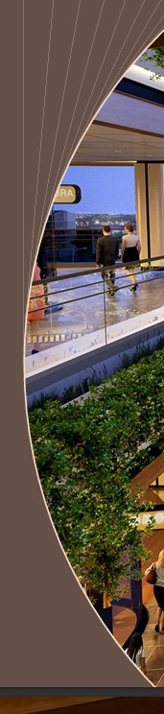
A New Hub of Vibrant Lifestyles
The Observatory
opens its doors to those from all walks of urban culture, reimagining city life for its residents, neighboring communities, and surrounding districts. As a contemporary mixed-use complex designed for convenience, THE Observatory revamps experiences with flavorful dining, fresh choices, specialty offerings, and unique shopping spaces accompanied by panoramic views of the BGC skyline

Slide 14
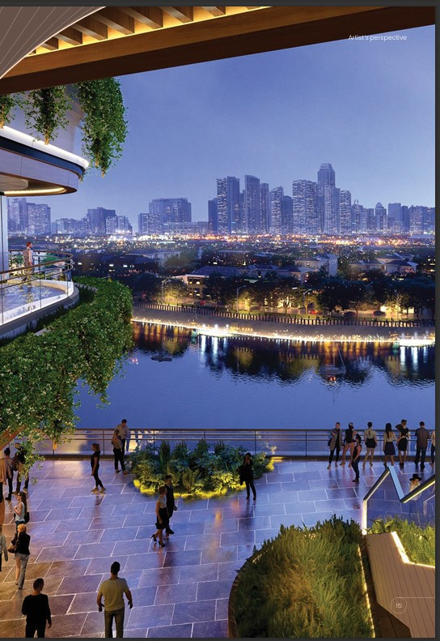
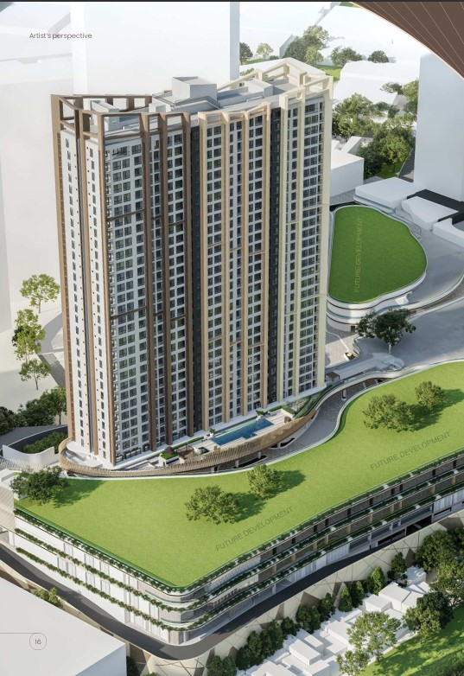
THE OBSERVATORY
SORA TOWER
The first residential tower rising at THE OBSERVATORY ushers in a new era living in the city. Its Japanese name meaning “sky”, SORA TOWER soars over the city as your next home at the seat of urban culture and fast-paced lifestyles in Metro Manila.

Slide 15

RESIDENTIAL UNITS
The wide range of units offered among the skies at THE OBSERVATORY SORA TOWER are thoughtfully designed to keep up with every stage of your city life. Each unit features ingenious solutions to your changing needs.
UNIT TYPE | UNIT COUNT | UNIT AREA
STUDIO | 336 | 28 - 33.5 Sqm
ONE BED ROOM | 228 | 45.5 - 61.5 Sqm
TWO BED ROOM | 48 | 65 - 87 Sqm
TREE BED ROOM | 32 | 137 - 148 Sqm
PENTHOUSE | 6 | 155.5 - 202 Sqm
TOTAL | 650

Slide 16

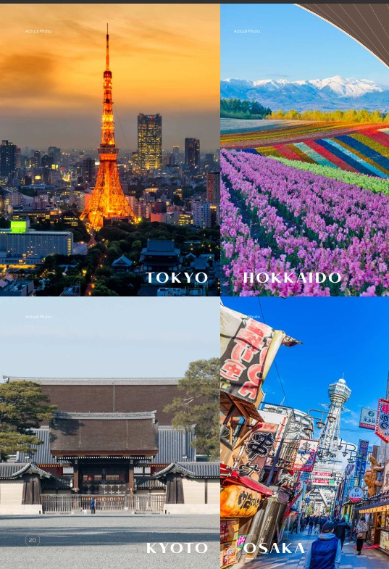
JOURNEY ACROSS JAPAN
Immerse yourself in the best of Japanese city culture at THE OBSERVATORY. The amenities of each residential tower at your next home evoke the identities of remarkable districts in Tokyo, Hokkaido, Kyoto, and Osaka

Slide 17
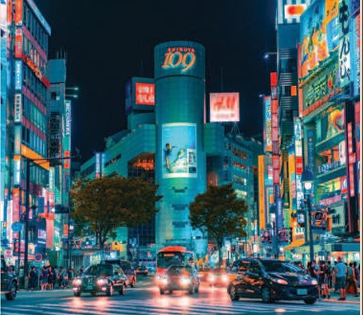
SHIBUYA
AT
SORA TOWER
Inspired by the vibrant and constantly moving SHIBUYA district in Tokyo, the amenities at SORA TOWER perfectly blend into your lifestyle at your home in the metro

Slide 18
Facilities & Services
Storage Solutions
  Genkan
  Adjustable Kitchen Cabinets
  Modular Closets
Japanese-branded Water Closet
Spalet for Master T&B
Rangehood
Separate Shower & Bathtub in Master Bedroom T&B (select units)
Multi-functional & Space-saving Sink
Elevator & Main Door Key Card Access

Slide 19
OUTDOOR
Swimming Pool and Pool Deck
Children’s Pool
Children’s Play
Area Pet Park
Lobby Garden
Outdoor Lounge
INDOOR
Sky Lobby
Children’s Playroom
Co-working / Business Center
Yoga Studio
Fitness Gym
Entertainment Room
Function Room

Slide 20
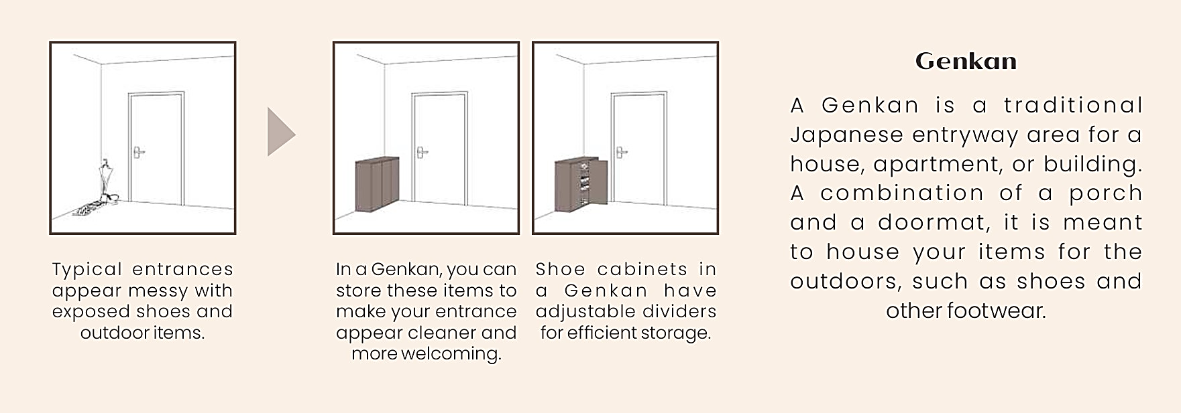
STORAGE SOLUTIONS
Innovative solutions for your storage needs are made to maximize your living areas

Slide 21
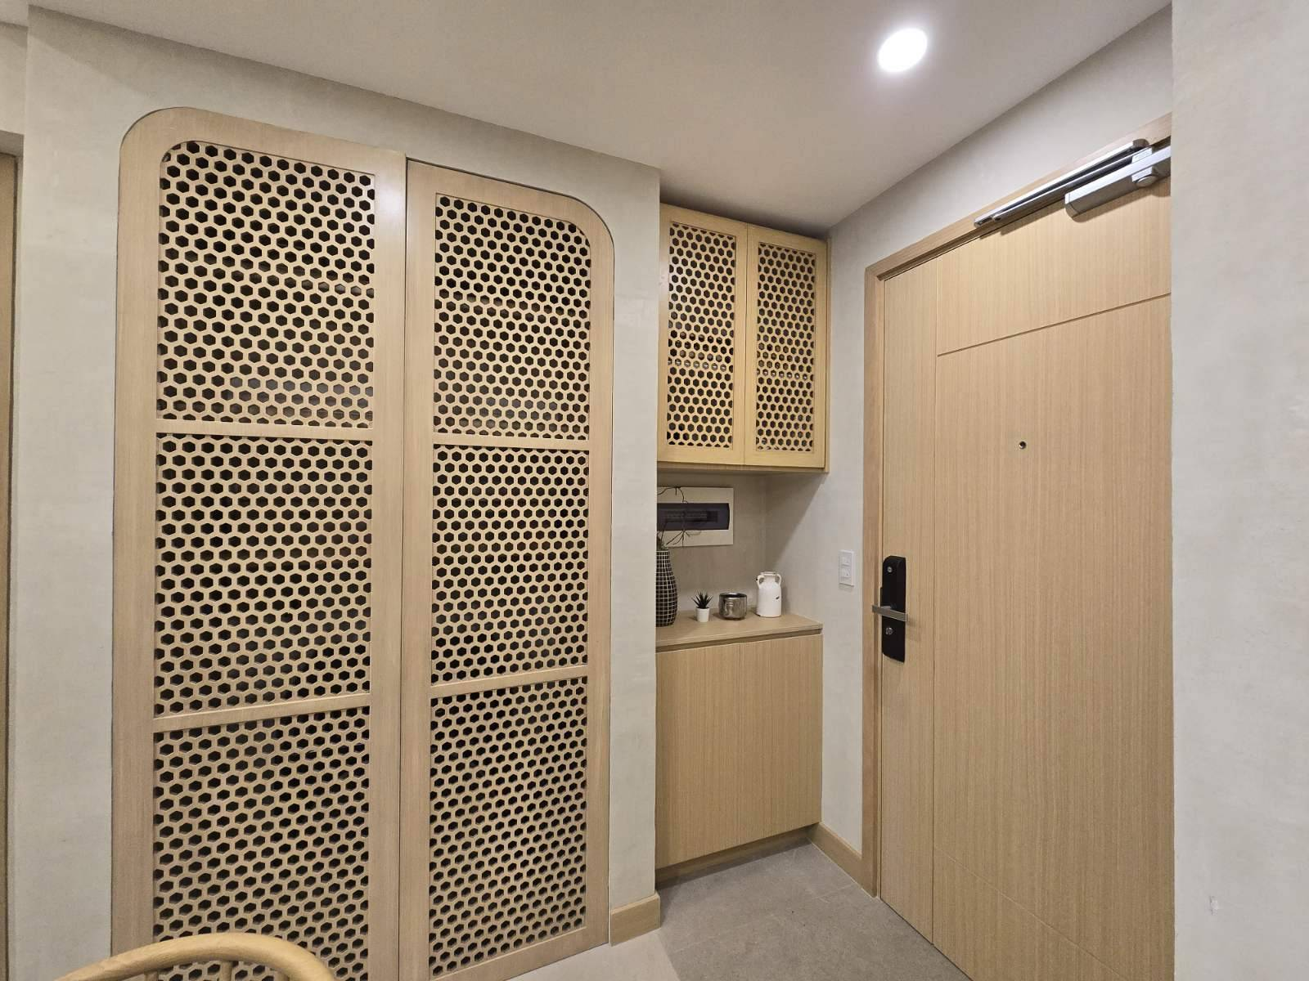
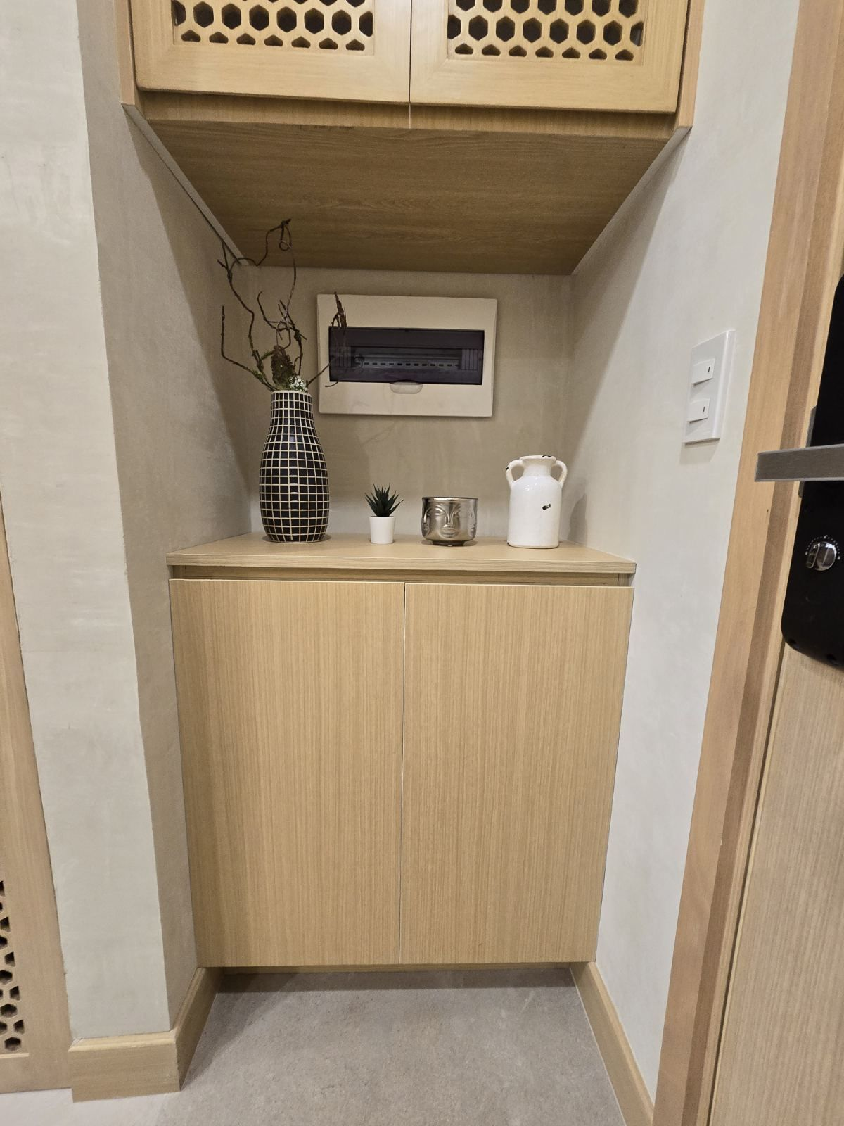
GENKAN
Front Door

Slide 22
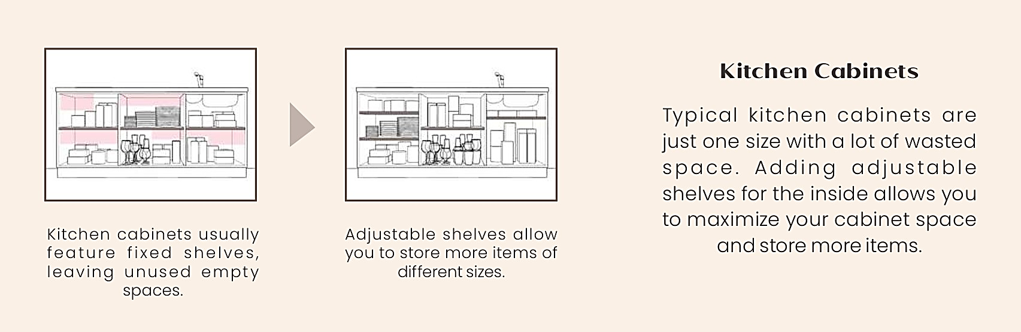

Slide 23
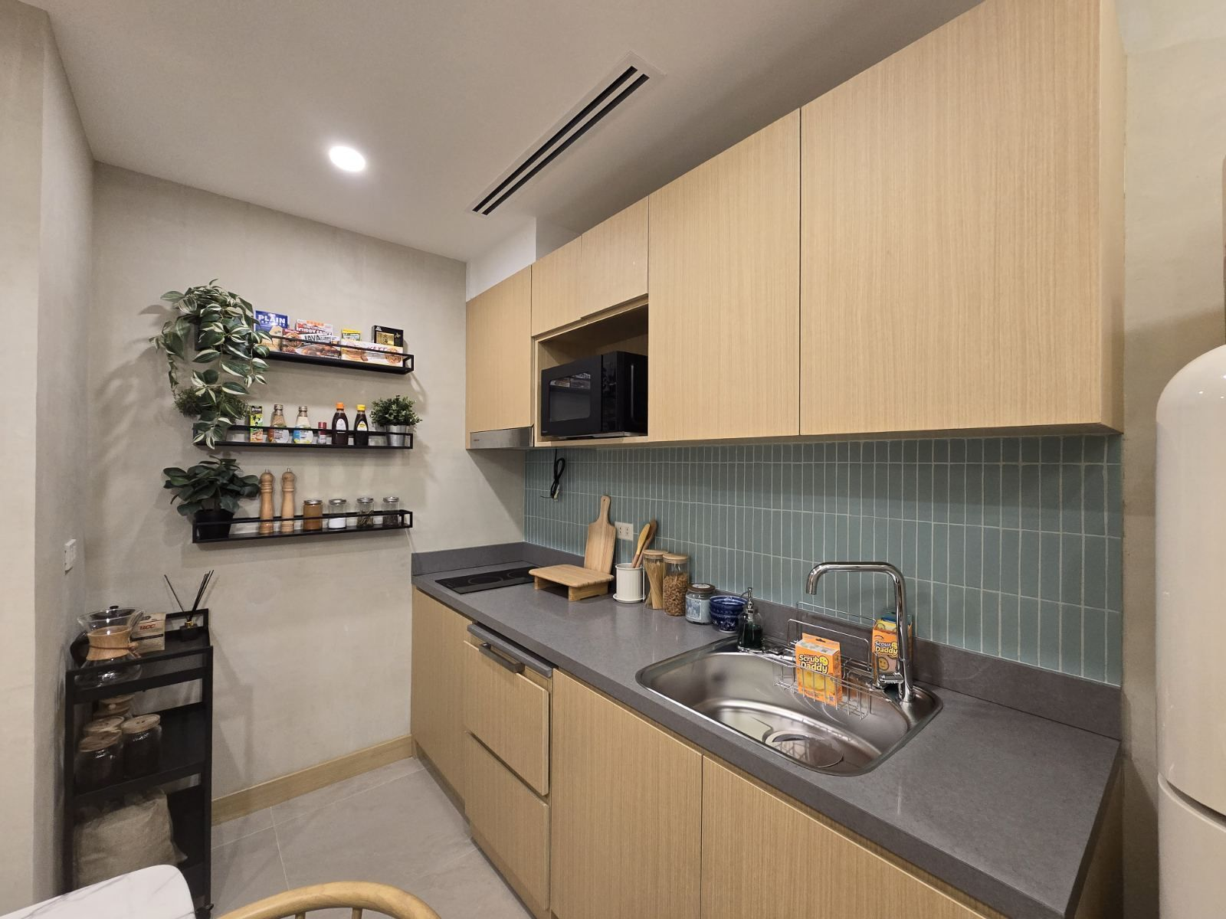
KITCHEN

Slide 24


Slide 25
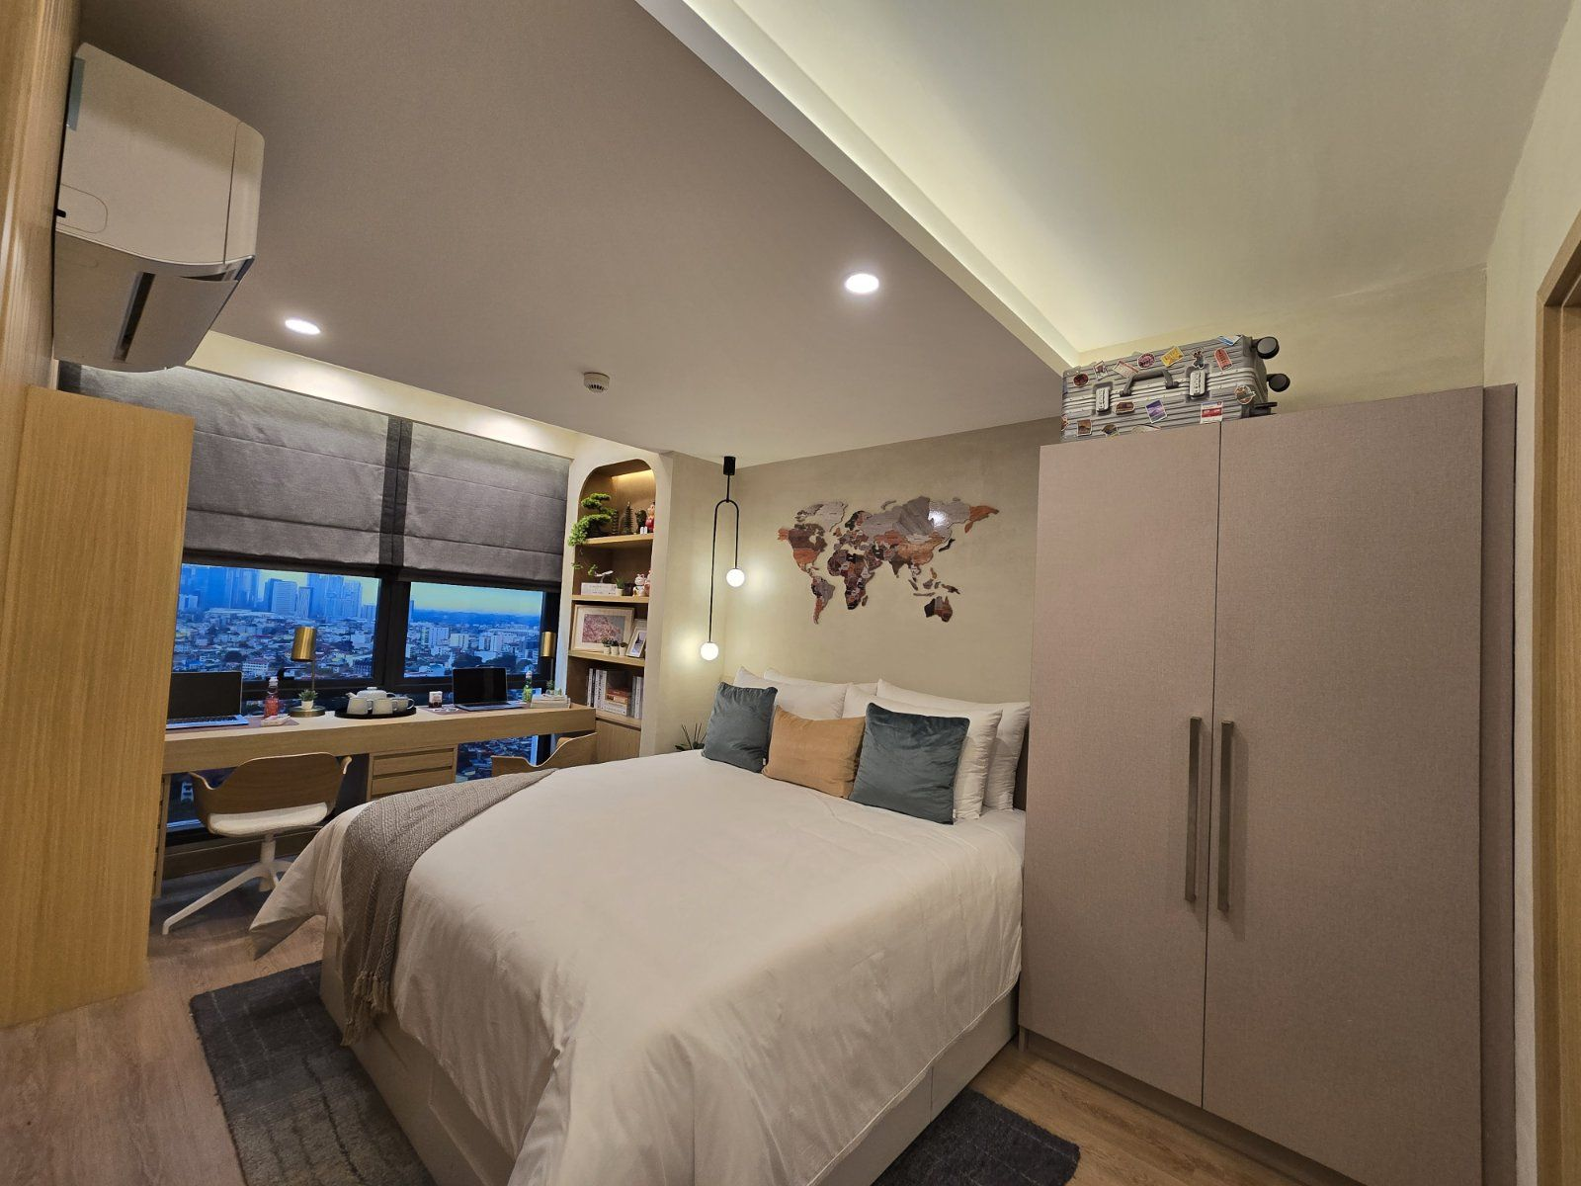
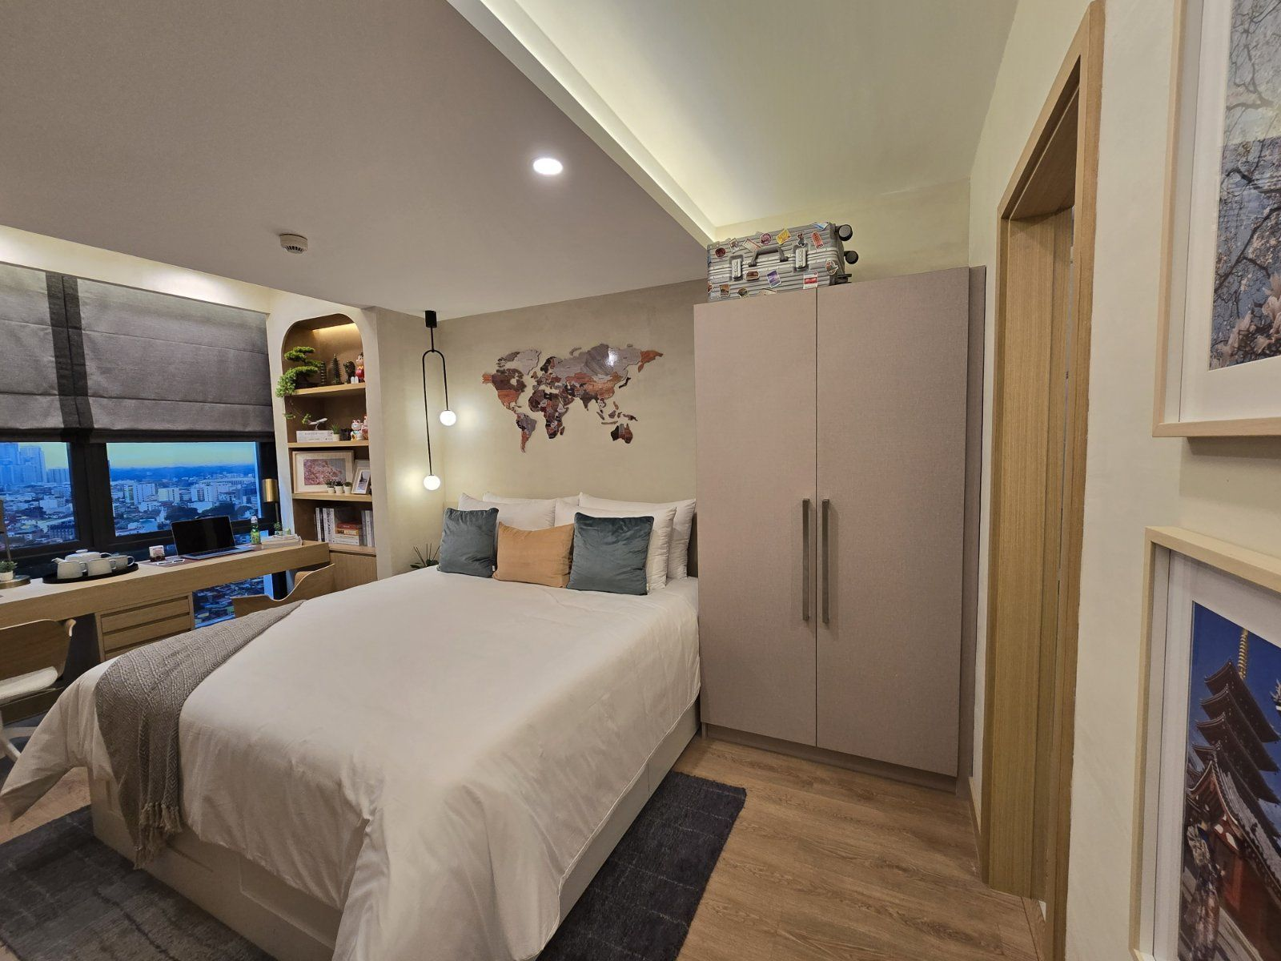
WARDROBE

Slide 26
UNIT FINISHES
ROOM | FLOOR | WALL | CEILING
Genkan | Homogenous Tiles | Painted | Painted Ceramic
Living / Dining | Homogenous Tiles | Painted | Painted Ceramic
Kitchen | Homogenous Tiles | Painted | Painted Gypsum Board
Master Bedroom | Laminated Wood | Painted | Painted Cement
Second Bedroom | Laminated Wood | Painted | Painted Cement
Master T&B | Homogenous Tiles | Painted / Homogenous Tiles | Painted Moisture - Resistant Gymsum Board
Common T&B | Homogenous Tiles | Painted / Homogenous Tiles | Painted Moisture - Resistant Gymsum Board
Utility Room | Ceramic Tiles | Painted | Painted Cement
Utility T&B | Ceramic Tiles | Painted / Ceramic Tiles | Painted Moisture - Resistant Gymsum Board
Balcony | Ceramic Tiles | Panted | Painted Cement

Slide 27

TERMS AND EXPERTS

Slide 28

TERMS AND EXPERTS

Slide 29

