Slide 1
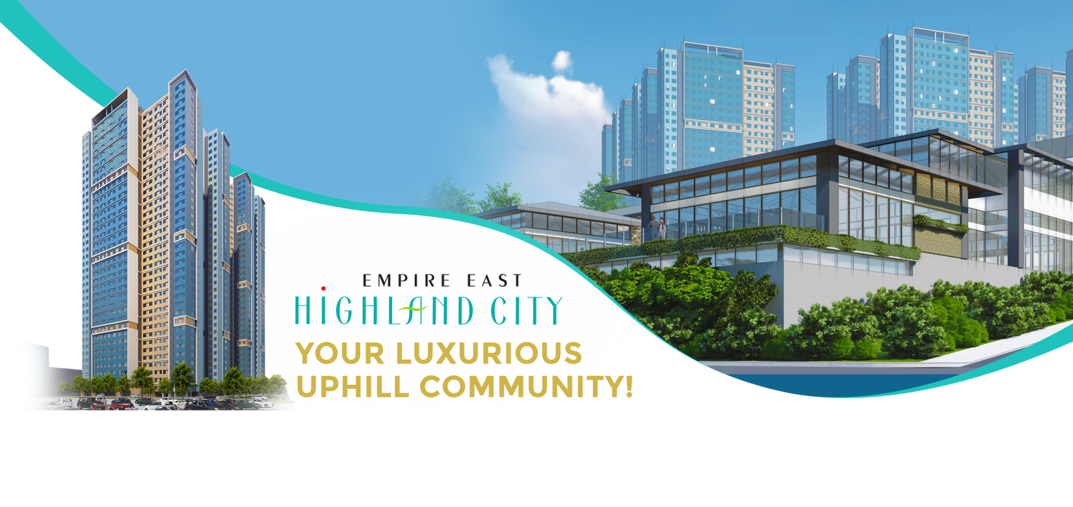
Be one of the firsts to live in the newest, highest, and grandest landmark vicinity in the east!
Empire East Highland City is a 24-hectare property located at the periphery of Pasig City and Cainta.
Envisioned to be the prominent and prestigious benchmark of the country's exciting mixed-use development - Empire East Highland City will surely be the ideal destination not only of adventure-seeking individuals but also of families and professionals who wish to reside in this vibrant setting.
HIGHLAND RESIDENCES
Admirable. Appealing. Above standards.
A total of 37 towers on-stilts, which ensures admirable elevation - ideal for enjoying breathtaking views of the natural slopes of Antipolo and the mesmerizing urban skyline of Metro Manila. Highland Residences will be impressively constructed and living here will give you that elegant and luxurious lifestyle without losing the spirit of a community! Choose among upscale and widely-spaced suites ideal for the family.
HIGHLAND PARK
A grand and spacious welcome.
An 8,000-square meter open park shall greet every resident and guest upon entering, with the perfect mix of community features such as a 500-seater church, an amphitheater, sprawling greenery, and landscapes. The Highland Park is elevated up to 6 meters from the main road, which signifies the upgraded lifestyle in this development.
HIGHLAND MALL
Sophisticated shopping experience.
Top off your community lifestyle by experiencing a unique and stylish shopping and dining experience through a 58,000-sqm luxury mall filled only with high-end retail establishments that will cater to your daily needs.
THE CHARTERED CLUB
Premium Exclusivity, Scenery, Activity and Delicacy
An even more exclusive lifestyle awaits those who wish to join the membership-only club that offers sports and recreational facilities to deliver a stylish and one-of-a kind city-living experience in an uphill community.
Upgrade your lifestyle and improve your bonding experience with family, friends, and the community. Be one step closer to being in the country’s first elevated city. Discover your home options today!

Slide 2
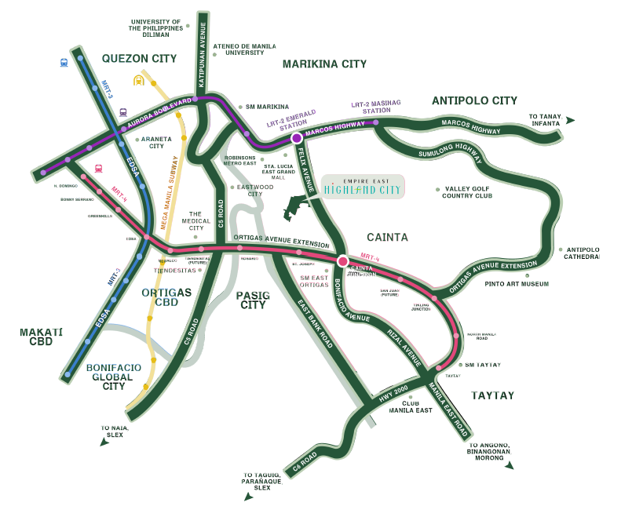
LOCATION MAP
Details are subject to change without prior notice. As of May 2020.

Slide 3
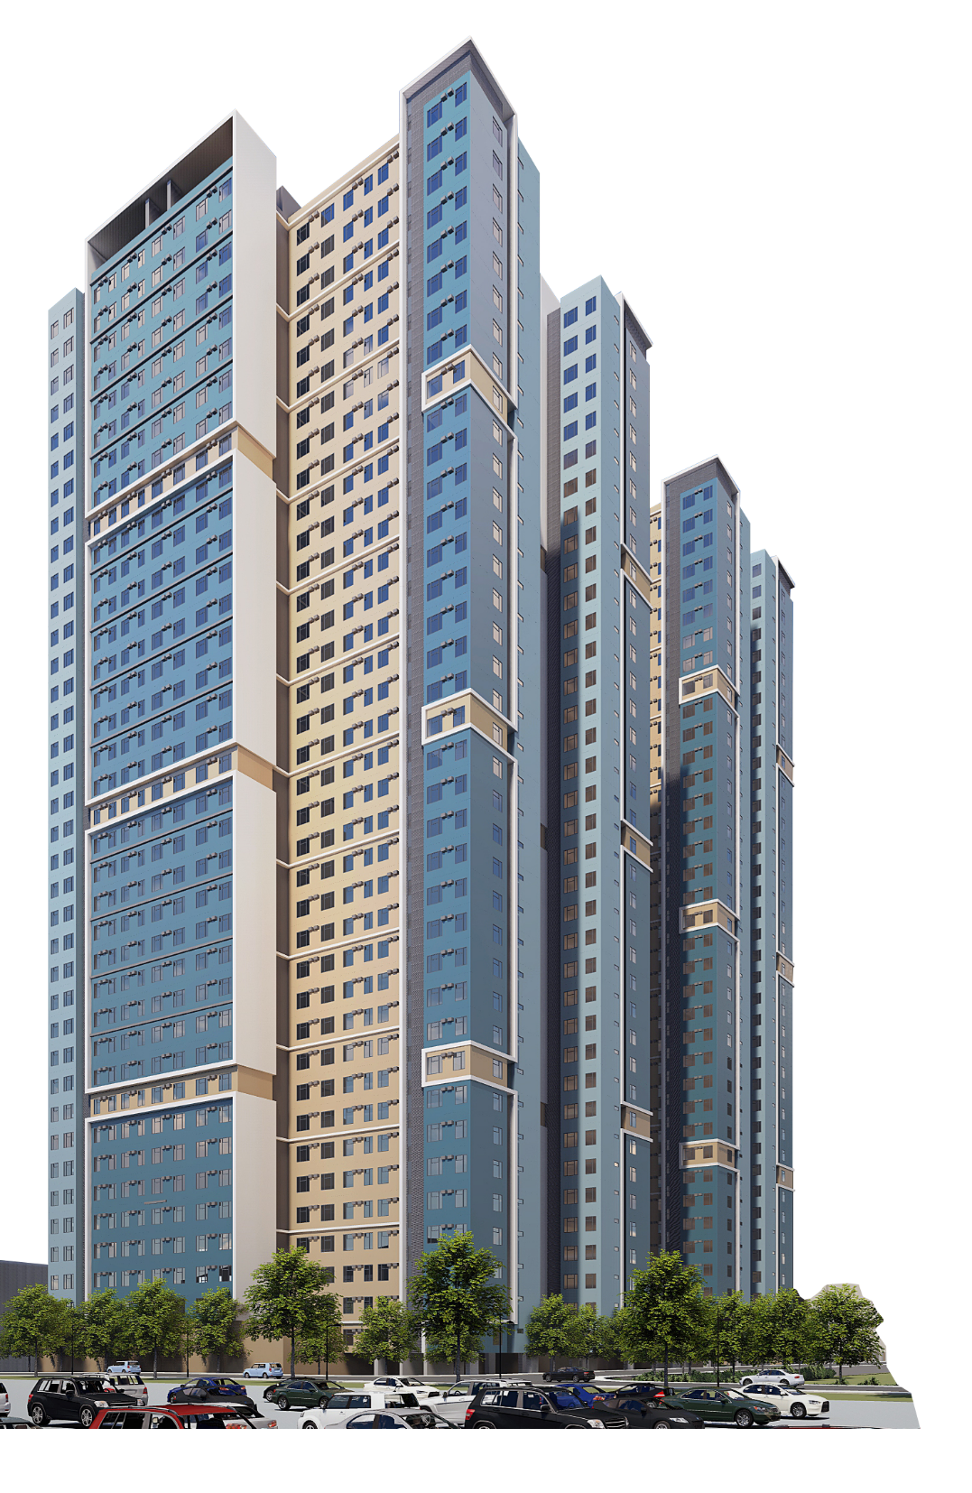
Highland Residences
A community of 37 high-rise towers carefully designed to preserve privacy, safety, and luxury, Highland Residences await and fulfill aspiring homeowners’ dreams of the high life.
Details are subject to change without prior notice. As of May 2020.

Slide 4
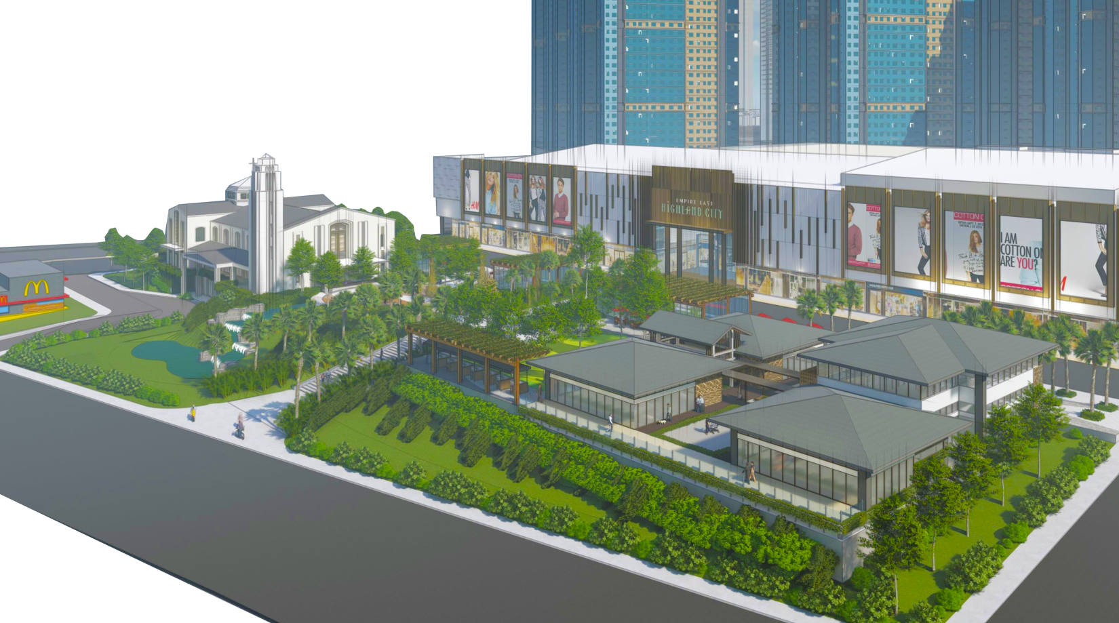
Mindful Planning
Each floor of every tower offers a defined number of units in various sizes to preserve privacy. Residents could choose from 21.38 square meters to 46.50 square meters of living spaces, ranging from studio to
2-bedroom units, whichever fits their lifestyles.
Details are subject to change without prior notice. As of May 2020.

Slide 5
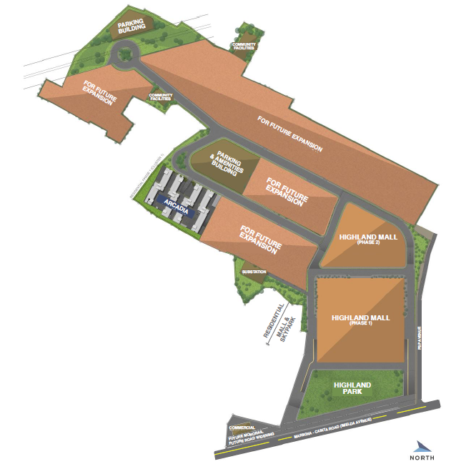
SITE DEVELOPMENT PLAN
Details are subject to change without prior notice. As of May 2020.

Slide 6
ARCADIA SITE DEVELOPMENT PLAN
Details are subject to change without prior notice. As of May 2020.

Slide 7
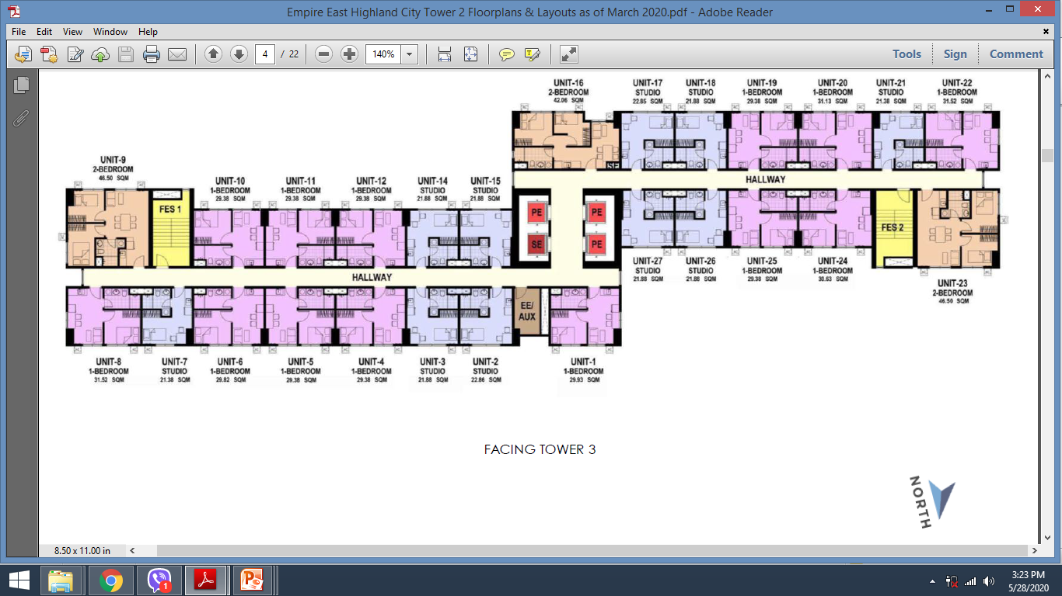
ARCADIA TOWER 2 TYPICAL FLOOR PLAN 7th to 9th Floor 11th to 20th Floor 22nd to 37th Floor
006th Floor
Unit 026
Details are subject to change without prior notice. As of May 2020.

Slide 8
ARCADIA TOWER 1 STUDIO UNIT 21.88 SQM 2nd floor: Unit 22 2nd to 37th Floor: Unit 3, 11, 16 3rd to 37th Floor: Unit 24
Details are subject to change without prior notice. As of May 2020.

Slide 9
Sample Computation
Promo until July 31, 2021 only
Details are subject to change without prior notice. As of May 2020.

Slide 10
ARCADIA TOWER 2 TYPICAL FLOOR PLAN 7th to 9th Floor 11th to 20th Floor 22nd to 37th Floor
022nd Floor
Unit 011
Details are subject to change without prior notice. As of May 2020.

Slide 11
ARCADIA TOWER 2 1-BEDROOM UNIT 29.38 SQM 2nd floor: Unit 23 2nd to 37th Floor: Unit 4, 5, 11, 12, 19 3rd to 37th Floor: Unit 25
Details are subject to change without prior notice. As of May 2020.

Slide 12
Sample Computation
Promo until July 31, 2021 only
Details are subject to change without prior notice. As of May 2020.

Slide 13
ARCADIA TOWER 2 TYPICAL FLOOR PLAN 7th to 9th Floor 11th to 20th Floor 22nd to 37th Floor
020th Floor
Unit 009
Details are subject to change without prior notice. As of May 2020.

Slide 14
ARCADIA TOWER 2 2-BEDROOM 46.50 SQM 7th to 37th Floor: Unit 9, 23

Slide 15
Sample Computation
Promo until July 31, 2021 only
Details are subject to change without prior notice. As of May 2020.

Slide 16
Unit Reservation
You may deposit the reservation payment to any of the following bank accounts:
You also have an option to pay through our Online Payment Portal through this link: https://realestate.aqwire.io/empireeast
Submit the following documentary requirements:
Signed digital copy of Request for Reservation and Offer to Purchase (RROP) and Payment Mode Confirmation (PMC). Your salesperson shall be sending digital copy through your email.
Scanned copy of two (2) valid IDs
Scanned copy of Proof of billing
Scanned copy of Signed Computation sheet

