Slide 4
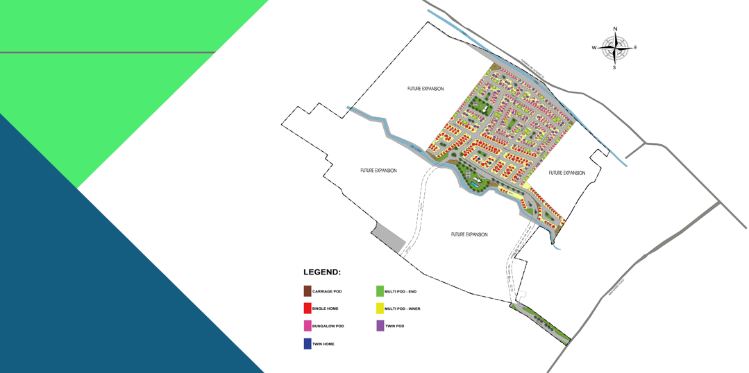

Slide 13
SAMPLE COMPUTATION
 | Twin Pod
Contract Price | 1,771,729.05
10% Downpayment | 177,172.91
Reservation Fee | (15,000.00)
Net DP | 162,172.91
Monthly DP | 9,009.61 Payable for 18 mos.
90% Bank Loan | 1,594,556.14
MONTHLY AMMORTIZATION (8.88% Interest)
5 Years | 33,007.57
10 Years | 20,095.75
15 Years | 16,059.42
20 Years | 14,223.80

