Slide 1
Overlay series photo
Your Series of
POSSIBILITIES
-Overlay Square photo -remove living beyond possibilities
-put the square nova logo

Slide 2
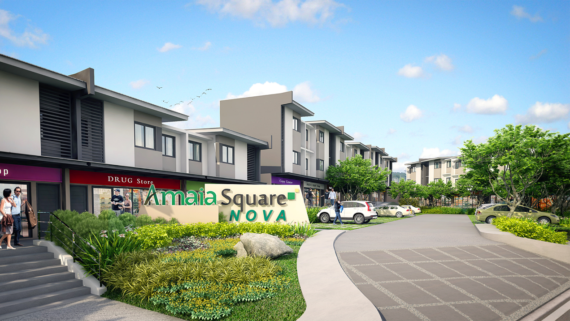
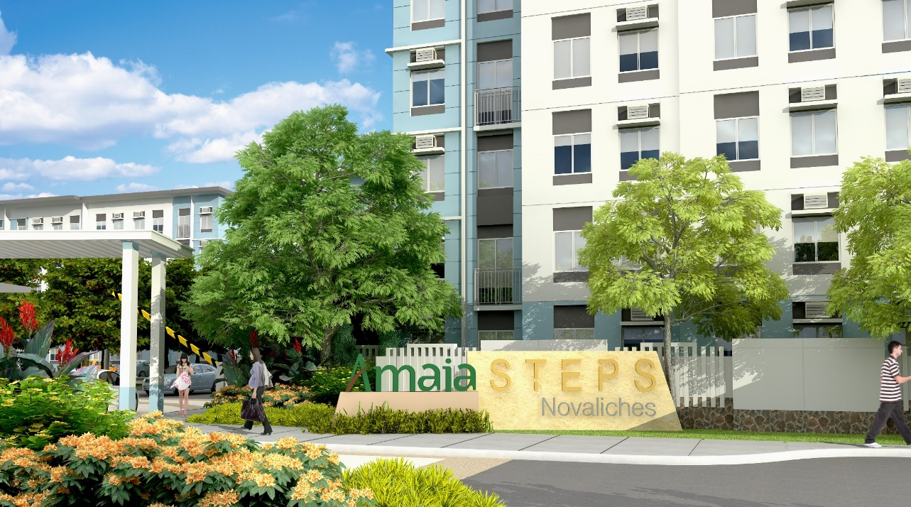
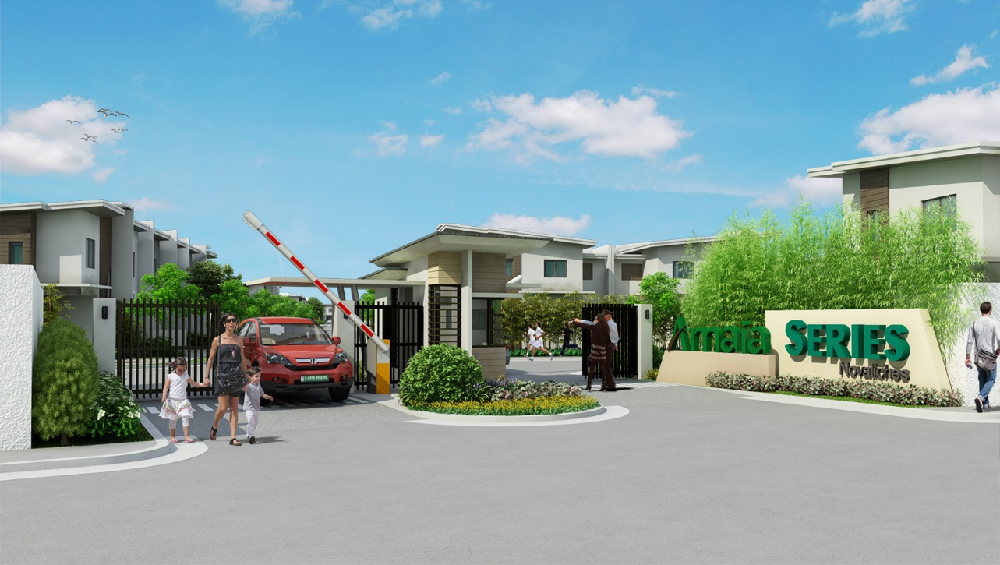
NOVALICHES ESTATE
Novaliches is the largest district in Quezon city that offers booming developments in the heart of the hustle and bustle of city life. Creating new ways of living, innovation and vigor to elevate the living standards of the future dwellers of Amaia Novaliches Estate.
WHY LIVE IN NOVALICHES, QUEZON CITY
Ease of transportation
Near growing business hubs
Premier hospitals are within reach
Your gateway to north and east destinations
Near top educational institutions
Fully developed district
Notes:
Novaliches Estate

Slide 3
THE PROJECT
Amaia Series Novaliches is a townhouse project inside the Amaia Novaliches Estate. The project offers spacious and modernly designed 4 and 6-series with its complete amenities and facilities to give you and your family a safe abode.
Notes:
Series Logo

Slide 4
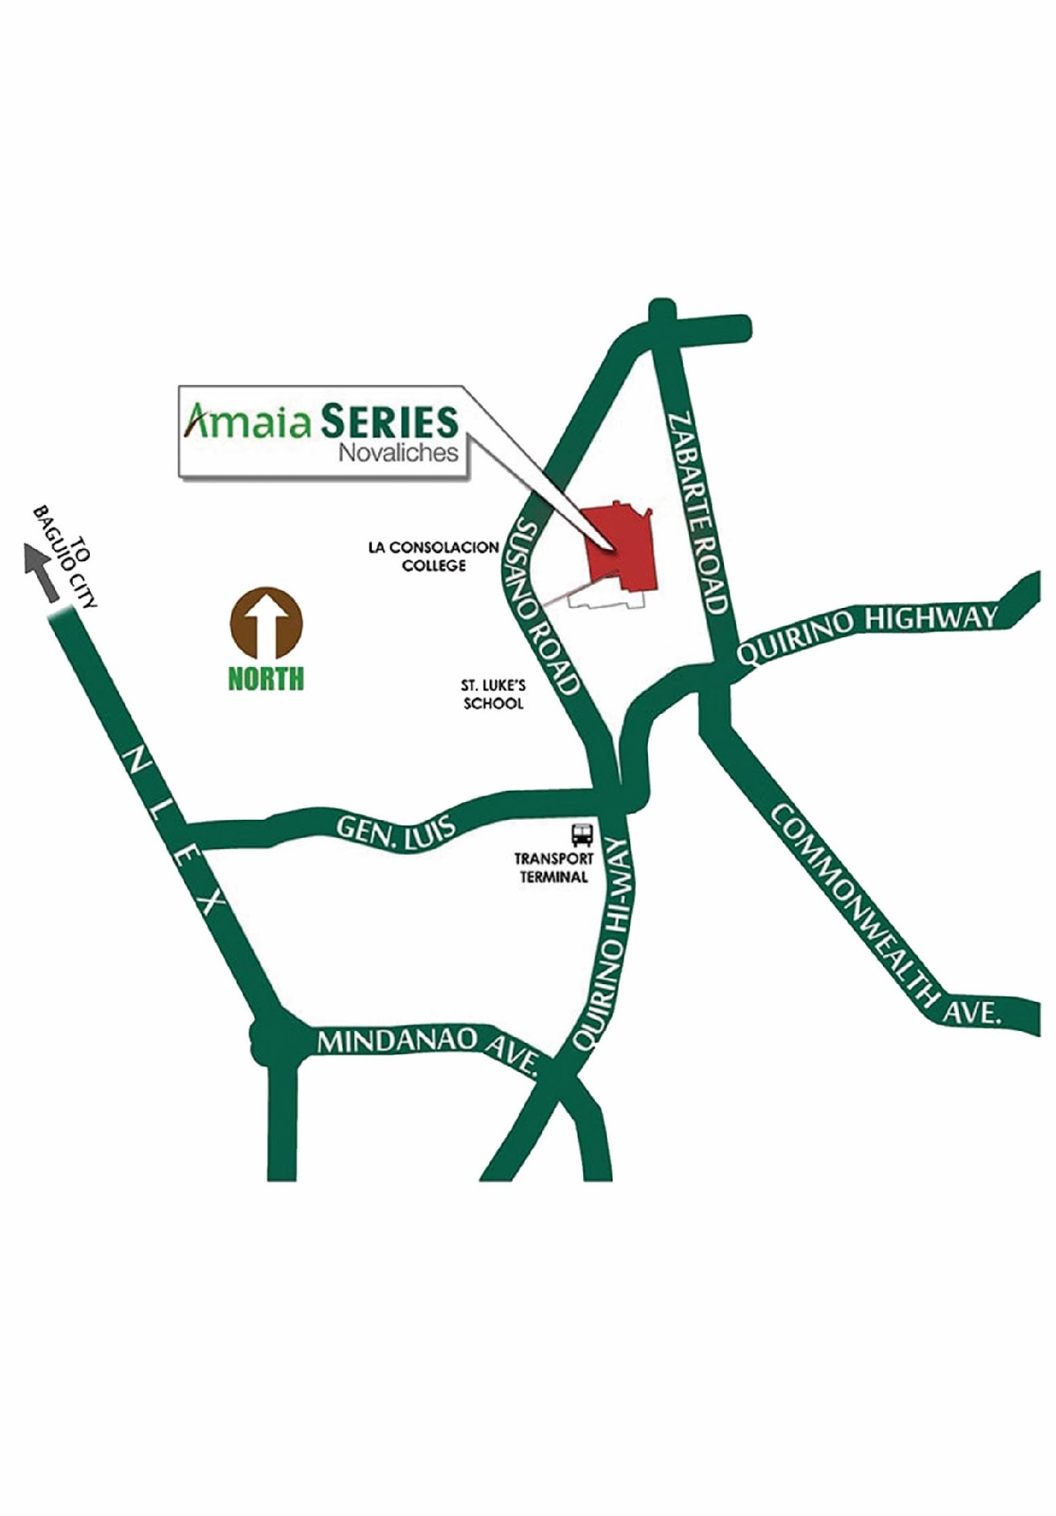
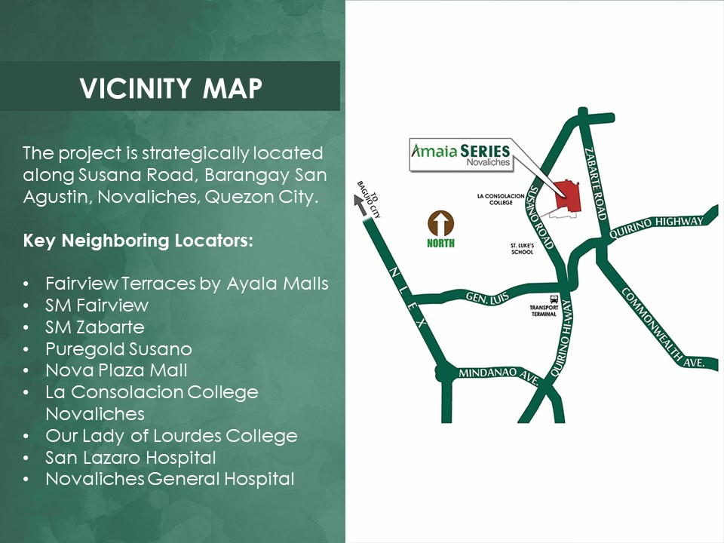
VICINITY MAP
The project is strategically located along Susana Road, Barangay San Agustin, Novaliches, Quezon City.
Key Neighboring Locators:
Fairview Terraces by Ayala Malls
SM Fairview
SM Zabarte
Puregold Susano
Nova Plaza Mall
La Consolacion College Novaliches
Our Lady of Lourdes College
San Lazaro Hospital
Novaliches General Hospital

Slide 5
THE PROJECT

Slide 6
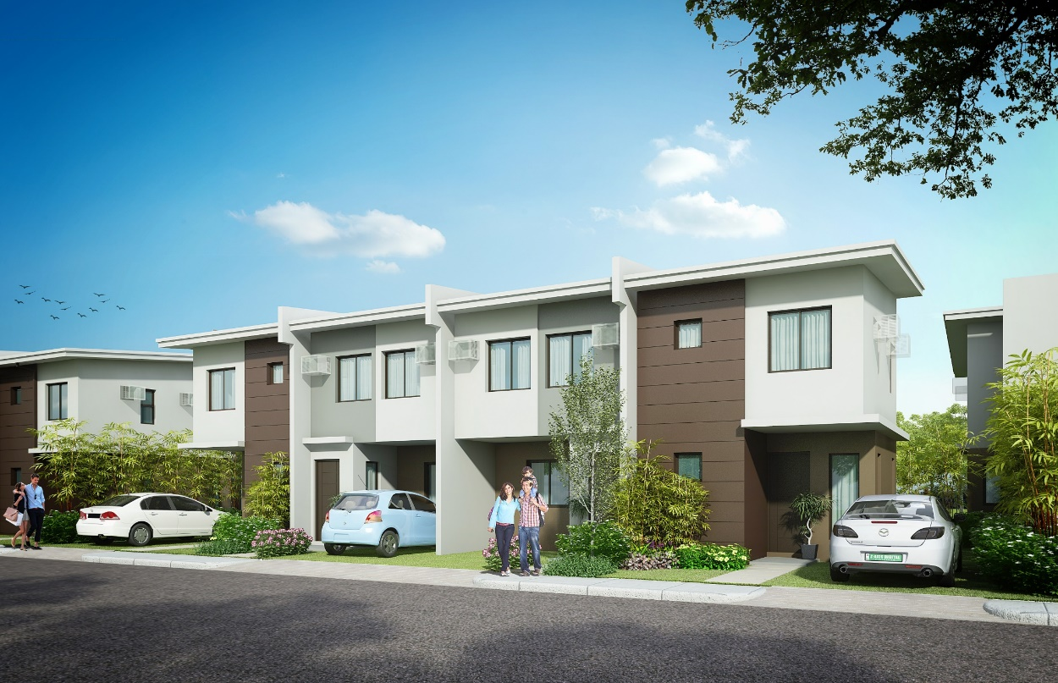
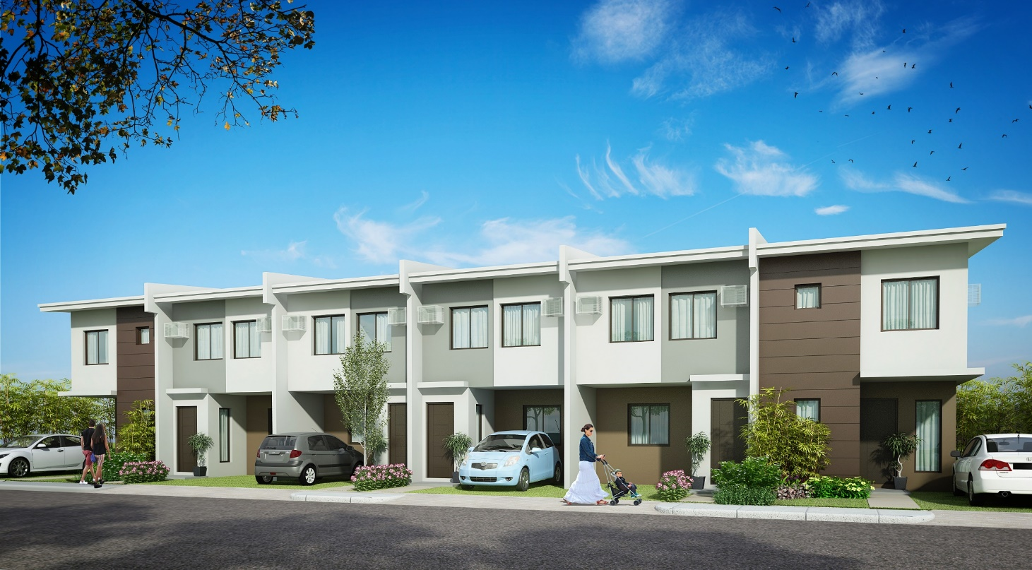
HOUSE MODEL
4-SERIES
6-SERIES
UNIT FEATURES
Dining and living area
Service area
3-Bedroom unit
1 Toilet & Bath
1 Car port
Porch
Provision for T&B at GF

Slide 7
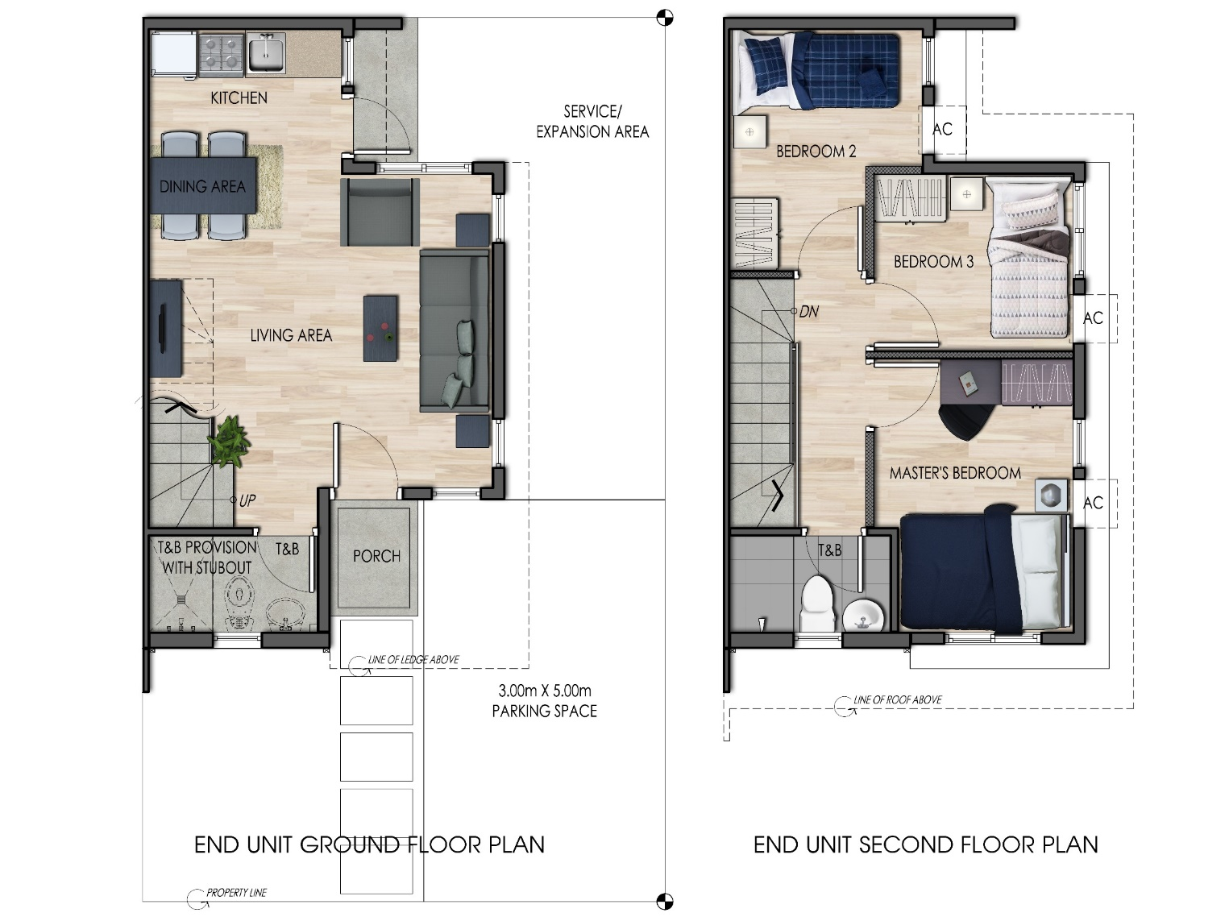
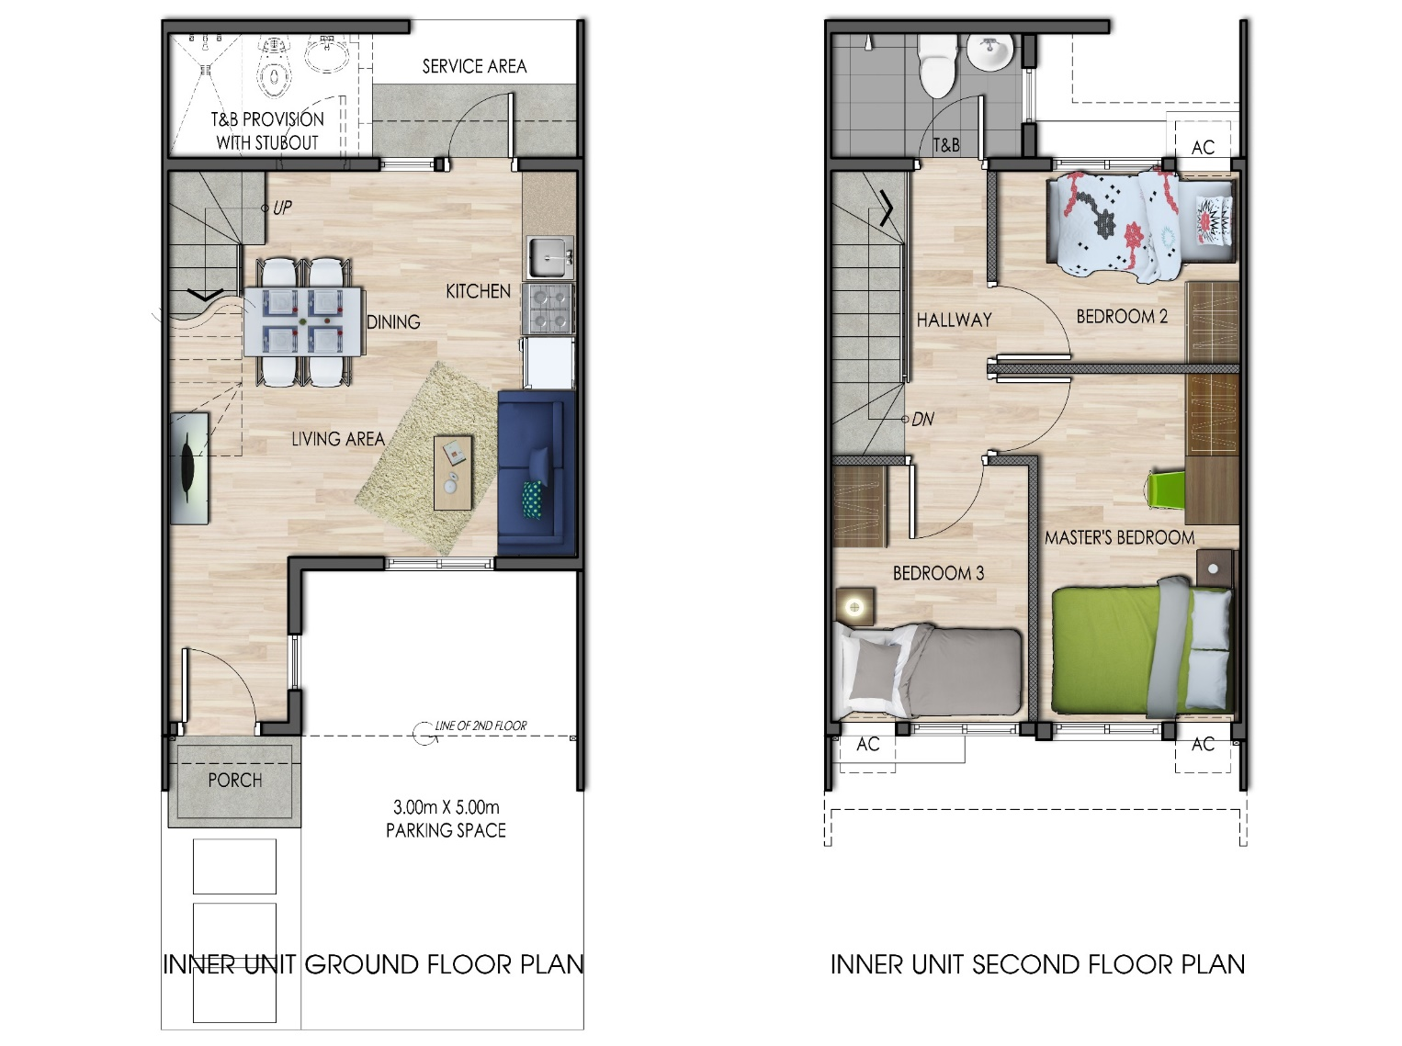
FLOOR PLANS
END UNIT
INNER UNIT
Average Lot Area: 105 sqm
Average Floor Area: 61 sqm
Average Lot Area: 51 sqm
Average Floor Area: 56 sqm

Slide 8
UNIT DELIVERABLES
Notes:
Novaliches Estate

Slide 9
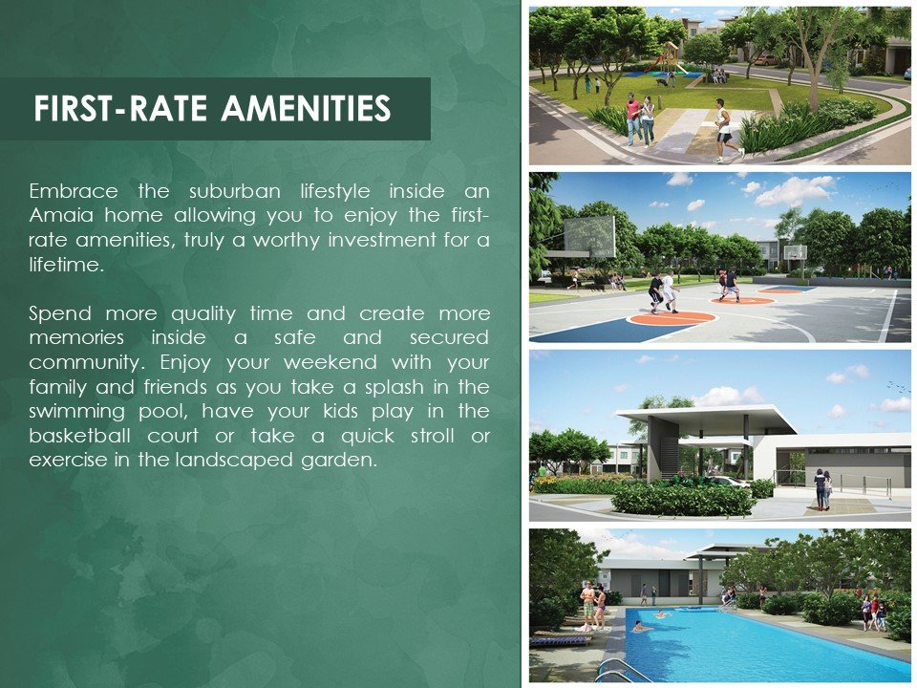
FIRST-RATE AMENITIES
Embrace the suburban lifestyle inside an Amaia home allowing you to enjoy the first-rate amenities, truly a worthy investment for a lifetime.
Spend more quality time and create more memories inside a safe and secured community. Enjoy your weekend with your family and friends as you take a splash in the swimming pool, have your kids play in the basketball court or take a quick stroll or exercise in the landscaped garden.

Slide 10
 | END UNIT
CONTRACT PRICE | P6,900,000
10% DP | P762,409
OTHER CHARGES | P724,099
RESERVATION FEE | P25,000
NET DP | P737,409
MONTHLY DP (30 Months) | P24,580
BANK LOAN
BANK AMORTIZATION
5 YEARS | P142,038
10 YEARS | P86,475
15 YEARS | P69,109
20 YEARS | P61,207
The above monthly amortization is computed based on 8.88% interest rate.

Slide 11
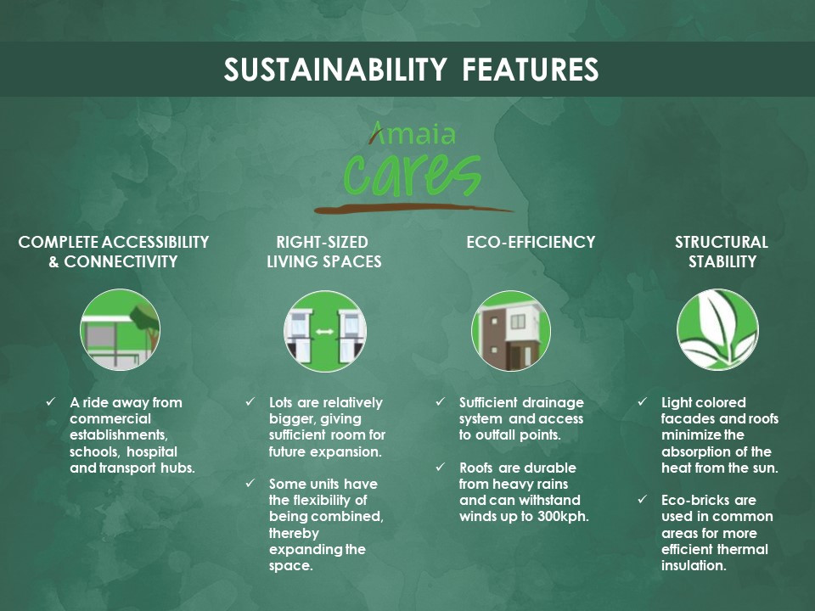
SUSTAINABILITY FEATURES
COMPLETE ACCESSIBILITY
& CONNECTIVITY
RIGHT-SIZED
LIVING SPACES
ECO-EFFICIENCY
STRUCTURAL
STABILITY
A ride away from commercial establishments, schools, hospital and transport hubs.
Lots are relatively bigger, giving sufficient room for future expansion.
Some units have the flexibility of being combined, thereby expanding the space.
Sufficient drainage system and access to outfall points.
Roofs are durable from heavy rains and can withstand winds up to 300kph.
Light colored facades and roofs minimize the absorption of the heat from the sun.
Eco-bricks are used in common areas for more efficient thermal insulation.

Slide 12
Amaia Series Novaliches
LTS 28582, 31551
HLURB AD APPROVAL AA-2016/12-1640
Project Address: Brgy. San Agustin, Novaliches, Quezon City

